Slide 1

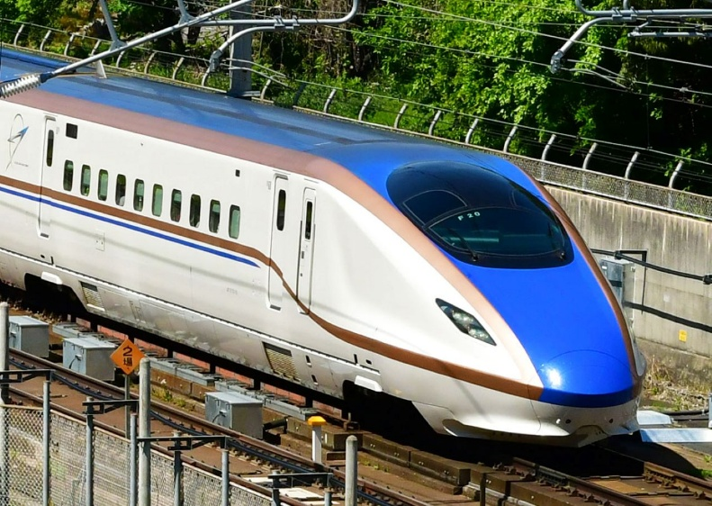
Introduction to signal processing
Honza Černocký, FIT BUT
ZRE #02

Slide 2

Organization of this morning
The basics
Spectral analysis
Digital filtering
AI remarks
Please copy and run Python notebook on Google Colab https://colab.research.google.com/drive/14YwhZOcI0QXLla3ru8KkYVlfe9ThjIwu?usp=sharing – watch and/or play with it yourself!

Slide 3
Agenda
Basics
Spectral analysis
  Discrete Fourier Transform (DFT)
  Spectrogram
Filters
  Filters with feedback - IIR
  Analyzing a filter
  Frequency response
  Factorizing the transfer function
  Stability
Signal processing and AI

Slide 4
Functions and sequences
Signals with continuous time (analog, real world) are defined for all times t.
  From math point of view, they are functions x(t) ← round brackets
Signals with discrete time (computer, digital world), sampled signals are defined only for integer times (sample numbers) n.
  From math point of view, they are sequences x[n] ← square brackets.
Converting one to another ? Take samples with sampling frequency F_{s}, (inverse of sampling period T_{s} in seconds or milliseconds)
Visualization:
  Continuous ones should be visualized with a plot (but we can’t really work with continuous ones …)
  Discrete ones with stem
  But seeing figures with lots of samples is not practical, so plot anyway …

Slide 5
Exercise – basics
Loading of a signal
Visualization and listening
Selection of a segment (frame) for detailed visualization

Slide 6

Cosine function – continuous time
Basic cosine
has
  Period 2π rad – we are measuring angles in radians.
  Magnitude 1
  Phase shift 0
#cosine_basic

Slide 7


Cosine with more interesting parameters
Setting the number of periods per second: frequency f₁ in Hertz.
The period (in seconds) then becomes
Making the cosine do f₁ periods in second: multiply its argument by
This value is called angular frequency and is measured in rad/s

Slide 8

Cosine with more interesting parameters II
Changing the magnitude - just multiply the cosine by constant C₁.
Changing the phase – add angle Φ₁ to the argument
  Positive – shift to the left - advancing the signal
  Negative – shift to the right – delaying the signal
  After adding / subtracting 2π, we obtain the same, as the periodicity of cosine is 2π.
Full cosine:
#cosine_full
Notes:
V cem je pocatecni faze ?
V cem muze byt amplitude ?

Slide 9

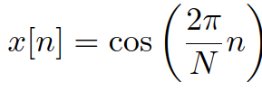
Cosine sequence – discrete time
Sequence
  Not very interesting - something like 6.28 samples per period ???
Enforcing the number of samples in one period to be N:
1/N is called normalized frequency – also denoted as f_{1.} The unit is [].
2π/N is called normalized angular frequency – also denoted as ω₁. The unit is rad.
Similarly as for the continuous one, we can change the magnitude and phase
#cosine_disc

Slide 10
Exercise: cosines and more
Generate 1 second of chamber “A” (440 Hz), at F_{s} = 16 kHz, visualize it and play it.
Add more harmonics (multiples of the fundamental frequency)

Slide 11
Agenda
Basics
Spectral analysis
  Discrete Fourier Transform (DFT)
  Spectrogram
Filters
  Filters with feedback - IIR
  Analyzing a filter
  Frequency response
  Factorizing the transfer function
  Stability
Signal processing and AI

Slide 12
Spectral analysis
}
Correlation
Determination of similarity
Projection to bases
Notation
  x[n] is the unknown signal
  a[n] is a known (generated) analysis signal
  c is the resulting coefficient quantifying correlation / similarity / strength of projection
The same !

Slide 13

Implementation of this simple equation
x[n] and a[n] are stored in row vectors.
np.sum(a * x) – straightforward implementation
np.dot(a, x.T) – dot product of 2 vectors (the 2nd one must be column)
np.matmul(a, x.T) – the same using a function for matrix multiplication
np.matmul(A, x.T)
  more bases stored in the rows of matrix A
  we’ll get whole vector of coefficients
  we’ll see this all the time !

Slide 14
Let’s try to build a detector of cosine
“Unknown” signal has N=128 samples and it is is 1 period of cosine
We’ll always show the product x[n] a[n]
Analysis signals will be
  another DC signal no similarity
  Cosine – 1 period in N samples big similarity
  Cosine – 2 periods in N samples no similarity
#1cos_analysis

Slide 15
“Unknown” signal are 2 periods of inverted cosine + some noise
Analysis signals will be
  another DC signal not showing - no similarity
  Cosine – 1 period in N samples not showing - no similarity
  Cosine – 2 periods in N samples some similarity – same as for clean one !
Wow, analysis by cosines seems to be robust !
#2cos_noise_analysis

Slide 16
Cosines seem to work !
Big positive – correlation, similarity, this frequency IS in the analyzed signal.
Big negative – anti-correlation, similar, but in the inverse sense, the frequency IS in the analyzed signal with minus sign.
Small / zero – no correlation, no similarity, the frequency is not there or just a little.

Slide 17
Disaster strikes …
How about if we just shift the cosine (or use sine instead) …
#DISASTER
Looks like phase is the problem …
What to do ?
Tune the phase shift until we find some match ?
Or better us two shifted functions for analysis !
#cos_sin_analysis

Slide 18
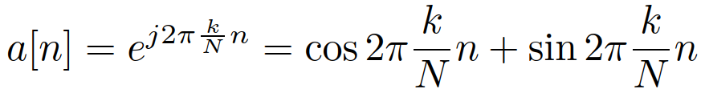
The ultimate basis for spectral analysis – a complex exponential
Complex exponential contains both cosine and sine in one function
Complex exponentials are also harmonically related: the first has normalized frequency 1/N, the next 2/N, etc …
#complex_exp

Slide 19
Exercise: cosine detected by a complex exponential
Take the same shifted cosine as in the previous exercise
Analyze it by complex exponential and of the reculsing coefficient take
  Magnitude
  Angle

Slide 20
Agenda
Basics
Spectral analysis
  Discrete Fourier Transform (DFT)
  Spectrogram
Filters
  Filters with feedback - IIR
  Analyzing a filter
  Frequency response
  Factorizing the transfer function
  Stability
Signal processing and AI

Slide 21
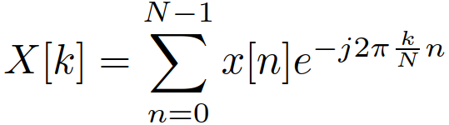
Discrete Fourier transform (DFT)
Not only for one frequency but for all frequencies
  start with k=0 (constant, D.C.), a[n] = 1
  one turn of complex exponential per N samples (k=1),
  increase the number of turns and k=2, 3, etc …
  End at k = N/2 – analysis of the fastest function – each sample changes polarity
Both k = 0 and k = N/2 are real !
We obtain coefficients X[k] that are called a spectrum
  magnitude spectrum
  Phase spectrum
  Plotting against k is nice, but even better is to convert to normal frequency !

Slide 22
Exercise: whole spectrum
Of a cosine that fits integer amount of periods in N samples
Of a cosine that does not
Of music
#whole spectrum

Slide 23
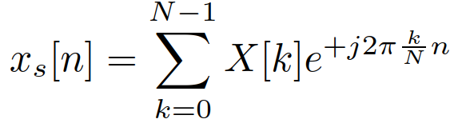
Reconstructing it back to signal
By multiplying the coefficients by the bases, we should get back the original thing – let’s try it only from k=0 till k = N/2
# synthesis - bad
… hm it is complex !
We need to work for the whole range of coefficients k = 0 till k = N-1
# DFT analysis and synthesis – good
Good, the result is only N times bigger than the original

Slide 24
Using a function and looking at the coefficients
fft to convert from signal to spectrum
ifft to to revert it back, including the 1/N correction
  The results should be real, but better use np.real() to enforce it ☺
# DFT analysis and synthesis with fft function

Slide 25
Agenda
Basics
Spectral analysis
  Discrete Fourier Transform (DFT)
  Spectrogram
Filters
  Filters with feedback - IIR
  Analyzing a filter
  Frequency response
  Factorizing the transfer function
  Stability
Signal processing and AI

Slide 26
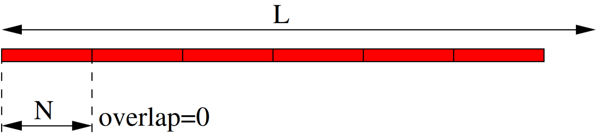
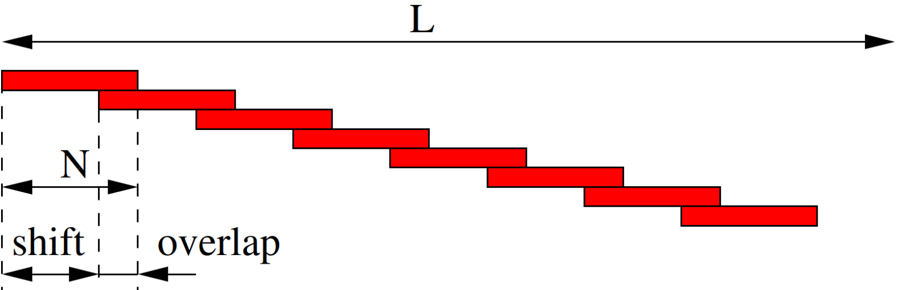
Evalution of spectrum over time
Division of a long signal into short segments – frames
Segmentation without overlap
Segmentation with overlap (more usual)

Slide 27
Windowing the frames and running DFT for all …
Window each frame by a selected window
  Rectangular – good frequency selectivity, more mess at higher frequencies.
  Hamming – worse frequency selectivity, less mess at higher frequencies.
  Hanning (or Hann) window – a sequence overlapping by N/2 sums up to 1 ! Beware of confusion ‘mm’ vs ‘nn’ …
If needed, zero-pad to reach the desired number of point N_{fft}.
As usual, select only 0… N/2, resp 0… N_{fft}/2 points.
Visualize
#spectrogram

Slide 28
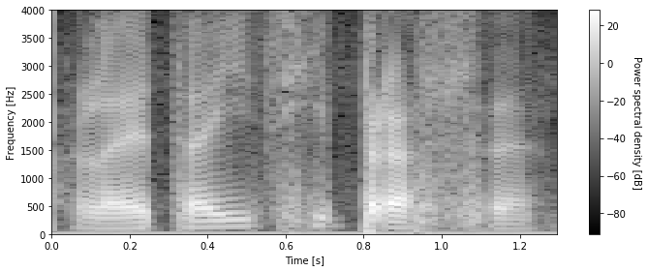
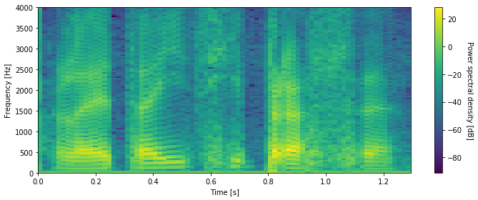
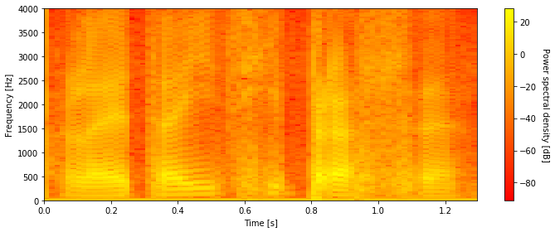
More on spectrogram visualization
We usually take the log of so called power spectral density – square of spectrum 10 log₁₀ |X[k]|² and claim it is in decibel [dB]
Selection of colormap …
Playing with brightness,
contrast, etc …

Slide 29
Synthesizing signal from spectrogram
Need to be careful with the analysis – define frames with ½ frame overlap and use Hanning (Hann) window – their sequence sums exactly to 1.
When synthesizing, initialize a buffer with the length of the resulting signal by zeros, then run a cycle:
  For each frame, take spectrum and complete the upper (from N/2+1 … N-1) by the symmetry X[k] = X*[N-k]
  Perform IDFT that generates the current frame.
  Add it to the buffer
  Move to the next frame, shift the position where signal will be added to the buffer by frame overlap.
#dft_synt

Slide 30
Playing with spectrogram – duration modification
Taking every 2nd frame from the spectrum – shortening 2x
Repeating every frame – lengthening 2x”
#playing with spectrogram
The quality of audio is not perfect – the phases would need better processing (continuity of phase across frames).

Slide 31
Agenda
Basics
Spectral analysis
  Discrete Fourier Transform (DFT)
  Spectrogram
Filters
  Filters with feedback - IIR
  Analyzing a filter
  Frequency response
  Factorizing the transfer function
  Stability
Signal processing and AI

Slide 32
Filtering
The goal is to change the signal
Some terminology …
Numerical filters
Discrete systems
Discrete-time systems etc.

Slide 33
3 simple operations needed for filtering
Multiplication with a constant *
Summation / addition +
Shift – implemented by a memory.
Special signal processors even have instructions called MACD (multiply-accumulate-delay).

Slide 34
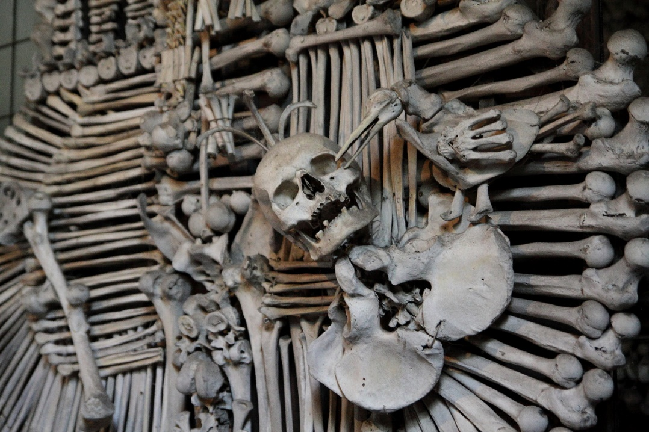
Shift ? Look only to the past !
x[n]
n
„now“, „presence“
past
future
Notes:
Definovat, že čas, kde jsme, je n.

Slide 35
A simple filter
y[n] = b₀x[n] + b₁x[n-1] + b₂x[n-2] + b₃x[n-3]
… this is called difference equation
Attention !!! This is NOT a differential equation – you may see these for continuous-time systems ☺

Slide 36
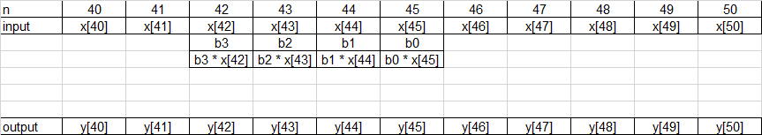
How does it work for sample n=45 ?
Σ
Notes:
CC do kreslitka, tam filtr a posouvat ho !

Slide 37
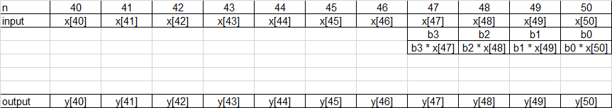
How does it work for sample n=50 ?
Σ

Slide 38
Trying our intuition – what will this filter do for:
 | b0 | b1 | b2 | b3
Filter1 | 0.25 | 0.25 | 0.25 | 0.25
Filter2 | 0.25 | -0.25 | 0.25 | -0.25
Filter3 | 1 | 0 | 0 | 0
Filter4 | 2 | 0 | 0 | 0
Filter5 | 0 | 0 | 0 | 1
Showing on a segment of noisy cosine …
#filter1 … #filter5

Slide 39
How to represent a filter ?
y[n] = b₀x[n] + b₁x[n-1] + b₂x[n-2] + b₃x[n-3]
… difference equation
scheme
z⁻¹ blocks are delays by 1 sample
(explanation to come later)
Triangles are mutliplicaitons
Big circle is summation.
x[n]
b₀
Σ
y[n]
z⁻¹
b₁
z⁻¹
b₂
z⁻¹
b₃

Slide 40
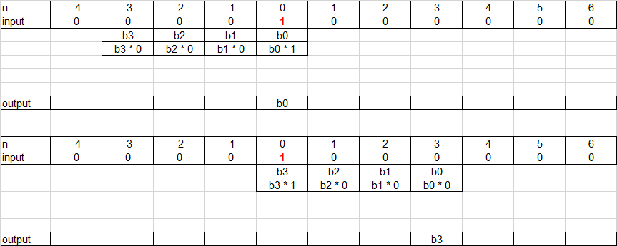
Impulse response – reaction to unit pulse
Σ
Σ

Slide 41
Impulse response
the impulse response is exactly equivalent to the coefficients:
  h[k] = b_{k} for k = 0,1,2,3
  h[k] = 0 otherwise
The length of this impulse response is 4, so it is finite – FIR – finite impulse response filter
The interaction of impulse response with a signal is called convolution
… What should we do to implement a filter with an infinite impulse reponse ?

Slide 42
Agenda
Basics
Spectral analysis
  Discrete Fourier Transform (DFT)
  Spectrogram
Filters
  Filters with feedback - IIR
  Analyzing a filter
  Frequency response
  Factorizing the transfer function
  Stability
Signal processing and AI

Slide 43
Recursive / IIR – infinite impulse response filters
Diference equation
y[n] = b₀x[n] + b₁x[n-1] + b₂x[n-2] + b₃x[n-3]
- a₁y[n-1] - a₂y[n-2] - a₃y[n-3]
Why not a₀ ?
Can’t use sample y[n] as it is being made.
Why do the feed-back coefficients have negative sign ?
Will complicate things now, but make them easier later …

Slide 44
Scheme
x[n]
b₀
Σ
y[n]
z⁻¹
b₁
-a₁
z⁻¹
z⁻¹
b₂
-a₂
z⁻¹
z⁻¹
b₃
-a₃
z⁻¹

Slide 45
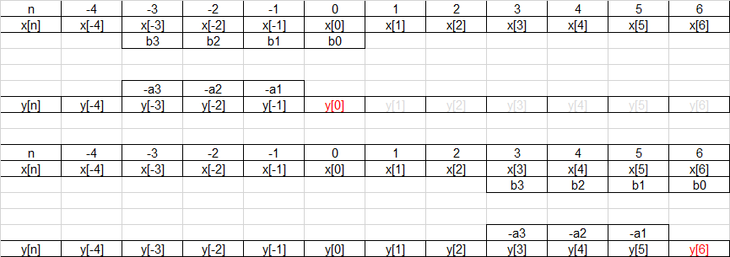
Operation – making use of filter output !
Σ
Σ

Slide 46
Infinite impulse response
For example for a simple, purely recursive filter (nothing done with the input)
#iir_response
What must be respected for a₁?
x[n]
Σ
y[n]
-a₁
z⁻¹

Slide 47
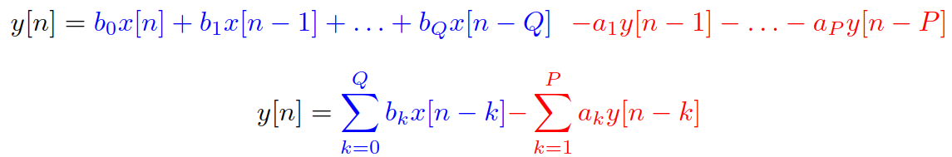
General digital filter - IIR
Scheme
Difference equation

Slide 48
Agenda
Basics
Spectral analysis
  Discrete Fourier Transform (DFT)
  Spectrogram
Filters
  Filters with feedback - IIR
  Analyzing a filter
  Frequency response
  Factorizing the transfer function
  Stability
Signal processing and AI

Slide 49
How does my filter behave ?
What is its frequency response ? Does it match what I wanted (low-pass, high-pass, band-pass, band-stop) ?
Is my filter stable ?
An beautiful mathematical tool to figure out is a z-transform

Slide 50

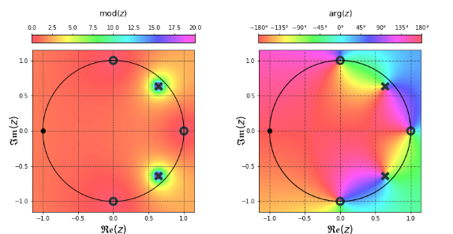

z-transform
z is a complex variable defined over the whole complex plane
z-transform maps discrete real signal to complex function over complex plane.
How to write it ?
How to imagine it ?
  As “mountains” over a surface
  Attention, these mountains are
  complex, so we need to
  visualize magnitude and phase …

Slide 51




Properties of z-transform
For signal x[n]:
When we multiply with a constant:
Linear combination of 2 (or more) signals:
Delay of the signal:
The most important will be delay of 1 sample:
That’s why we mark the delay boxes in the scheme z ⁻¹
z⁻¹

Slide 52

Letting z-transform process the difference equation
Remember the three “z-rules”:
  See a signal ? Rewrite it as its z-transform.
  See a constant ? Copy-paste
  Is the signal delayed by k samples ? Mutliply its z-transform by z ^{-k}
Our goal is to re-arrange it to obtain fraction

Slide 53

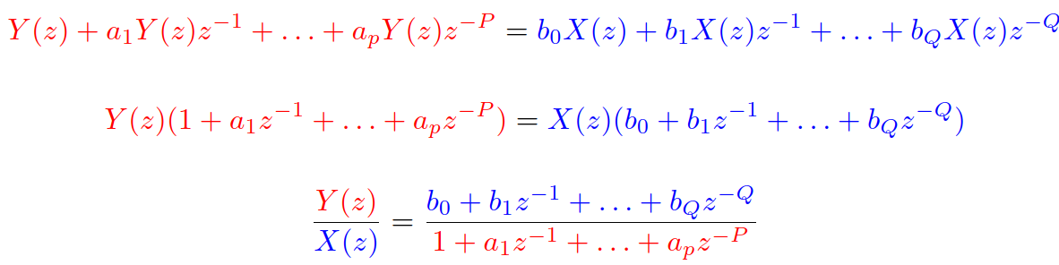
Transfer function H(z)
z-representation of the output over z-representation
of the input
Output / input is a very common way to express system’s behavior
  Amplification / attenuation = output voltage / input voltage
  Currency exchange rate = target currency amount / source currency amount
  Return of investment = how much I gained / how much I invested, etc.
For our
filter:

Slide 54
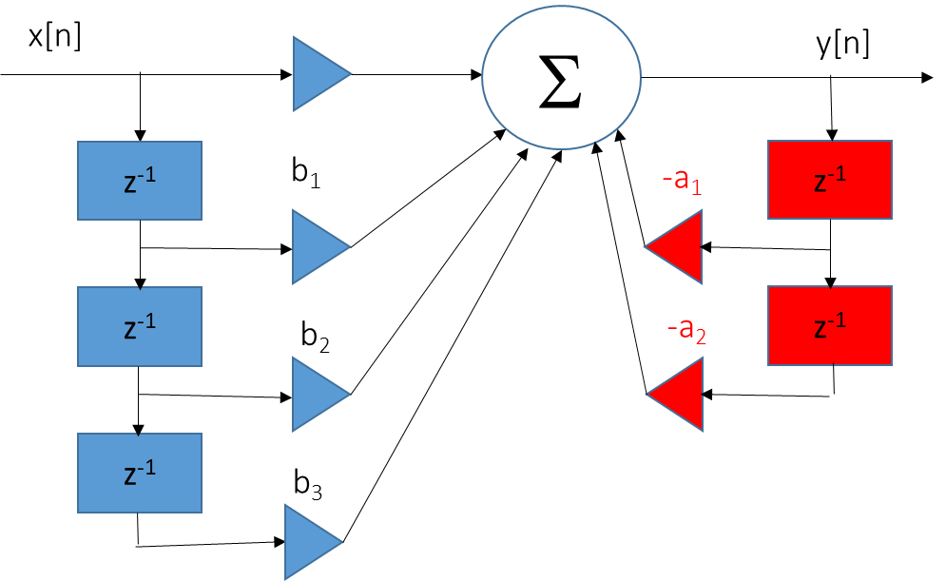
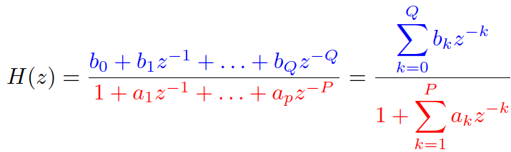
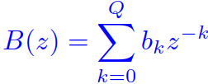
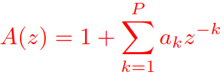
Transfer function II
Two polynomials
  Numerator, fully determined by coefficients
  multiplying the inputs of filter
  Denominator, fully determined by coefficients
  multiplying the outputs of filter
  We define a₀ = 1

Slide 55
Agenda
A bit motivation
Basics
Spectral analysis
  Discrete Fourier Transform (DFT)
  Spectrogram
Filters
  Filters with feedback - IIR
  Analyzing a filter
  Frequency response
  Factorizing the transfer function
  Stability
Signal processing and AI

Slide 56




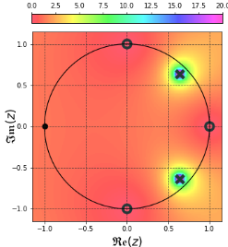
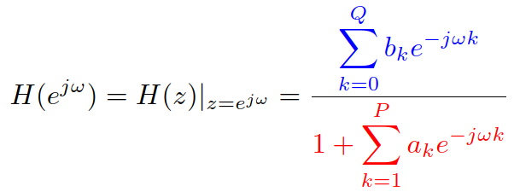
From transfer function to frequency response
We have H(z) but we want H(e^{jω})
Fortunately, there is this relation of z-transform and DTFT …
So that we can replace
this means taking the machine saw and cutting
around the unit circle.
Mathematically:
Numerator and denominator are actually the DFTs
of coefficients ! Fortunately, we have scipy.signal.freqz

Slide 57
How to visualize the frequency response ?
Run only from ω = 0 rad (corresponds to 0 Hz) till ω = π rad (corresponds to F_{s} / 2 Hz).
Select a reasonable number of points (256 is good)
It is a complex function of frequency, so visualize
  Magnitude: often in deciBells as
  Phase.
scipy.signal.freqz(B,A): B is vector of numerator coefficients, A vector of denominator coefficients (including a₀ = 1).
In case we need frequencies in Hz, just divide ω by 2π and denormalize by multiplying by F_{s}
#a filter and some music
#freqz
# magnitude - frequency axis in Hz

Slide 58
Agenda
Basics
Spectral analysis
  Discrete Fourier Transform (DFT)
  Spectrogram
Filters
  Filters with feedback - IIR
  Analyzing a filter
  Frequency response
  Factorizing the transfer function
  Stability
Signal processing and AI

Slide 59

Factorizing B(z) and A(z)
Let’s massage the fraction to have polynomials with positive powers of z:
We can now factorize the blue and red polynomials.
In case we find roots of a polynomial,
we can write it in a factorized form:

Slide 60
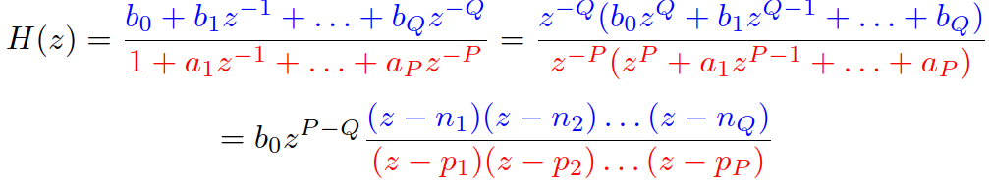
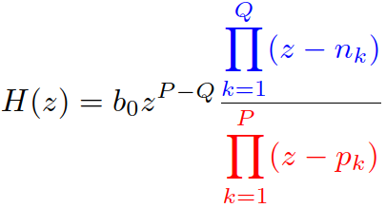
Factorizing the transfer function
Or, in fancy mathematical writing with Π denoting product:
Let’s take an example of our filter #roots_our_filter
b₀ = 1, b₁ = -1, b₂ = 1, b₃ = -1 → roots n₁ = j, n₂ = -j, n₃ = 1
a₀ = 1, a₁ = -1.2723, a₂ = 0.81 → roots p₁ = 0.9e^{jπ/4}, p₂ = 0.9e^{-jπ/4}

Slide 61

Understanding numerator and denominator roots
Let’s look at the behavior of complex function H(z) at the roots.
In case z falls into a root of the numerator,
z = n_{1,} z = n_{2,} etc., the whole function H(z) will be zero. The roots are therefore called zero points or simply zeros and marked O.
In case z falls into a root of the denominator
z = p_{1,} z = p_{2,} etc., the whole function H(z)
will be infinity. The roots are therefore called poles and marked X.

Slide 62
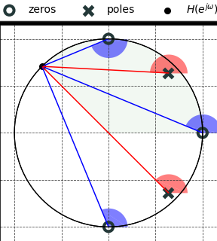

From zeros and poles to frequency response
With the factorization, frequency response
can be written as
We can imagine
  e^{jω} as a point on the unit circle. Its position
  corresponds to the frequency.
  Each blue bracket as a vector starting in a zero
  point and going to e^{jω}
  Each red bracket as a vector starting in a pole and
  going to e^{jω}

Slide 63


From zeros and poles to frequency response II
Each bracket is just a complex number, so the whole things is just a multiplication and division of complex numbers. Remember:
For multiplication, we multiply magnitudes and add phases
For division, we divide magnitudes and subtract phases
So
  When computing the magnitude of frequency response, take into account only the magnitudes (lengths of blue and red vectors)
  When computing the phase of the frequency response, take into account only the phases (angles of blue and red vectors) .

Slide 64

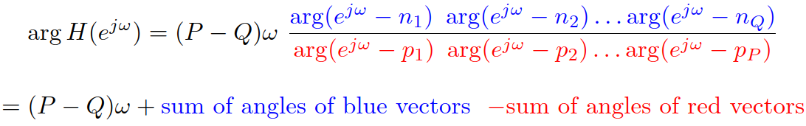
From zeros and poles to frequency response III
Magnitude (need to take into account b₀ if it is not 1):
Phase (need to take into account if P and Q are not the same):

Slide 65


Exercise on our filter for 4 typical frequencies
Only magnitudes, but take a time and play also with phases !
#zeros_poles_to_freq_response
ω = 0
ω = π / 4
ω = π / 2
ω = π

Slide 66
Agenda
Basics
Spectral analysis
  Discrete Fourier Transform (DFT)
  Spectrogram
Filters
  Filters with feedback - IIR
  Analyzing a filter
  Frequency response
  Factorizing the transfer function
  Stability
Signal processing and AI

Slide 67

Stability of IIR filters
We don’t care about B(z) – always stable !
We can determine stability only for the simplest filter
  |a₁| < 1
But with the factorization
we can imagine the filter as a sequence of filters with just one coefficient – the poles are the coefficients ! Therefore, the condition is
x[n]
Σ
y[n]
-a₁
z⁻¹

Slide 68
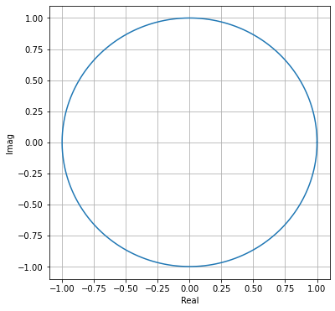
Stability of IIR filters II
BAD
BAD
All poles must be inside the unit circle
Beware when implementing IIR filters
with less precision (signal processors, FPGA)
  Even if your filter is stable with coefficients
  expressed as floats / doubles
  It can become unstable once they are quantized
  to less bits !
OK
BAD
BAD

Slide 69
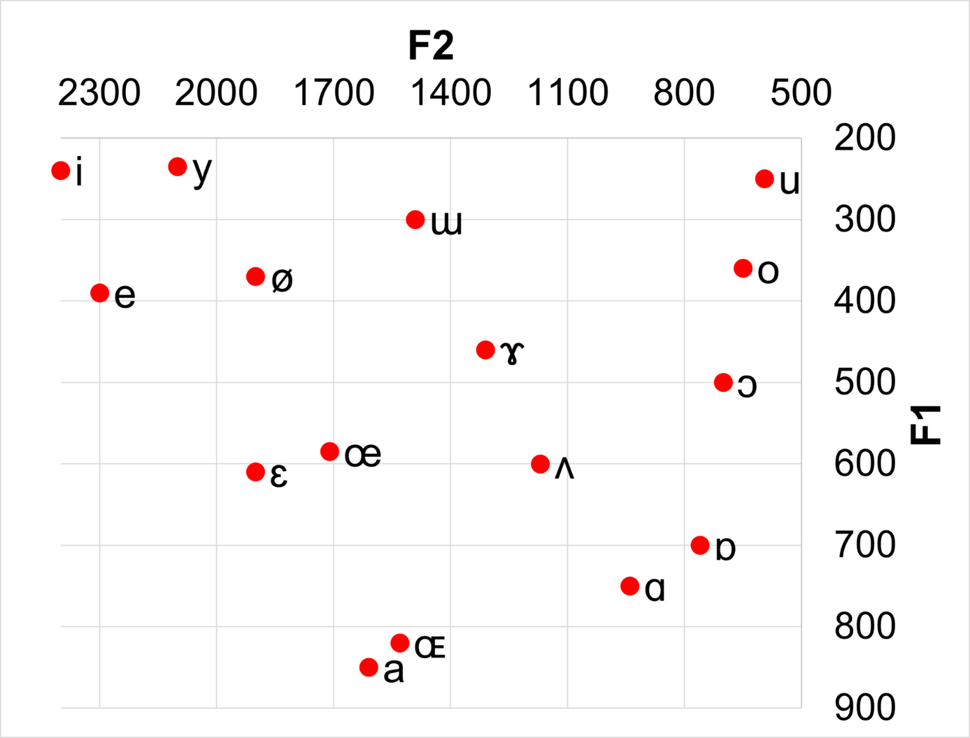
Final exercise: filters to generate wovels
Vocal tract has two important resonances and these can be found in a table
Let’s creta a set of filters
to generate
the basic vowels
#filters_vowels

Slide 70
Agenda
Basics
Spectral analysis
  Discrete Fourier Transform (DFT)
  Spectrogram
Filters
  Filters with feedback - IIR
  Analyzing a filter
  Frequency response
  Factorizing the transfer function
  Stability
Signal processing and AI

Slide 71
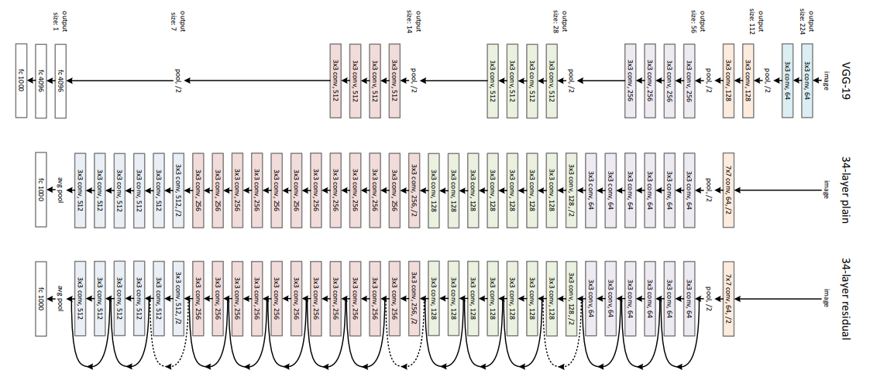
Where does one meet signal processing when working with AI models ?
Signal pre-processing
Feature extraction –
Mel-Frequency filter-bank
outputs, etc
Convolutional layers of DNNs
Sinusoidal Positional Encoding (the guys forgot their signal processing class, could’ve done it with DFT ☺
Exlainability and interpretability – what parts of spectrum are active for strong output responses ?

Slide 72

Converting words to signals was a good career-starter ☺
MIKOLOV Tomáš, KARAFIÁT Martin, BURGET Lukáš, ČERNOCKÝ Jan a KHUDANPUR Sanjeev. Recurrent neural network based language model. In: Proceedings of the 11th Annual Conference of the International Speech Communication Association (INTERSPEECH 2010). Makuhari, Chiba: International Speech Communication Association, 2010, s. 1045-1048. ISBN 978-1-61782-123-3. ISSN 1990-9772.

