Slide 1

Two revolutions in the life of a not so old speech recognition researcher
Honza Černocký
Intro of ZRE 2025/26

Slide 2
Agenda
What led me to speech research
Early days
First revolution
Second revolution
What can we do - research manager's perspective
Build on the large models
Adapt them for tasks they were not trained for
Make them multichannel and smaller
Deal with multimodality and evaluations
BUT Speech@FIT a jak se zapojit

Slide 3
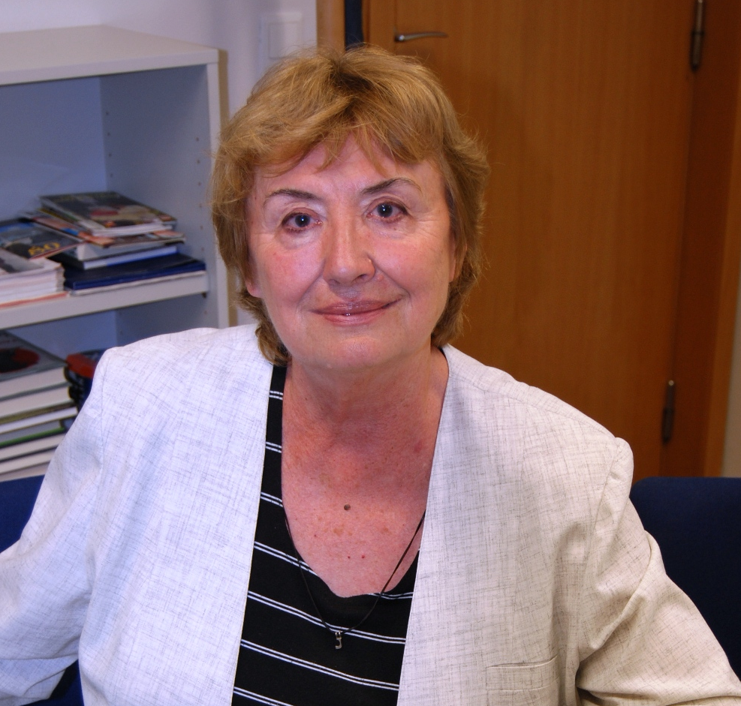
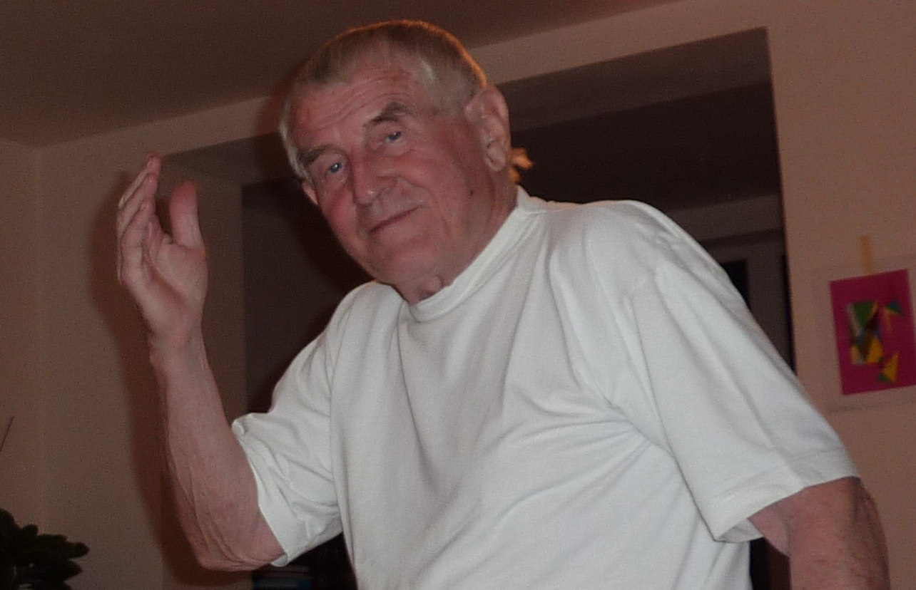
Truly strong scientific background ☺

Slide 4
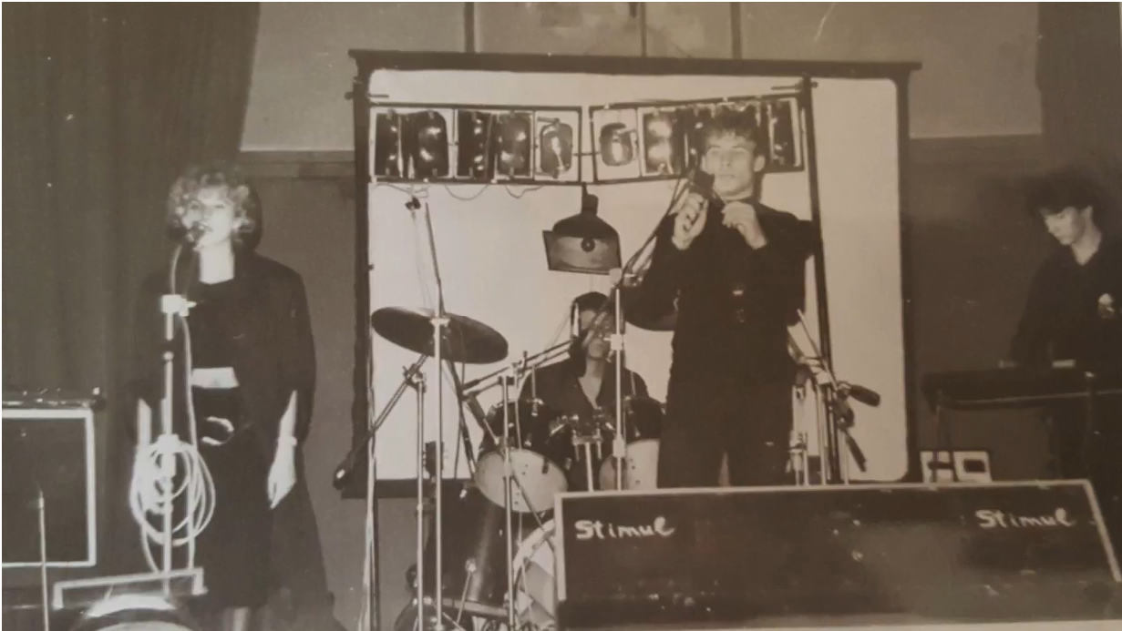
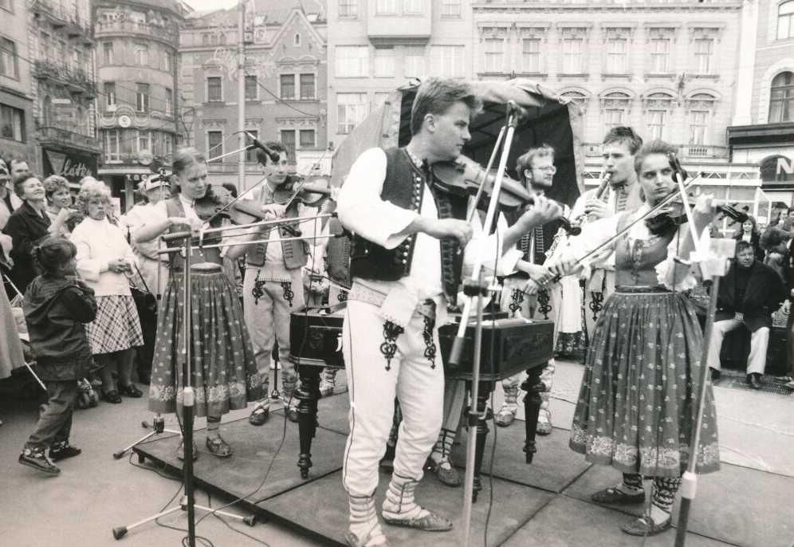
My plans when I was 18 (1988)
Be a professional musician and/or sound engineer
Emigrate from Czechoslovakia as soon as I am done with University

Slide 5
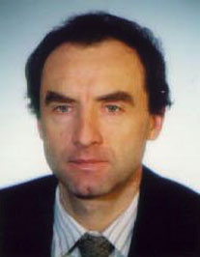
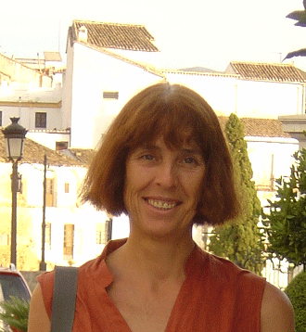

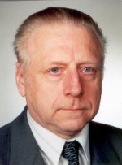
Getting in touch with speech processing
small project with Milan Sigmund at BUT
Diploma thesis in France with Genevieve Baudoin at ESIEE Paris
Czech-French PhD studies (1994-1998) with Genevieve Baudoin, Gerard Chollet and Vladimir Sebesta, as co-supervisors at Universite Paris-Sud (now Saclay), ENST, ESIEE and BUT

Slide 6
Agenda
What led me to speech research
Early days
First revolution
Second revolution
What can we do - research manager's perspective
Build on the large models
Adapt them for tasks they were not trained for
Make them multichannel and smaller
Deal with multimodality and evaluations
BUT Speech@FIT a jak se zapojit

Slide 7
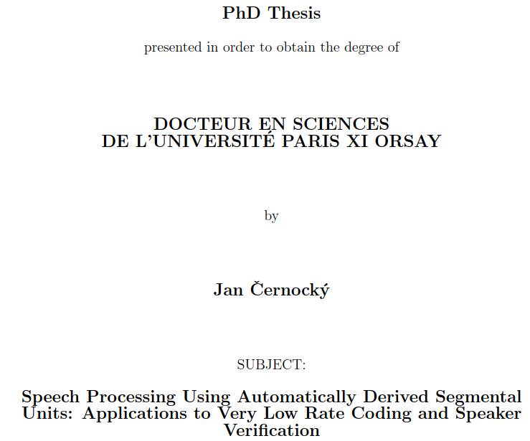
No single neural network in my PhD!
…. actually yes, done by my colleague Jean Hennebert for speaker ID
Did not work at all …
I never saw NN in class
… Btw, Yann LeCun (Turing award) has his Engineering degree from the same school (ESIEE Paris) – he probably also never saw it in class
No idea about “AI”

Slide 8
Automatic speech recognition (ASR)
Acoustic models
Language model
Pronunciation dictionary
Recognition network
Feature extraction
Evaluation of likelihoods (scores of hypothesis)
“Decoding”
speech
text
Notes:
Explain briefly (one sentence) what acoustic model, LM and pronun dico are for.

Slide 9
My and my lab’s early work was mainly in feature extraction and acoustic modeling
Acoustic models
Language model
Pronunciation dictionary
Recognition network
Feature extraction
Evaluation of likelihoods (scores of hypothesis)
“Decoding”
speech
text
Notes:
Explain briefly (one sentence) what acoustic model, LM and pronun dico are for.

Slide 10
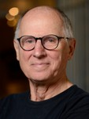
Post-doc with Hynek Heřmanský
In 2001 – posterior features
Long temporal trajectories for speech feature extraction
Band classifers and merger were neural networks !
They worked worse than standard MFCC features…
I don’t remember if we called it “AI”, probably not.
Hynek Hermansky, Daniel PW Ellis, Sangita Sharma: Tandem connectionist feature extraction for conventional HMM systems, in Proc. IEEE ICASSP 2000

Slide 11
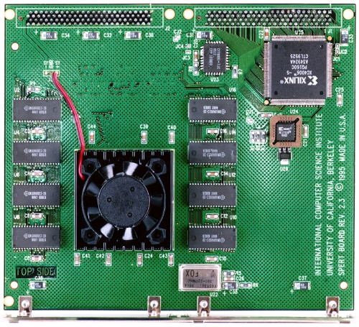
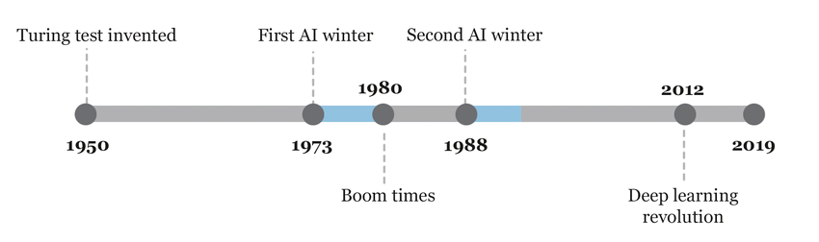
He he he, another guy believing in Hynek’s weird stuff
Around 2000, people did not like neural networks.
Working with them involved writing own code, using obscure custom hardware
Data was hard to get
Every community was “hermetic”, people did not talk and did not understand each other …

Slide 12
Agenda
What led me to speech research
Early days
First revolution
Second revolution
What can we do - research manager's perspective
Build on the large models
Adapt them for tasks they were not trained for
Make them multichannel and smaller
Deal with multimodality and evaluations
BUT Speech@FIT a jak se zapojit

Slide 13
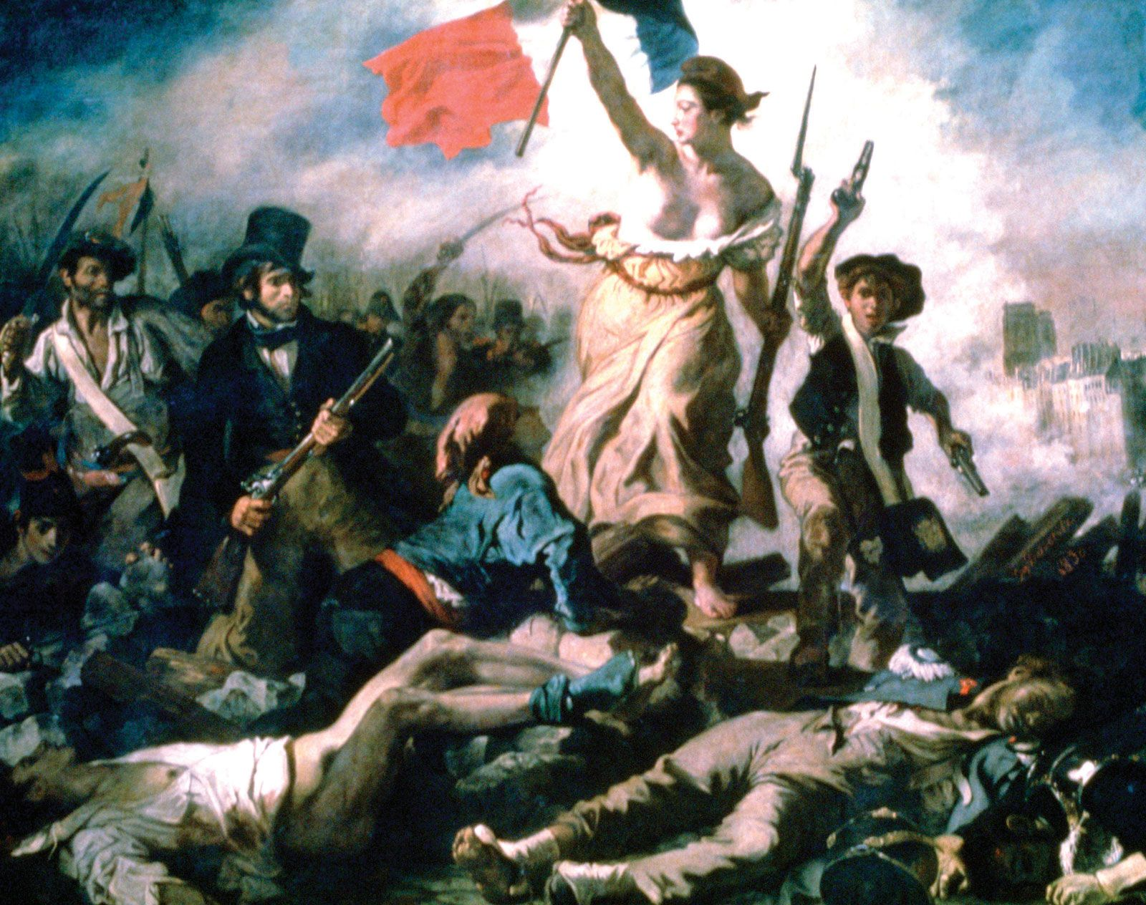
Revolution #1 – neural networks dominate the world

Slide 14
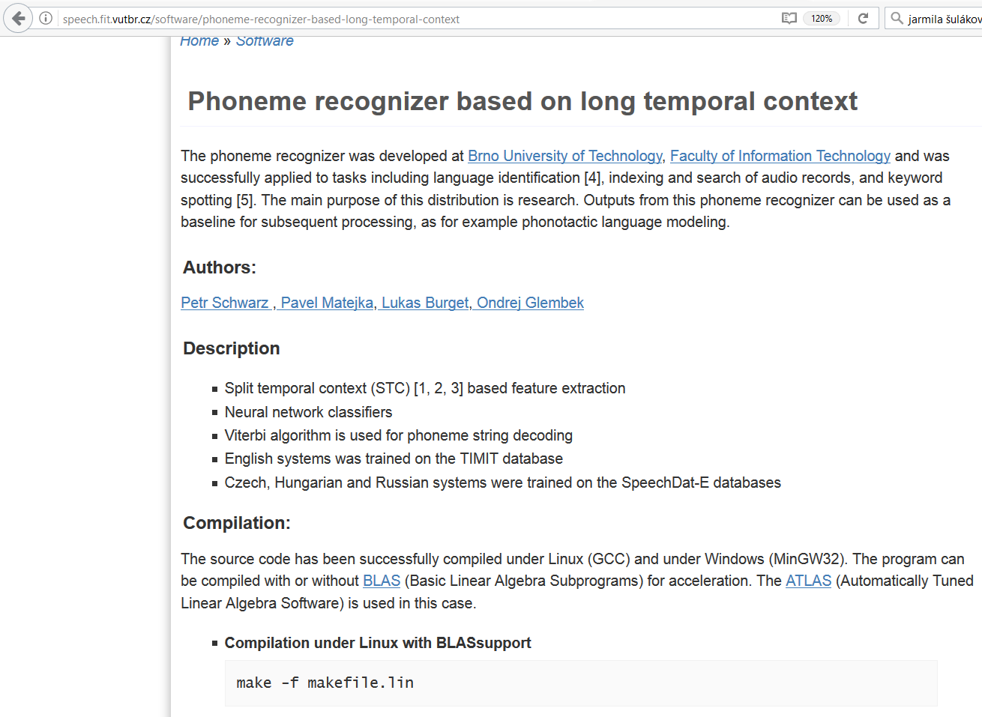
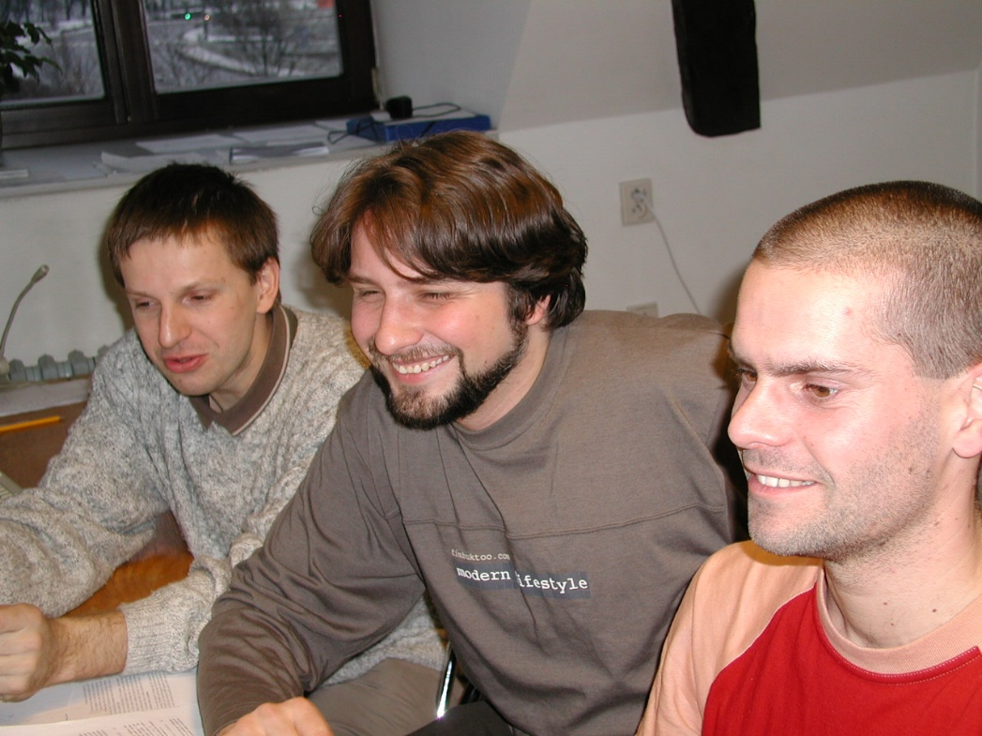
2004-06 The “BUT phoneme recognizer”
SCHWARZ Petr, MATĚJKA Pavel a ČERNOCKÝ Jan. Towards Lower Error Rates in Phoneme Recognition. In: Proceedings of 7th International Conference Text,Speech and Dialoque 2004. Brno: Springer Verlag, 2004, s. 8. ISBN 3-540-23049-1.

Slide 15
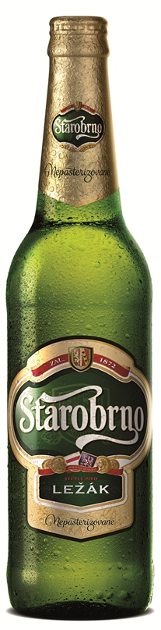

Slide 16
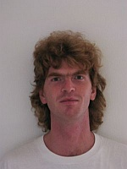
František Grézl @ ICASSP 2007: NN bottle-neck features first beating MFCCs!
GRÉZL František, KARAFIÁT Martin, KONTÁR Stanislav a ČERNOCKÝ Jan. Probabilistic and bottle-neck features for LVCSR of meetings. In: Proc. IEEE International Conference on Acoustics, Speech and Signal Processing (ICASSP 2007). Hononulu: IEEE Signal Processing Society, 2007, s. 757-760. ISBN 1-4244-0728-1.

Slide 17

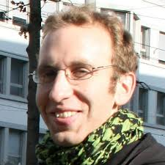
Stacked bottle-neck features (SBN)
Hierarchical structure resembling the brain
Really long temporal context
Significantly better than MFCCs
Allowed to integrate F₀ for Asian languages without hurting performance on Western ones
Doing great also for speaker recognition !
VESELÝ Karel, KARAFIÁT Martin a GRÉZL František. Convolutive Bottleneck Network Features for LVCSR. In: Proceedings of ASRU 2011. Big Island, Hawaii: IEEE Signal Processing Society, 2011, s. 42-47. ISBN 978-1-4673-0366-8.

Slide 18
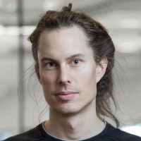
Tom Mikolov @ Interspeech 2010: Recurrent Neural networks do work for language modeling
MIKOLOV Tomáš, KARAFIÁT Martin, BURGET Lukáš, ČERNOCKÝ Jan a KHUDANPUR Sanjeev. Recurrent neural network based language model. In: Proceedings of the 11th Annual Conference of the International Speech Communication Association (INTERSPEECH 2010). Makuhari, Chiba: International Speech Communication Association, 2010, s. 1045-1048. ISBN 978-1-61782-123-3. ISSN 1990-9772.

Slide 19
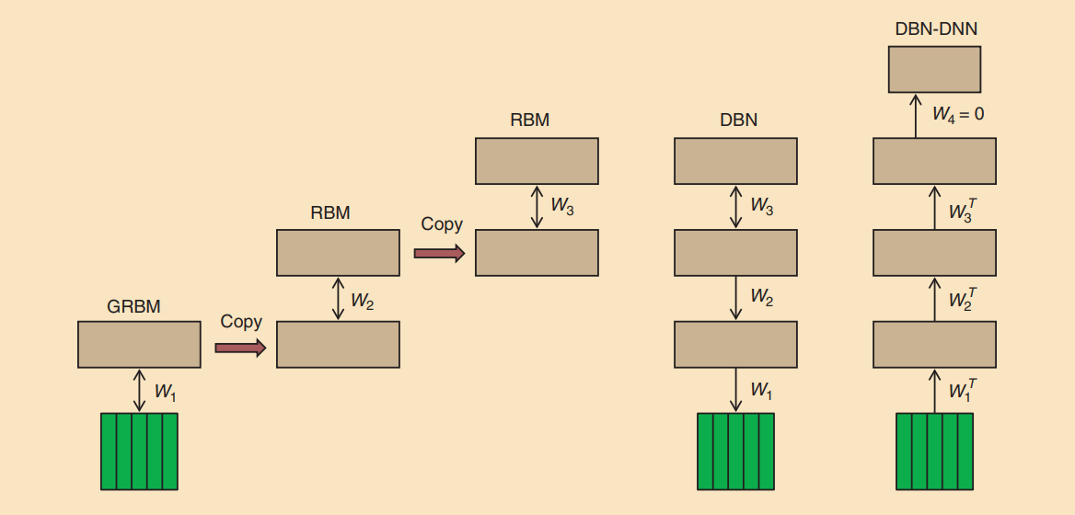
Hinton, Deng, Yu, et al @ SP Magazine 2012: Deep NNs work for acoustic modeling in speech recognition

Slide 20
What allowed revolution #1 ?
Smart people
Development (or re-discovery and clever engineering) of algorithms.
Availability of data
Starting availability of GPUs (from games to R&D)

Slide 21
Good things it brought
It worked and started to be massively used by companies and real users
Google translate
Apple Siri
Amazon Alexa
SW toolkits lowering the entry bar – more people could play with it.
People started to make their papers, code, data and models public – GitHub, arXiv, later HuggingFace
reproducible and trustable results.
Much faster R&D
Communities getting together as everyone used similar approaches – computer vision, NLP, MT, speech, robotics …
We (slowly and reluctantly) started calling it “AI” !

Slide 22
Bad things it brought
Need for more data (these NNs are data hungry …)
Need for more GPUs (that cost money)
Opening gap between the big companies and the rest of the world
People thought less about math and coding: connecting black-boxes is less brain-demanding …

Slide 23
What followed …
Architectures
NN
RNN
(Bi)LSTM
Attention
Transformer
…
Training
Adversarial
Reinforced
Active
Multi-criteria
End to end
Multi-modal
…
Computing
GPUs
Tensor machines
Super-computers
Streaming
Edge
…
Standards and toolkits
Theano
Pytorch
ONNX
Kaldi
ESPNet
K2, Lhotse
SpeechBrain
…

Slide 24
… but still need for more data
Never enough in-domain data
So efforts to train on whatever was available and adapt / fine-tune on the target domain.
IARPA Babel work back between 2012 and 2016
Train on many known languages
Adapt on a new, low-resourced one
VESELÝ Karel, KARAFIÁT Martin, GRÉZL František, JANDA Miloš and EGOROVA Ekaterina. The Language-Independent Bottleneck Features. In: Proceedings of IEEE 2012 Workshop on Spoken Language Technology. Miami: IEEE Signal Processing Society, 2012, s. 336-341. ISBN 978-1-4673-5124-9.

Slide 25
Agenda
What led me to speech research
Early days
First revolution
Second revolution
What can we do - research manager's perspective
Build on the large models
Adapt them for tasks they were not trained for
Make them multichannel and smaller
Deal with multimodality and evaluations
BUT Speech@FIT a jak se zapojit

Slide 26
Revolution #2 – large pre-trained models

Slide 27
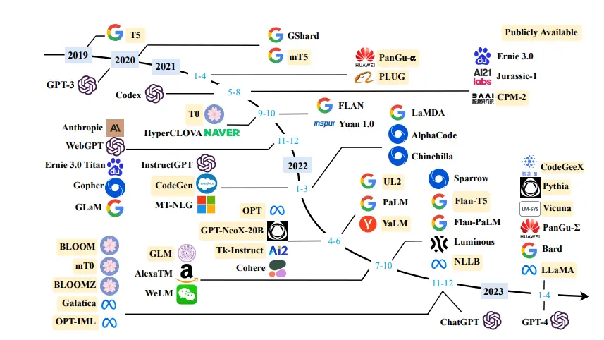
Everywhere you look …

Slide 28
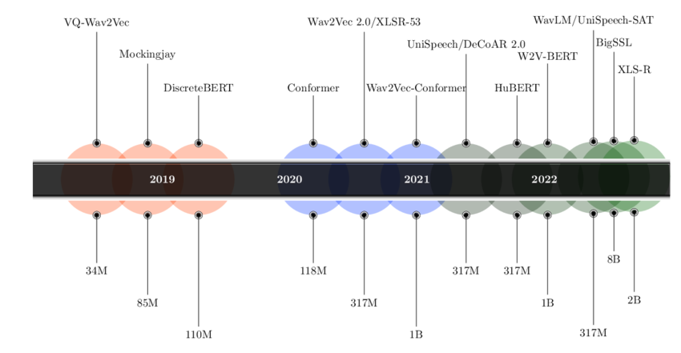
Speech is not spared !

Slide 29
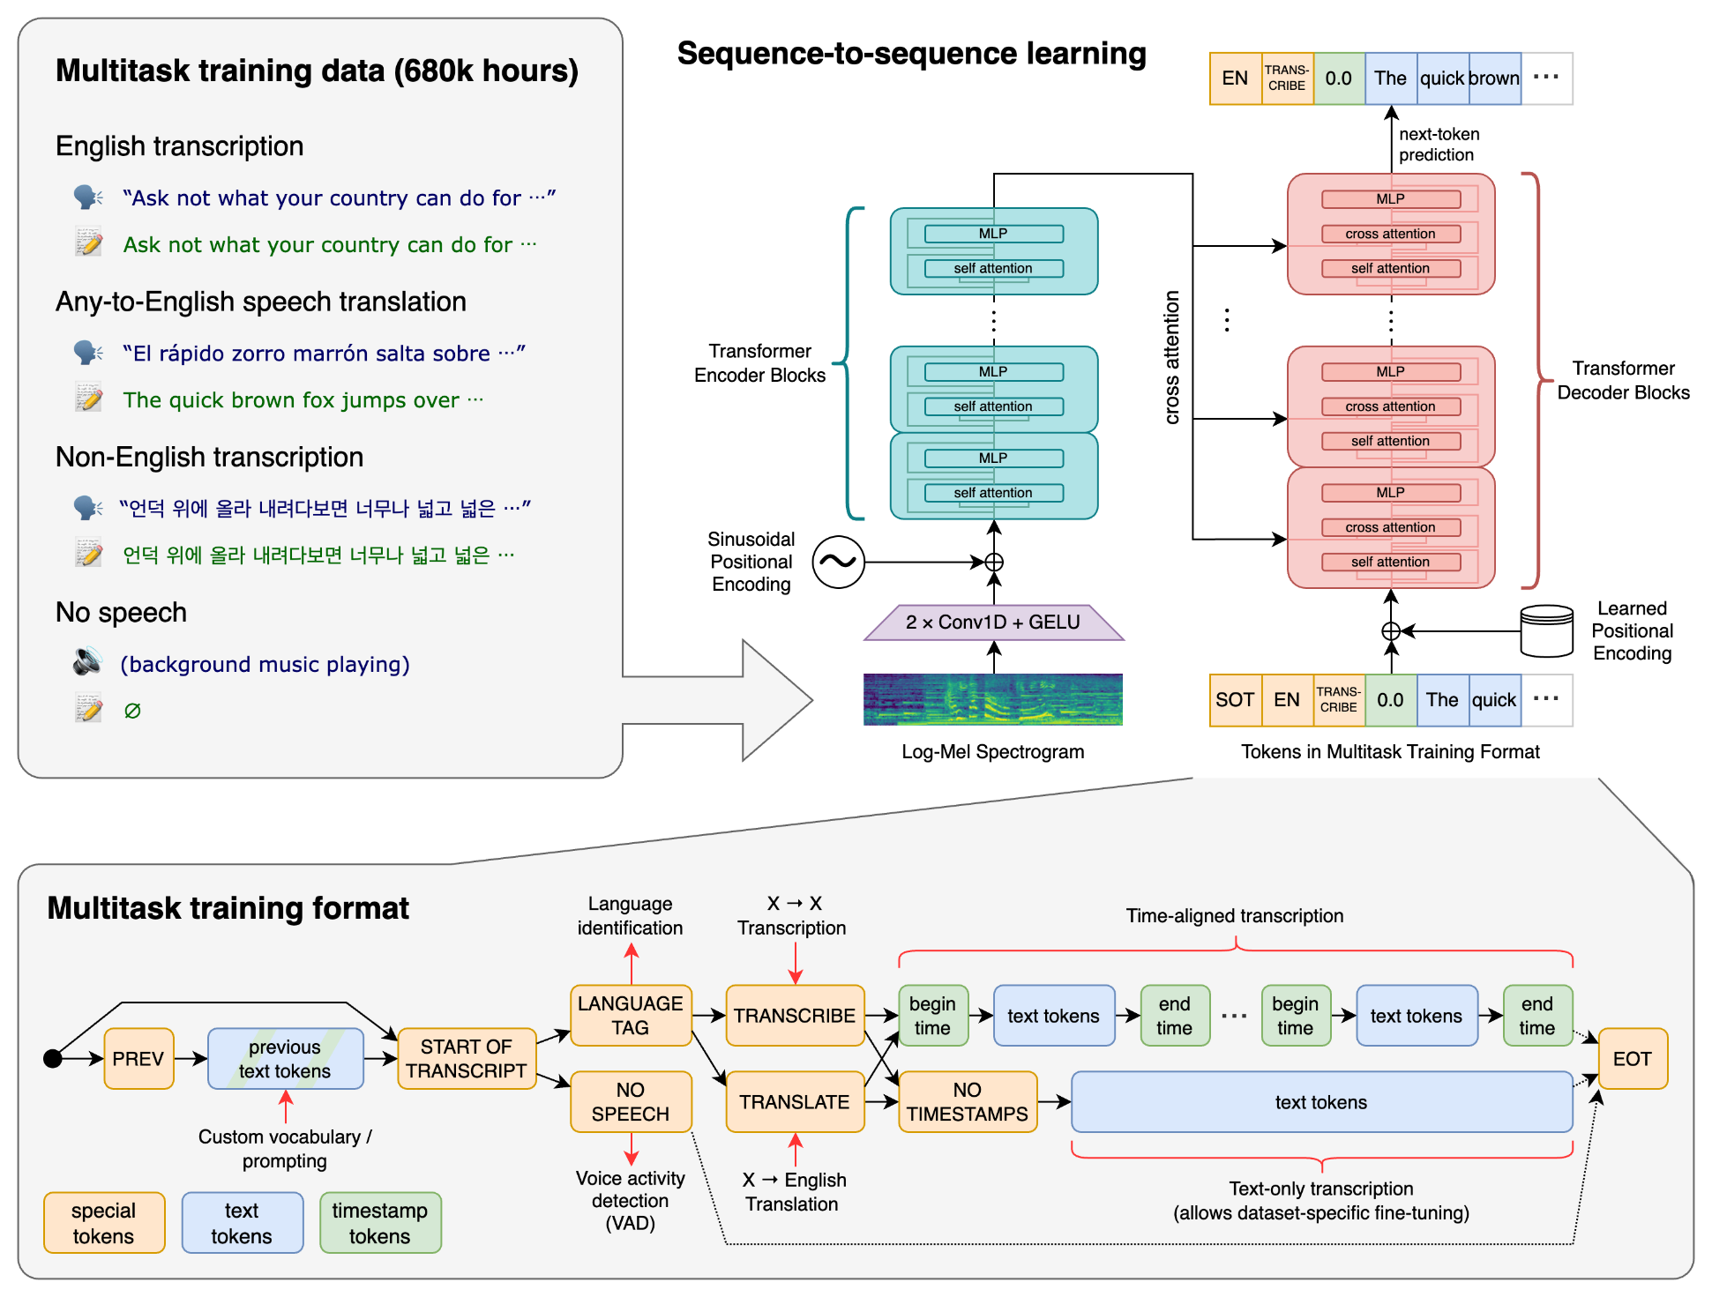
… and there’s Whisper
1.5 bn parameters
Trained on 680k hours of speech

Slide 30
10 years back …
Lots of data
Lots of math, thinking and programming
The newest very advanced NN based algorithm
The world’s best results
Many computers with GPUs

Slide 31
5 years back …
Little in-domain data
Lots of out of domain data
Lots of math, thinking and programming
Even more advanced NN based algorithm
The world’s best results
Even more computers with GPUs

Slide 32
Now
Big pre-trained model
Little in-domain data
The most advanced NN algorithm based on a pre-trained model
The world’s best results
Some math, thinking and programming
Many computers with GPUs

Slide 33
What allowed revolution #2 ?
Smart people figuring out how to train the models in unsupervised way – masking, quantization, multiple losses …
Big companies having big resources
Money to pay these people
More data than you can ever have
More GPUs than you can ever have.

Slide 34
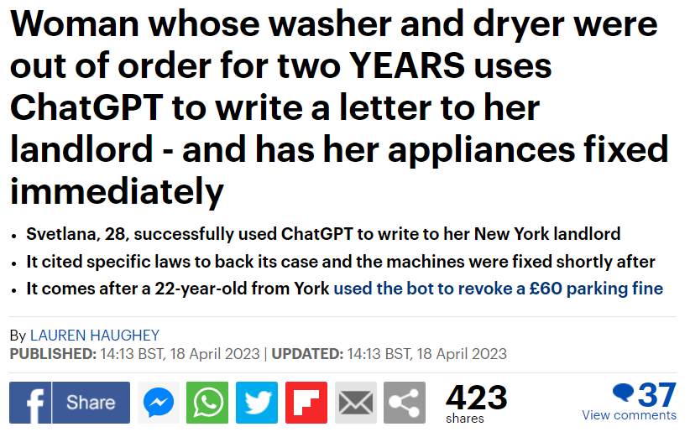
Good things it brought
Strong baselines
Further lowering the bar for newcomers
Useable models for start-ups
Hidden representations for many other tasks
Some positive PR

Slide 35
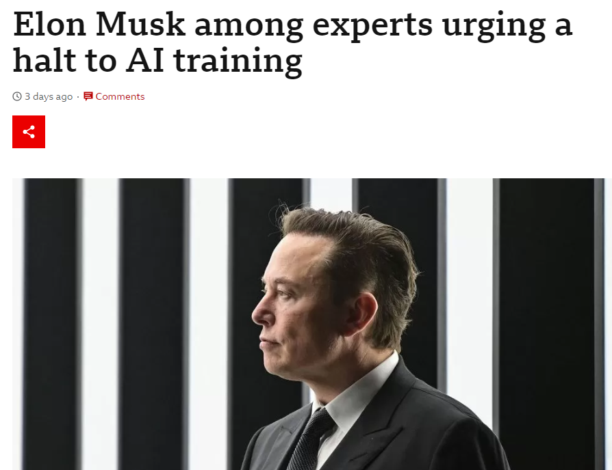
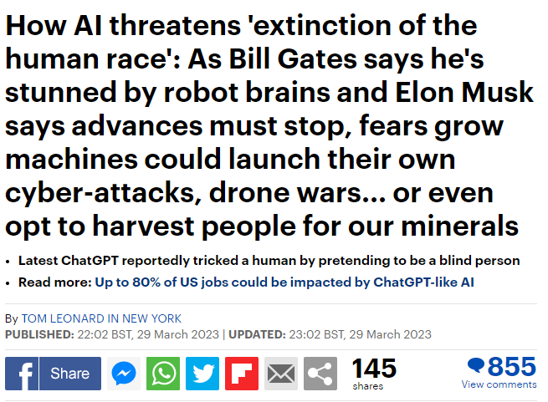
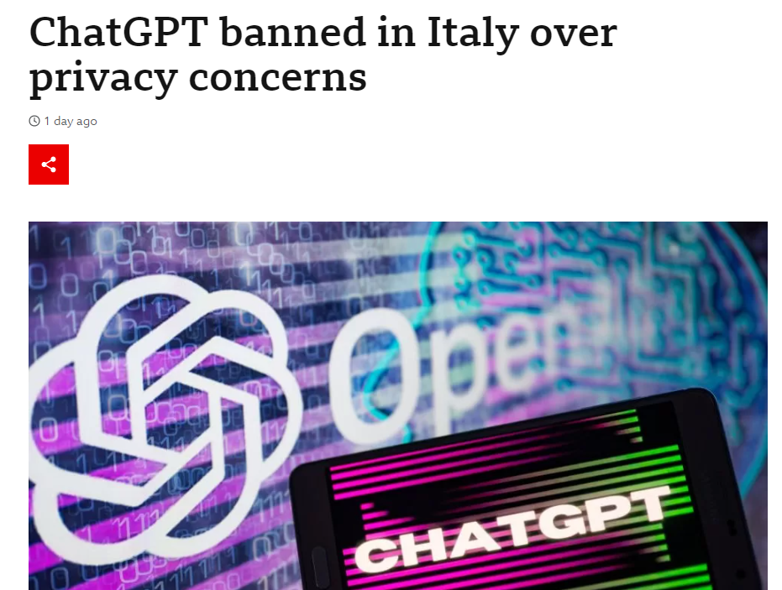
Bad things it brought
Unsure sources of data (licenses, bias)
when models were used for detection / recognition / …, no one cared much
but generative models changed all this.
Yet more dominance of big companies.
People thinking even less – no more necessary to train, just download and run
Lots of negative PR

Slide 36
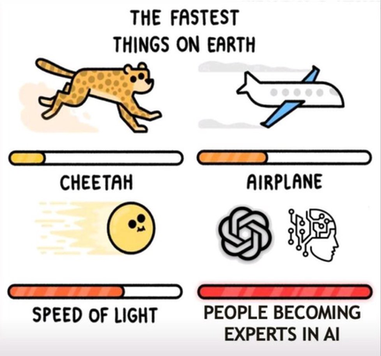
Thx Alicia Lozano [UAM] for sharing this jewel !

Slide 37
Agenda
What led me to speech research
Early days
First revolution
Second revolution
What can we do - research manager's perspective
Build on the large models
Adapt them for tasks they were not trained for
Make them multichannel and smaller
Deal with multimodality and evaluations
BUT Speech@FIT a jak se zapojit

Slide 38

So what can we do ?
Large pre-trained models completely changed the research landscape and made us re-think what to do.
The directions below are from my lab, but the situation is the same in many AI fields and many labs.

Slide 39
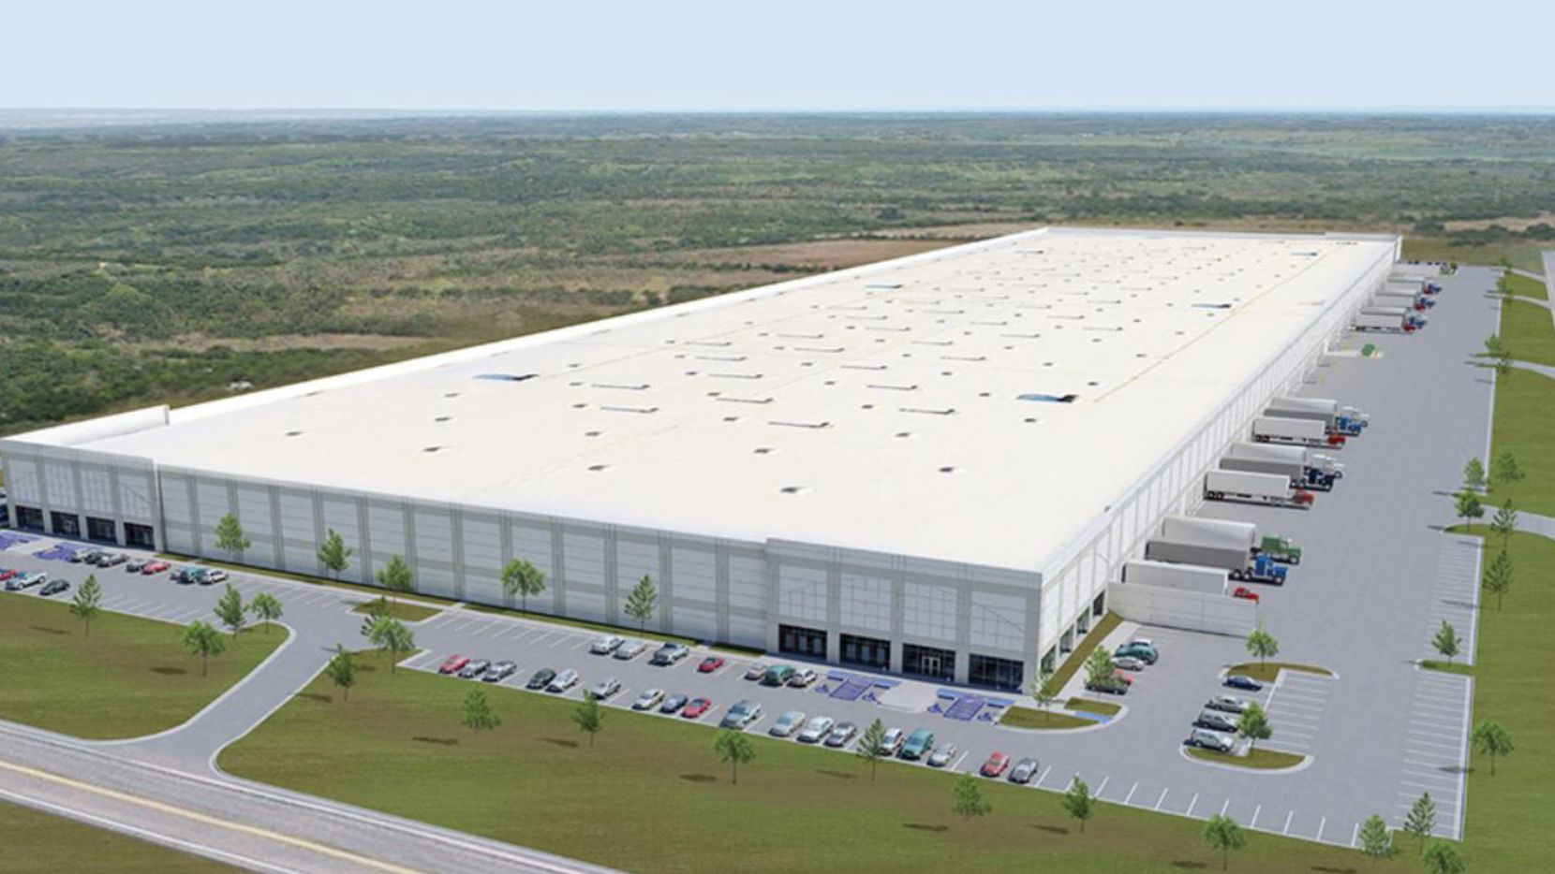

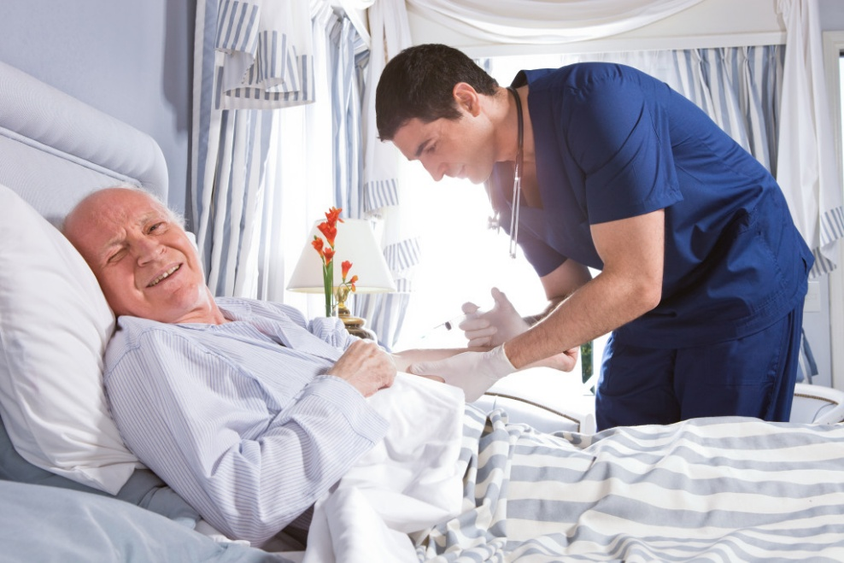

Give up and do something else !
National level
Stop supporting AI R&D and build even more assembly factories and large ware-houses.
Personal level – do something highly demanded

Slide 40
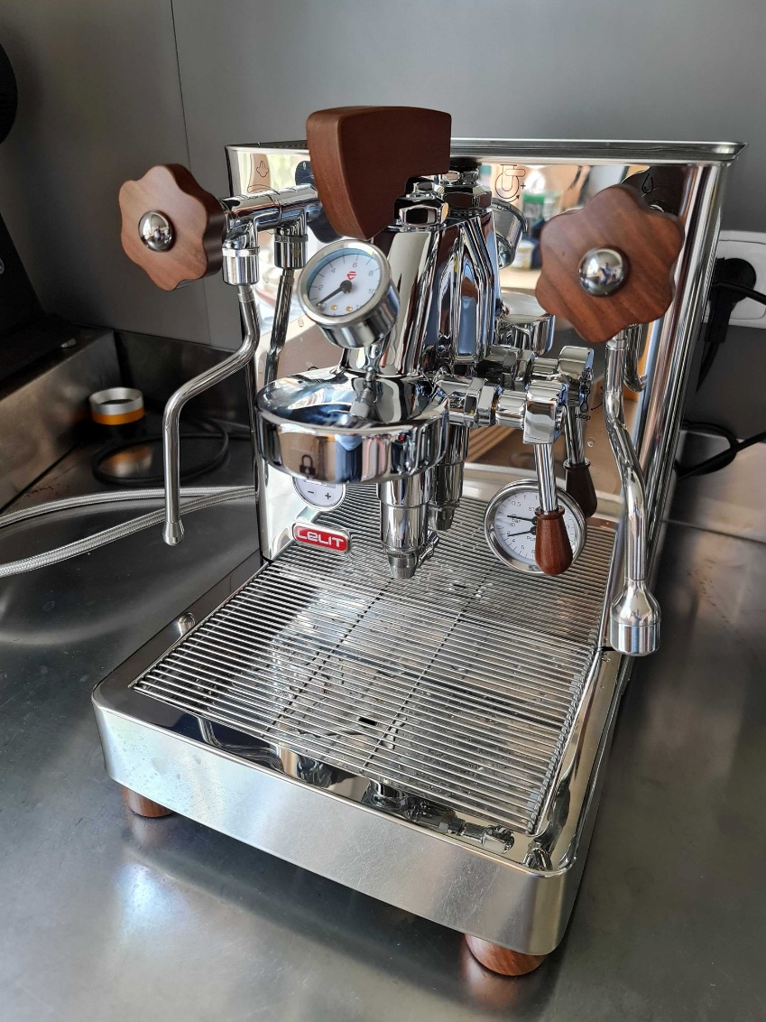
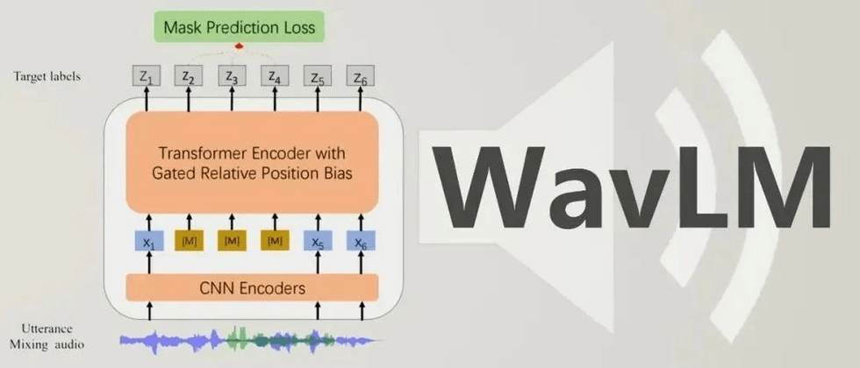
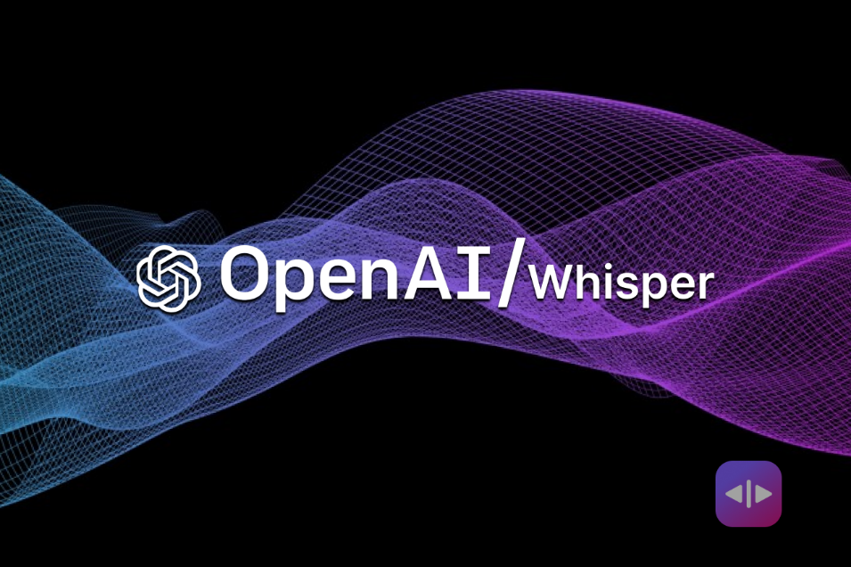
Consider large models a commodity
Smart people
Money to pay them
Some offices
Some computing (definitely less than OpenAI)
Some data (definitely less than OpenAI)

Slide 41
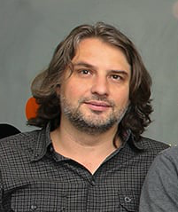
… and have an excellent brain behind
Lukáš Burget

Slide 42
Agenda
What led me to speech research
Early days
First revolution
Second revolution
What can we do - research manager's perspective
Build on the large models
Adapt them for tasks they were not trained for
Make them multichannel and smaller
Deal with multimodality and evaluations
BUT Speech@FIT a jak se zapojit

Slide 43
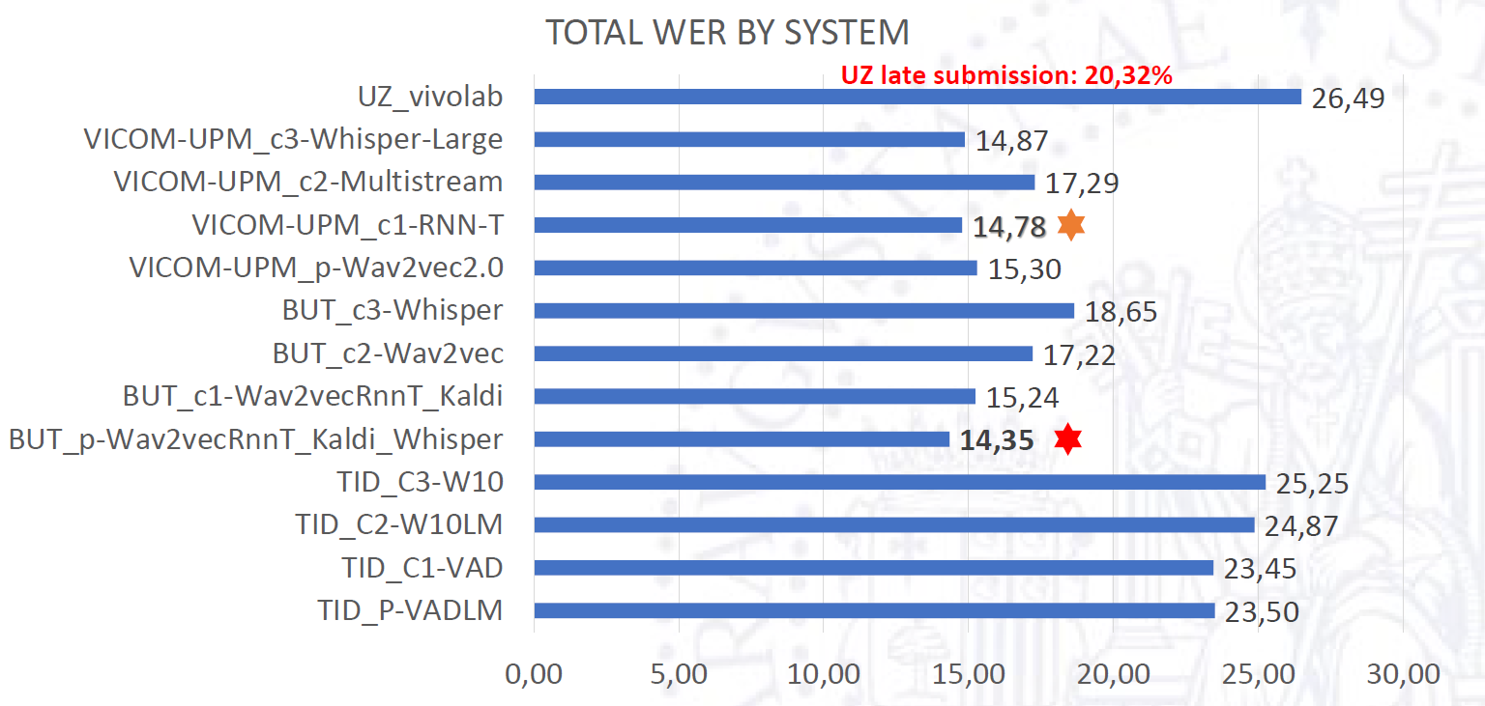
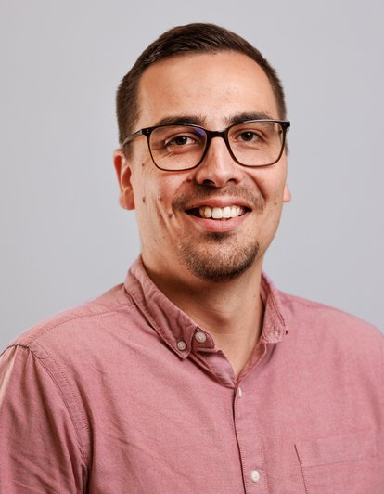
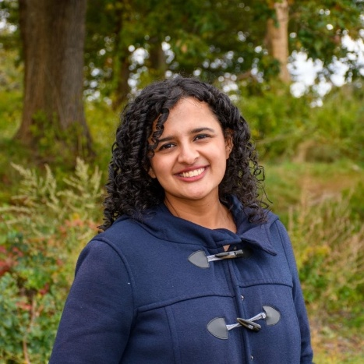
Combine them with what you know and apply smart engineering
they produce excellent features that work well with “old” models !
Albayzin 2022 Spanish ASR challenge
KOCOUR, M.; UMESH, J.; KARAFIÁT, M.; ŠVEC, J.; LOPEZ, F.; BENEŠ, K.; DIEZ SÁNCHEZ, M.; SZŐKE, I.; LUQUE, J.; VESELÝ, K.; BURGET, L.; ČERNOCKÝ, J. BCN2BRNO: ASR System Fusion for Albayzin 2022 Speech to Text Challenge. Proceedings of IberSpeech 2022. Granada: International Speech Communication Association, 2022. p. 276-280.

Slide 44
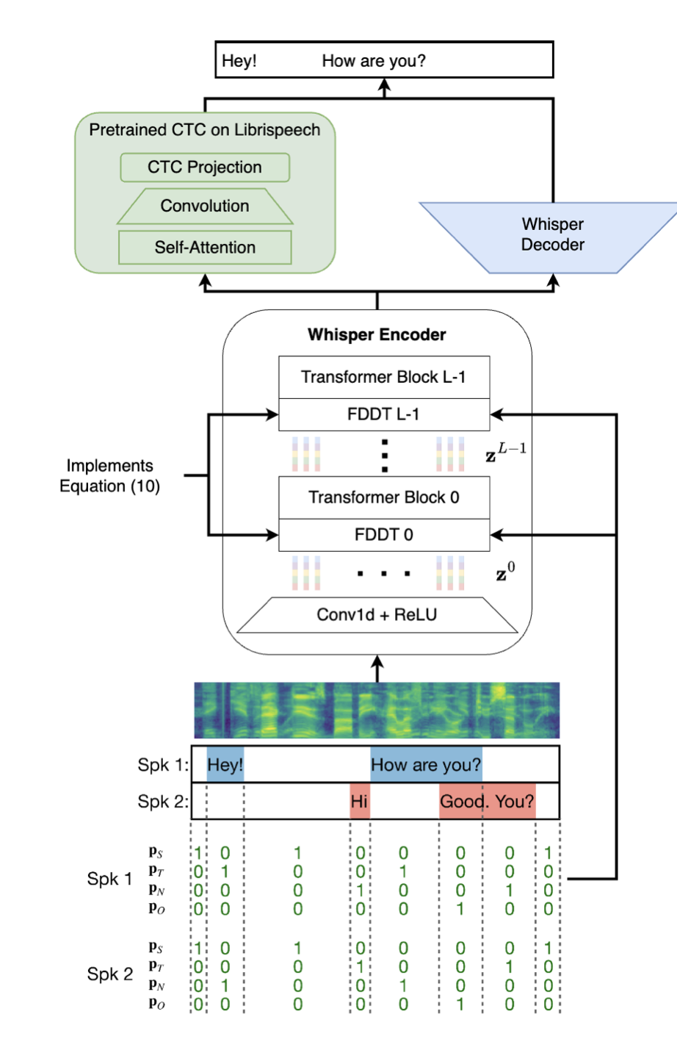
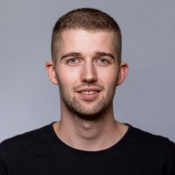
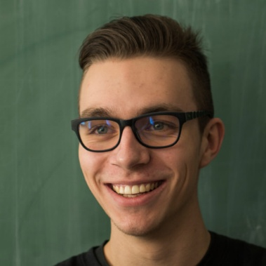
DiCoW: Diarization-Conditioned Whisper for Target Speaker Automatic Speech Recognition
Conditions on the entirety of the diarization output
Encode: Silence (S), Target Speech (T) Non-target Speech (N) Overlapped speech (O)
Each STNO class is encoded via a frame-level affine transformation at the input of transformer blocks
Polok, A., Klement, D., Han, J., Sedláček, Š., Yusuf, B., Maciejewski, M., Wiesner, M. S., & Burget, L. (2024). BUT/JHU system description for CHiME-8 NOTSOFAR-1 challenge. Proceedings of the 8th International Workshop on Speech Processing in Everyday Environments (CHiME 2024).
Polok, A., Klement, D., Wiesner, M., Khudanpur, S., Černocký, J., & Burget, L. (2025). Target speaker ASR with Whisper. Proceedings of the 2025 IEEE International Conference on Acoustics, Speech, and Signal Processing (ICASSP). IEEE.
Polok, A., Klement, D., Kocour, M., Han, J., Landini, F., Yusuf, B., Wiesner, M., Khudanpur, S., Černocký, J., & Burget, L. (2024). DiCoW: Diarization-Conditioned Whisper for target speaker automatic speech recognition. arXiv preprint arXiv:2501.00114.

Slide 45

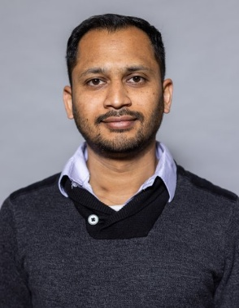
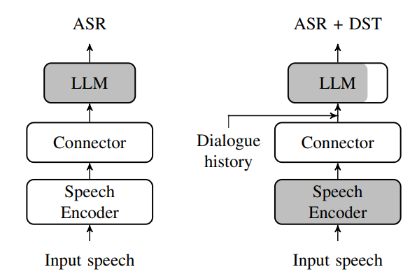
Connections of pre-trained models for Dialogue state tracking (DST)
Two stage-training
(Fig. left → Fig. right)
SotA DST results on SpokenWoz with fully open models.
Type | System | Joint Goal Accuracy
Cascade | ASR → Gemma2-9B [1] | 34.10
Cascade | Whisper → OLMo-1B (Full FT) | 30.74
E2E | WavLM-Large + Conn. + OLMo-1B (LoRA) [2] | 34.66
E2E | WavLM-Large + Conn. + Gemma2-9B (LoRA) [2] | 42.17
Shaded → parameters are frozen
Un-shaded → trainable params
Richardson et al “Schema Augmentation for Zero-Shot Domain Adaptation in Dialogue State Tracking” https://arxiv.org/pdf/2411.00150
Sedlacek Simon, Yusuf. B, Svec. J, Kesiraju. S et al “Approaching Dialogue State Tracking via Aligning Speech Encoders and LLMs” Interspeech 2025

Slide 46
Agenda
What led me to speech research
Early days
First revolution
Second revolution
What can we do - research manager's perspective
Build on the large models
Adapt them for tasks they were not trained for
Make them multichannel and smaller
Deal with multimodality and evaluations
BUT Speech@FIT a jak se zapojit

Slide 47
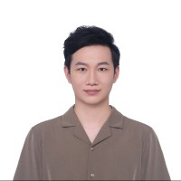
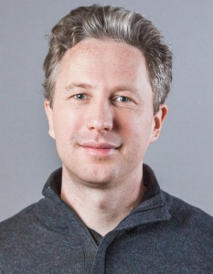
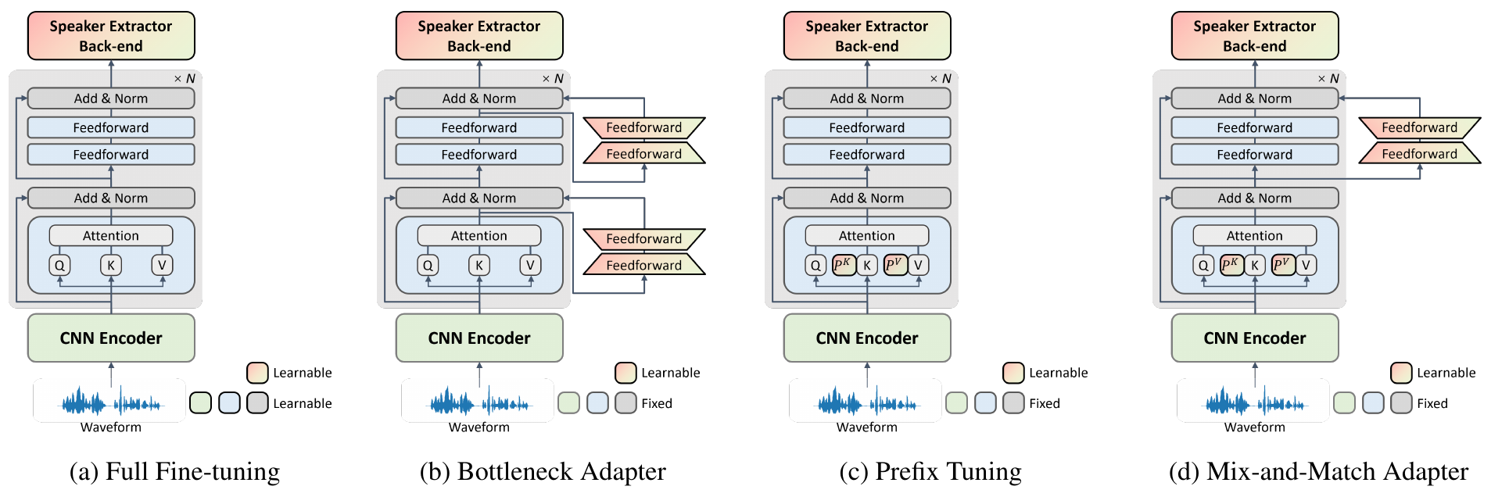
Adapters for adapting large SSL models to speaker recognition task
Peng, Junyi, et al. "Parameter-efficient transfer learning of pre-trained Transformer models for speaker verification using adapters." IEEE-ICASSP 2023

Slide 48
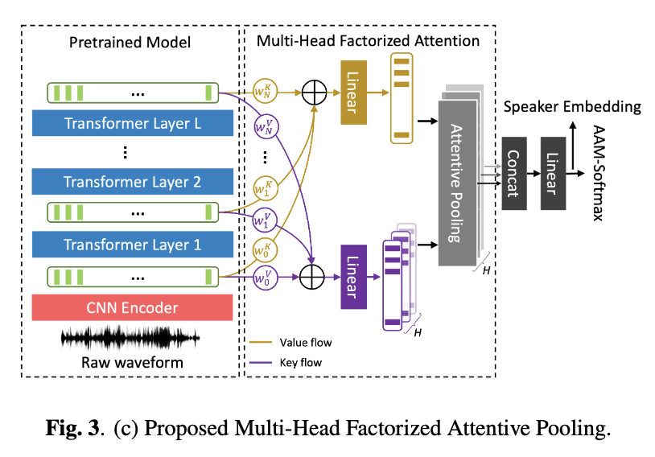
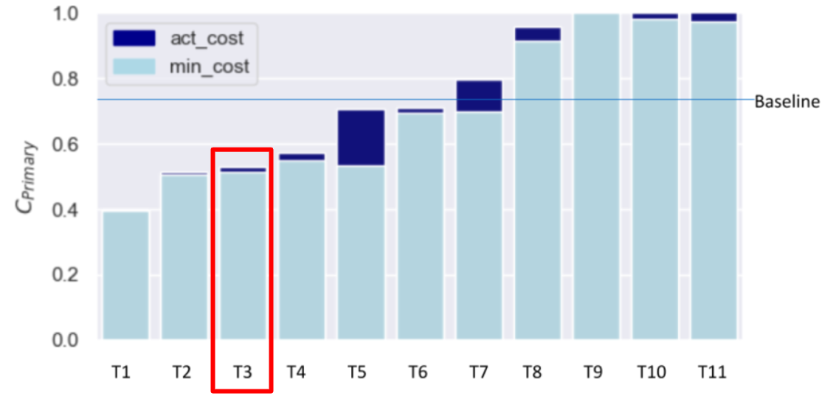
Speaker verification using Attention-based backend on top of WavLM
Exploring fine-tuning strategies for adapting large pre-trained models to speaker verification
Multi-head factorized attentive pooling to factorize the comparison of speaker representations into multiple phonetic clusters.
Excellent results on standard data-sets (VoxCeleb), NIST 2024 and other tasks
Peng, Junyi, et al. "An attention-based backend allowing efficient fine-tuning of transformer models for speaker verification." in Proc. IEEE SLT 2022

Slide 49
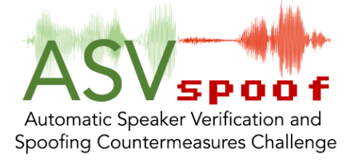
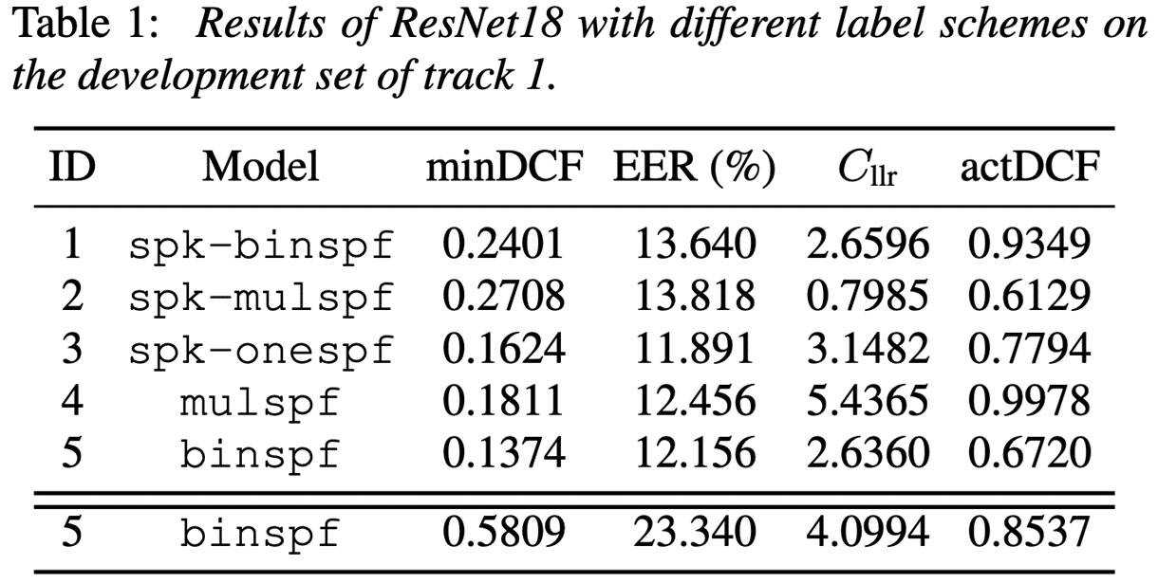
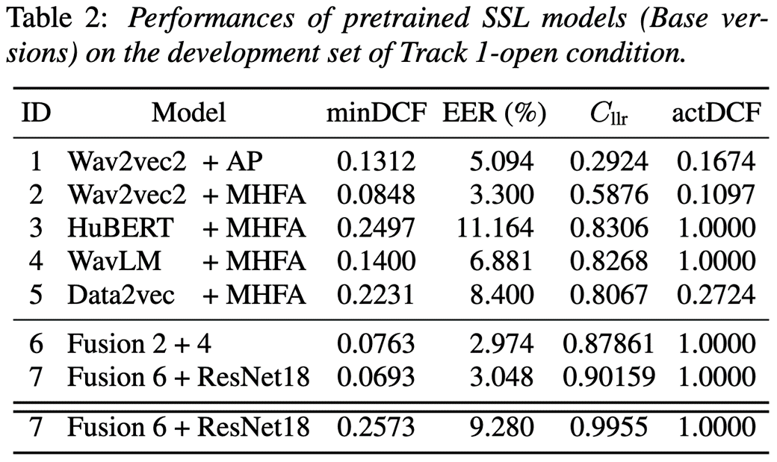

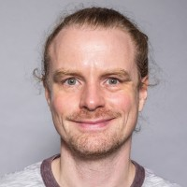


Voice deepfake detection AVSpoof 5
Tracks 1: Voice deep-fake detection, 2: spoofing-robust automatic speaker verification.
Massive use of large SSL models and Multi-head factorized attentive pooling (MHFA) developed for speaker recognition
ROHDIN, J.; ZHANG, L.; PLCHOT, O.; STANĚK, V.; MIHOLA, D.; PENG, J.; STAFYLAKIS, T.; BEVERAKI, D.; SILNOVA, A.; BRUKNER, J.; BURGET, L. BUT systems and analyses for the ASVspoof 5 Challenge. Proceedings of ASV spoof 2024 Workshop. Kos Island: International Speech Communication Association, 2024. p. 24-31.

Slide 50




WavLM based Speaker Diarization
End-to-end Neural Diarization (EEND) built on top of large pre-trained WavLM model
SOTA diarization performance on different meeting datasets
Much more robust against data scarcity
DiariZen available on GitHub
J. Han, F. Landini, J. Rohdin, A. Silnova, M. Diez, and L. Burget, “Leveraging self-supervised learning for speaker diarization,”, ICASSP 2025, Hyderabad, India.

Slide 51
Agenda
What led me to speech research
Early days
First revolution
Second revolution
What can we do - research manager's perspective
Build on the large models
Adapt them for tasks they were not trained for
Make them multichannel and smaller
Deal with multimodality and evaluations
BUT Speech@FIT a jak se zapojit

Slide 52


Multi-Channel Extension of Pre-trained Models (for Speaker Verification)
Adapting single-channel (i.e. single mic) large SSL model to multi-channel input
Alternative to multi-channel pre-processing
No propagation of enhancement errors
Interleaved per-channel and cross-channel processing
Not only for speaker verification
Compatible with various models (WavLM, wav2vec, …)
L. Mošner, R. Serizel, L. Burget, O. Plchot, E. Vincent, J. Peng, J. Černocký, “Multi-Channel Extension of Pre-trained Models for Speaker Verification,” INTERSPEECH 2024.

Slide 53


Structured Pruning
Applied to the WavLM based Speaker Diarization
85% lighter, 4.7× faster, no performance loss.
J. Han, F. Landini, J. Rohdin, A. Silnova, M. Diez, Jan. Cernocky, and L. Burget, “Fine-tune before structured pruning: Towards compact and accurate self-supervised models for speaker diarization,” INTERSPEECH 2025.

Slide 54
Agenda
What led me to speech research
Early days
First revolution
Second revolution
What can we do - research manager's perspective
Build on the large models
Adapt them for tasks they were not trained for
Make them multichannel and smaller
Deal with multimodality and evaluations
BUT Speech@FIT a jak se zapojit

Slide 55

Advancing Expert-Level Reasoning and Understanding in Large Audio Language Models
Team of Ramani Duraiswami + Santosh Kesiraju @ JSALT 2025 in Brno

Slide 56

EDF Archer – organizing speech and language evaluations for military and security
European Defence Fund: Agile and robust human language technologies for defence – Organisation of a technological challenge
EDF-2023-LS-RA-CHALLENGE-DIGIT-HLTO
DARPA-like challenge, but with focus on human-in-the-loop evaluations
Military / law enforcement / intelligence will never share any of their data
Government / emergency / medical domains are similar
You don’t want hot data in your lab – huge mess with GDPR, ethical boards, etc
However, in the wild, users are able to screw up much simpler things than large ML models…

Slide 57
Agenda
What led me to speech research
Early days
First revolution
Second revolution
What can we do - research manager's perspective
Build on the large models
Adapt them for tasks they were not trained for
Make them multichannel and smaller
Deal with multimodality and evaluations
BUT Speech@FIT a jak se zapojit

Slide 58











BUT Speech@FIT
Est. 1997
30 members
10 countries

Slide 59



Leaders
Lukáš Burget
Research director and the central brain
Hynek Heřmanský
JHU Emeritus and the psychoacoustic guru (now back in Brno)
Honza Černocký
Managing director

Slide 60




Senior researchers – SID/LID
Oldřich Plchot
Johan Rohdin
Anna Silnova
Prachi SIngh
Mireia Diez Sanchez

Slide 61





Senior researchers – ASR
Martin Karafiát
Igor Szöke
Petr Schwarz
Karel Veselý
Santosh Kesiraju
Bolaji Yusuf

Slide 62






Proud of our alumni !
21“native”, 3 elsewhere (IIIT-H India, NUST Norway, ZCU Pilsen)
Tomáš Mikolov – founder of NN embeddings, BUT -> Google -> Facebook -> CTU (167k citations on Google Scholar)
Petr Motlíček – speech group leader at IDIAP Switzerland (+ assoc. prof at BUT)
Ilya Oparin – manager of Language Modeling group at Apple Inc.
Marcel Kockmann – CTO at Validsoft
Kateřina Žmolíková – Researcher at Meta London
Murali Karthick Baskar – Researcher at Google Research, N.Y.

Slide 63













Funding - ~1.5 MEUR / year, 85% competitive
EC projects
US
National
Industry

Slide 64











Industrial cooperation

Slide 65




Spin-offs

Slide 66





Community service

Slide 67
Jak se zapojit ?
Diplomky https://docs.google.com/document/d/1EJNMyun8zoLodlHjGoNeYdG4Cq1VOO5f8zeHZr99J8Y/edit?usp=sharing – bude update, ale dává přehled o tom, co se dělá.
Erasmus/Socrates – pomůžeme Vás vystrčit k šikovným kolegům v EU, ale i v USA nebo Asii – akademické labiny i průmysl
PhD
Doporučení / nedoporučení firem
Start-ups in speech

