Slide 1

Bayesian Models in Machine Learning
Approximate inference in Bayesian models
Latent Dirichlet Allocation Model
Lukáš Burget

Slide 2

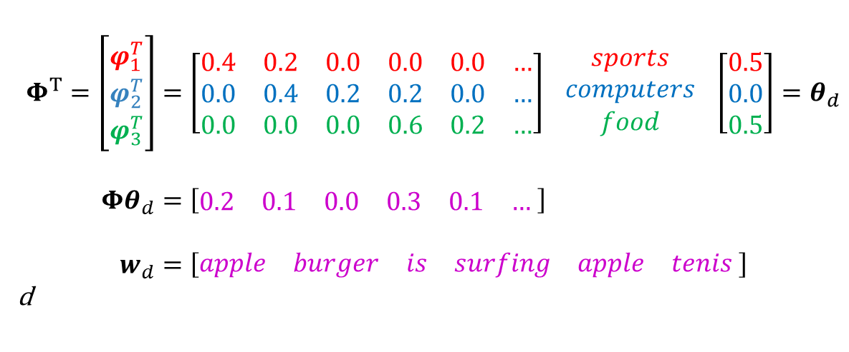
Latent Dirichlet Allocation Model
𝑡𝑒𝑛𝑖𝑠
𝑠𝑢𝑟𝑓𝑖𝑛𝑔
𝑠𝑜𝑓𝑡𝑤𝑎𝑟𝑒
𝑎𝑝𝑝𝑙𝑒
𝑏𝑢𝑟𝑔𝑒𝑟
Set of topic (color) specific word distributions
Document specific topic mixture weights
$$Φ^{T}=\left[\begin{matrix}φ_{1}^{T} \\ \begin{aligned}φ_{2}^{T} \\ φ_{3}^{T}\end{aligned}\end{matrix}\right]=\left[\begin{matrix}0.4 & 0.2 & 0.0 & 0.0 & 0.0 & … \\ 0.0 & 0.4 & 0.2 & 0.2 & 0.0 & … \\ 0.0 & 0.0 & 0.0 & 0.6 & 0.2 & …\end{matrix}\right] \begin{aligned}sports \\ computers \\ food\end{aligned} \left[\begin{aligned}0.5 \\ 0.0 \\ 0.5\end{aligned}\right]=θ_{d} \\ Φθ_{d}=\left[\begin{matrix}0.2 & 0.1 & 0.0 & 0.3 & 0.1 & …\end{matrix} \right] \\ w_{d}=\left[\begin{matrix}apple & burger & is & surfing & apple & tenis\end{matrix} \right]$$
d
Document specific word distribution.
Mixture of Categorical distributions is again Categorical distribution.
Document, where each word is independently drawn from the document specific distribution
$$w_{jt}\sim Cat(Φθ_{d})$$

Slide 3
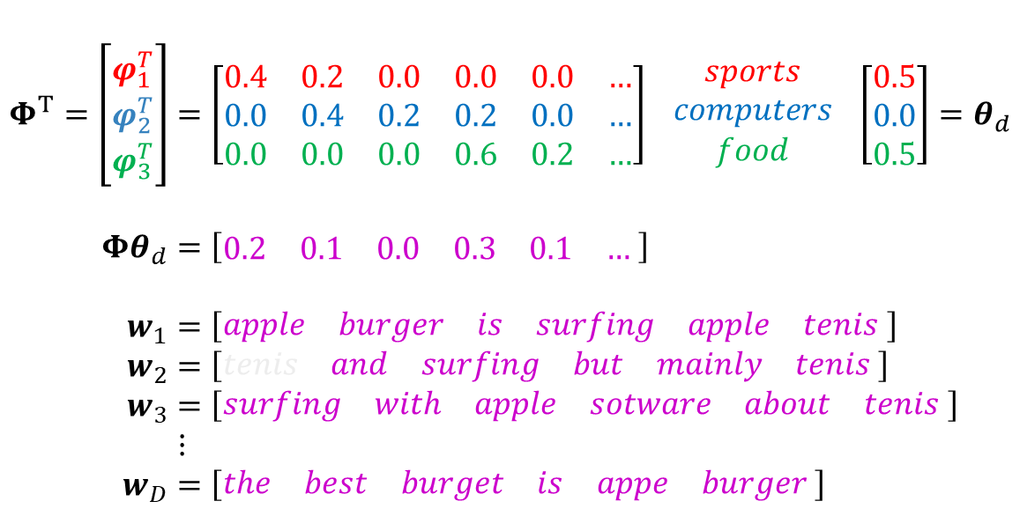
The Task
𝑡𝑒𝑛𝑖𝑠
𝑠𝑢𝑟𝑓𝑖𝑛𝑔
𝑠𝑜𝑓𝑡𝑤𝑎𝑟𝑒
𝑎𝑝𝑝𝑙𝑒
𝑏𝑢𝑟𝑔𝑒𝑟
Given a set of documents and chosen number of topics
learn the set of topic specific word distribution
without knowing any topic labels (i.e. topics are latent)
and, for each document, estimate the topic mixture weights.
$$Φ^{T}=\left[\begin{matrix}φ_{1}^{T} \\ \begin{aligned}φ_{2}^{T} \\ φ_{3}^{T}\end{aligned}\end{matrix}\right]=\left[\begin{matrix}0.4 & 0.2 & 0.0 & 0.0 & 0.0 & … \\ 0.0 & 0.4 & 0.2 & 0.2 & 0.0 & … \\ 0.0 & 0.0 & 0.0 & 0.6 & 0.2 & …\end{matrix}\right] \begin{aligned}sports \\ computers \\ food\end{aligned} \left[\begin{aligned}0.5 \\ 0.0 \\ 0.5\end{aligned}\right]=θ_{d} \\ Φθ_{d}=\left[\begin{matrix}0.2 & 0.1 & 0.0 & 0.3 & 0.1 & …\end{matrix} \right] \\ w_{1}=\left[\begin{matrix}apple & burger & is & surfing & apple & tenis\end{matrix} \right] \\ w_{2}=\left[\begin{matrix}tenis & and & surfing & but & mainly & tenis\end{matrix} \right] \\ w_{3}=\left[\begin{matrix}surfing & with & apple & sotware & about & tenis\end{matrix} \right] \\ ⋮ \\ w_{D}=\left[\begin{matrix}the & best & burget & is & appe & burger\end{matrix} \right]$$
This vector can serve as low-dimensional representation of the document (e.g. for topic clustering).
Group of documents for which the same weight dominates are probably on one and the same topic.

Slide 4


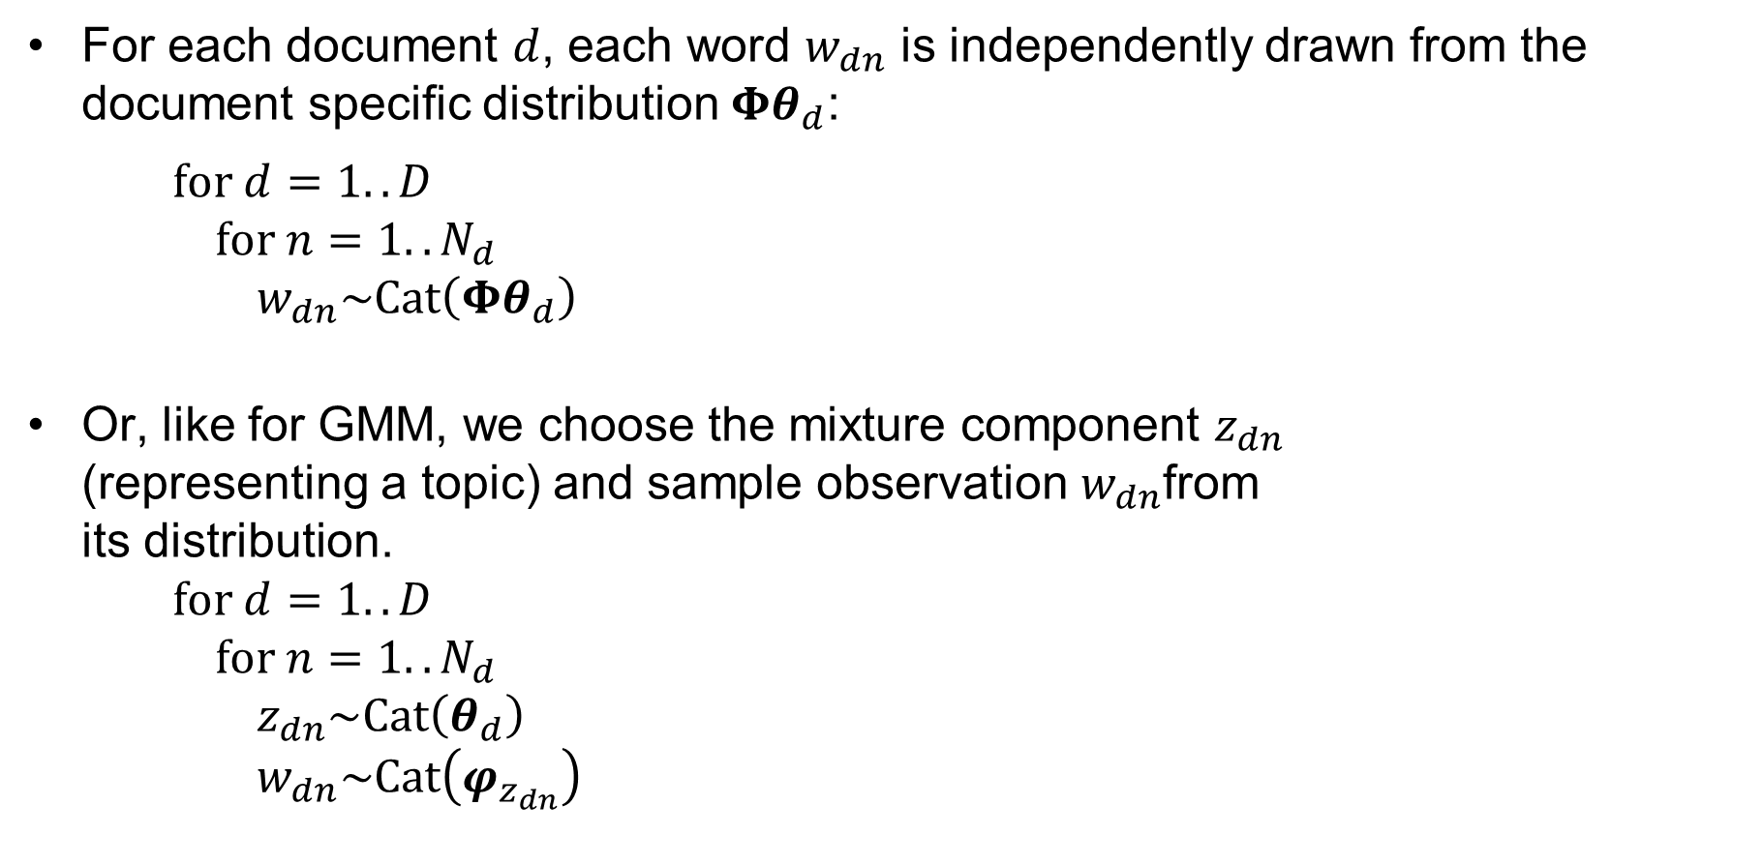



LDA assumed generative process
For each document $d$, each word $w_{dn}$ is independently drawn from the document specific distribution $Φθ_{d}$:
for $d=1..D$
for $n=1..N_{d}$
$w_{dn}\sim Cat\left(Φθ_{d}\right)$
Or, like for GMM, we choose the mixture component $z_{dn}$
(representing a topic) and sample observation $w_{dn}$from
its distribution.
for $d=1..D$
for $n=1..N_{d}$
$z_{dn}\sim Cat\left(θ_{d}\right)$
$w_{dn}\sim Cat\left(φ_{z_{dn}}\right)$
$$d=1..D$$
$$θ_{d}$$
z_{dn}
w_{dn}
$$φ_{k}$$
$$n=1.. N_{d}$$
$$k=1.. K$$

Slide 5








Full Bayesian LDA
Let’s treat parameters of each topic specific distribution $φ_{k}$and document specific weights $θ_{d}$ as random variables with Dirichlet priors: $φ_{k}\sim Dir\left(β\right)$ and $θ_{d}\sim Dir\left(α\right)$
The generative process is now:
$$d=1..D$$
for $k=1..K$
$φ_{k}\sim Dir\left(β\right)$
for $d=1..D$
$θ_{d}\sim Dir\left(α\right)$
for $n=1..N_{d}$
$z_{dn}\sim Cat\left(θ_{d}\right)$
$w_{dn}\sim Cat\left(φ_{z_{dn}}\right)$
$$θ_{d}$$
$$α$$
z_{dn}
$$β$$
w_{dn}
$$φ_{k}$$
$$n=1.. N_{d}$$
$$k=1.. K$$

Slide 6
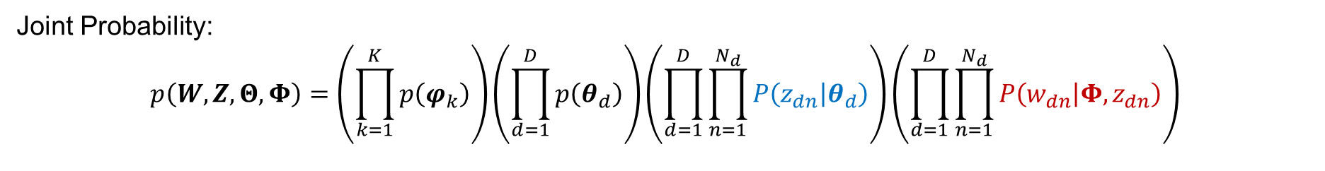

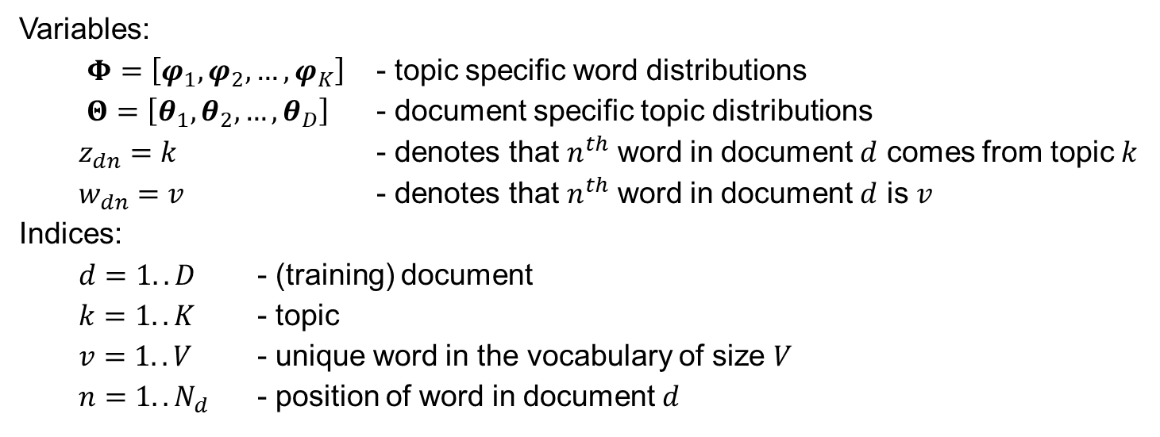


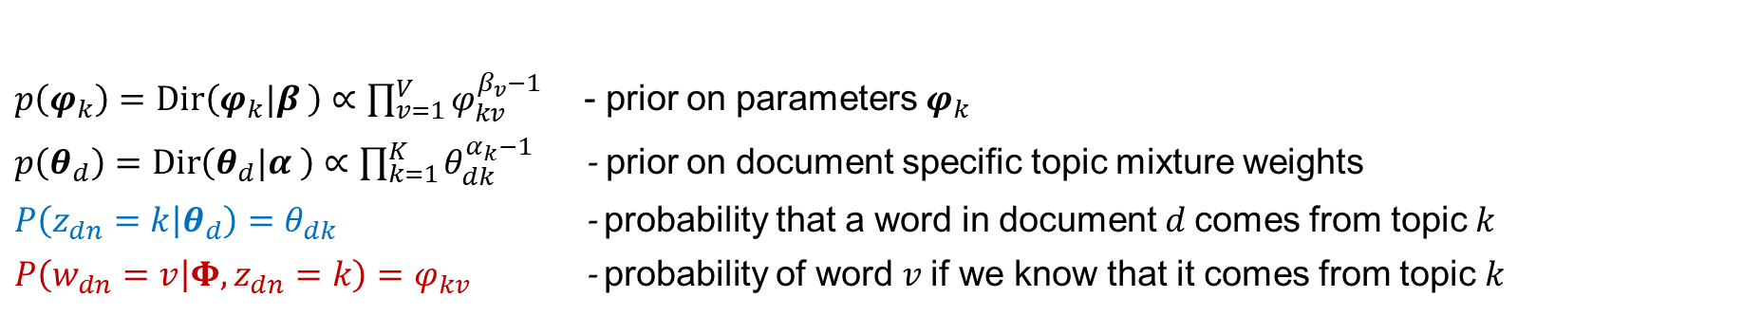
Bayesian LDA model summary
Joint Probability:
$$p\left(W,Z,Θ,Φ\right)=\left(\prod_{k=1}^{K}{p\left(φ_{k}\right)}\right)\left(\prod_{d=1}^{D}{p\left(θ_{d}\right)}\right)\left(\prod_{d=1}^{D}{\prod_{n=1}^{N_{d}}{P\left(z_{dn} | θ_{d}\right)}}\right)\left(\prod_{d=1}^{D}{\prod_{n=1}^{N_{d}}{P\left(w_{dn} | Φ, z_{dn}\right)}}\right)$$
Variables:
  $Φ=\left[φ_{1}, φ_{2}, …, φ_{K}\right]$ - topic specific word distributions
  $Θ=\left[θ_{1}, θ_{2}, …, θ_{D}\right]$ - document specific topic distributions
  $z_{dn}=k$ - denotes that $n^{th}$ word in document $d$ comes from topic $k$
  $w_{dn}=v$ - denotes that $n^{th}$ word in document $d$ is $v$
Indices:
  $d=1.. D$ - (training) document
  $k=1..K$ - topic
  $v=1..V$ - unique word in the vocabulary of size $V$
  $n=1..N_{d}$ - position of word in document $d$
$$d=1..D$$
$$θ_{d}$$
$$α$$
z_{dn}
$$β$$
w_{dn}
$$φ_{k}$$
$p\left(φ_{k}\right)=Dir\left(φ_{k}|β \right)∝\prod_{v=1}^{V}{φ_{kv}^{β_{v}−1}}$ - prior on parameters $φ_{k}$
$p\left(θ_{d}\right)=Dir\left(θ_{d}|α \right)∝\prod_{k=1}^{K}{θ_{dk}^{α_{k}−1}}$ - prior on document specific topic mixture weights
$P\left(z_{dn}=k | θ_{d}\right)=θ_{dk}$ - probability that a word in document $d$comes from topic $k$
$P\left(w_{dn}=v | Φ,z_{dn}=k\right)=φ_{kv}$ - probability of word $v$if we know that it comes from topic $k$
$$n=1.. N_{d}$$
$$k=1.. K$$

Slide 7
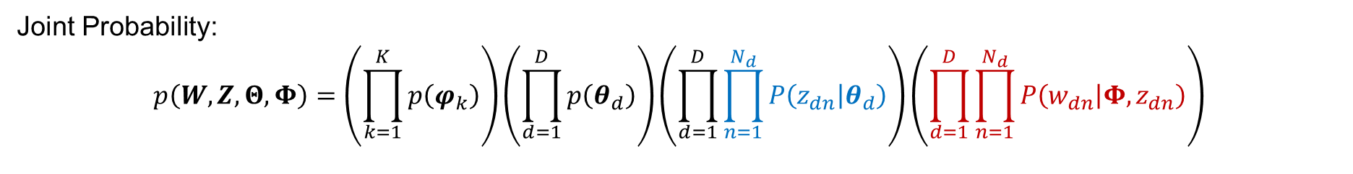


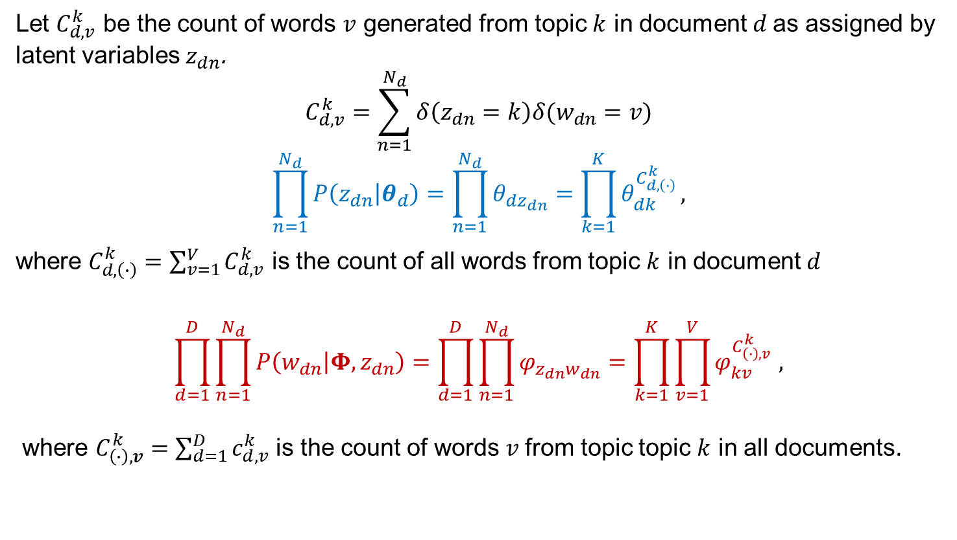
Using counts $C_{d,v}^{k}$
Joint Probability:
$$p\left(W,Z,Θ,Φ\right)=\left(\prod_{k=1}^{K}{p\left(φ_{k}\right)}\right)\left(\prod_{d=1}^{D}{p\left(θ_{d}\right)}\right)\left(\prod_{d=1}^{D}{\prod_{n=1}^{N_{d}}{P\left(z_{dn} | θ_{d}\right)}}\right)\left(\prod_{d=1}^{D}{\prod_{n=1}^{N_{d}}{P\left(w_{dn} | Φ, z_{dn}\right)}}\right)$$
Let $C_{d,v}^{k}$ be the count of words $v$ generated from topic $k$ in document $d$as assigned by latent variables $z_{dn}$.
$$C_{d,v}^{k}=\sum_{n=1}^{N_{d}}{δ\left(z_{dn}=k\right)δ(w_{dn}=v)}$$
$$\prod_{n=1}^{N_{d}}{P\left(z_{dn} | θ_{d}\right)}=\prod_{n=1}^{N_{d}}{θ_{dz_{dn}}}=\prod_{k=1}^{K}{θ_{dk}^{C_{d,\left(∙\right)}^{k}}},$$
where $C_{d,\left(∙\right)}^{k}=\sum_{v=1}^{V}{C_{d,v}^{k}}$ is the count of all words from topic $k$ in document $d$
$$\prod_{d=1}^{D}{\prod_{n=1}^{N_{d}}{P\left(w_{dn} | Φ, z_{dn}\right)}}=\prod_{d=1}^{D}{\prod_{n=1}^{N_{d}}{φ_{z_{dn}w_{dn}}}}=\prod_{k=1}^{K}{\prod_{v=1}^{V}{φ_{kv}^{C_{\left(∙\right),v }^{k}}},}$$
where $C_{\left(∙\right),v}^{k}=\sum_{d=1}^{D}{c_{d,v}^{k}}$ is the count of words $v$from topic topic $k$ in all documents.
$$d=1..D$$
$$θ_{d}$$
$$α$$
z_{dn}
$$β$$
w_{dn}
$$φ_{k}$$
$$n=1.. N_{d}$$
$$k=1.. K$$

Slide 8
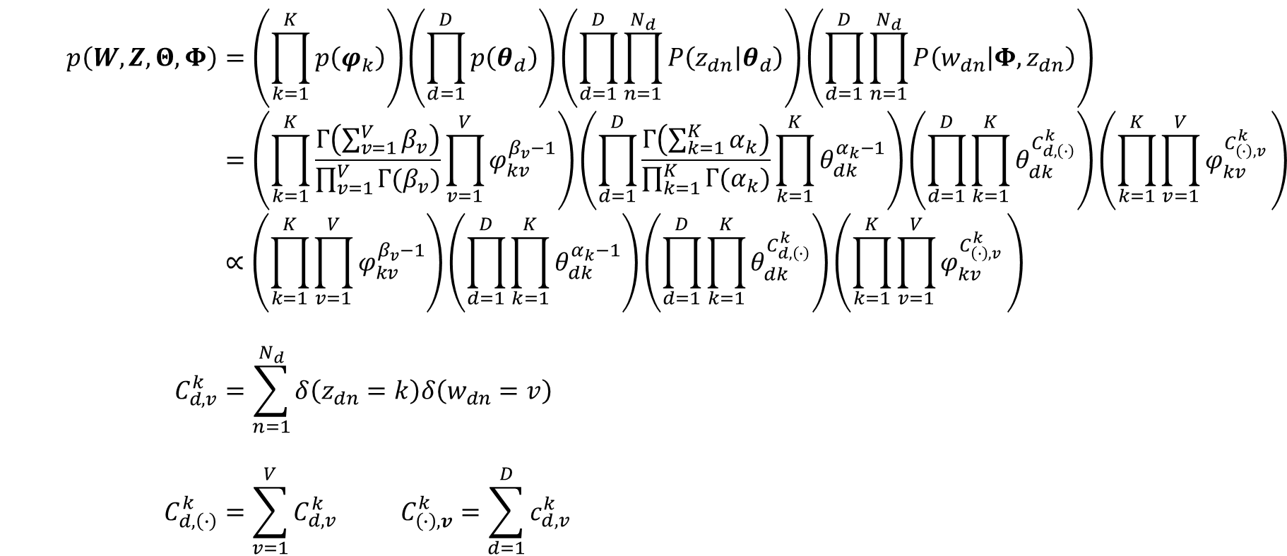

Joint probability using the counts
$$p\left(W,Z,Θ,Φ\right)=\left(\prod_{k=1}^{K}{p\left(φ_{k}\right)}\right)\left(\prod_{d=1}^{D}{p\left(θ_{d}\right)}\right)\left(\prod_{d=1}^{D}{\prod_{n=1}^{N_{d}}{P\left(z_{dn} | θ_{d}\right)}}\right)\left(\prod_{d=1}^{D}{\prod_{n=1}^{N_{d}}{P\left(w_{dn} | Φ, z_{dn}\right)}}\right) \\ =\left(\prod_{k=1}^{K}{\frac{Γ\left(\sum_{v=1}^{V}{β_{v}}\right)}{\prod_{v=1}^{V}{Γ(β_{v})}}\prod_{v=1}^{V}{φ_{kv}^{β_{v}−1}}}\right)\left(\prod_{d=1}^{D}{\frac{Γ\left(\sum_{k=1}^{K}{α_{k}}\right)}{\prod_{k=1}^{K}{Γ(α_{k})}}\prod_{k=1}^{K}{θ_{dk}^{α_{k}−1}}}\right)\left(\prod_{d=1}^{D}{\prod_{k=1}^{K}{θ_{dk}^{C_{d,\left(∙\right)}^{k}}}}\right)\left(\prod_{k=1}^{K}{\prod_{v=1}^{V}{φ_{kv}^{C_{\left(∙\right),v }^{k}}}}\right) \\ ∝\left(\prod_{k=1}^{K}{\prod_{v=1}^{V}{φ_{kv}^{β_{v}−1}}}\right)\left(\prod_{d=1}^{D}{\prod_{k=1}^{K}{θ_{dk}^{α_{k}−1}}}\right)\left(\prod_{d=1}^{D}{\prod_{k=1}^{K}{θ_{dk}^{C_{d,\left(∙\right)}^{k}}}}\right)\left(\prod_{k=1}^{K}{\prod_{v=1}^{V}{φ_{kv}^{C_{\left(∙\right),v }^{k}}}}\right) \\ C_{d,v}^{k}=\sum_{n=1}^{N_{d}}{δ\left(z_{dn}=k\right)δ\left(w_{dn}=v\right)} \\ C_{d,\left(∙\right)}^{k}=\sum_{v=1}^{V}{C_{d,v}^{k}} C_{\left(∙\right),v}^{k}=\sum_{d=1}^{D}{c_{d,v}^{k}}$$
$$d=1..D$$
$$θ_{d}$$
$$α$$
z_{dn}
$$β$$
w_{dn}
$$φ_{k}$$
$$n=1.. N_{d}$$
$$k=1.. K$$

Slide 9
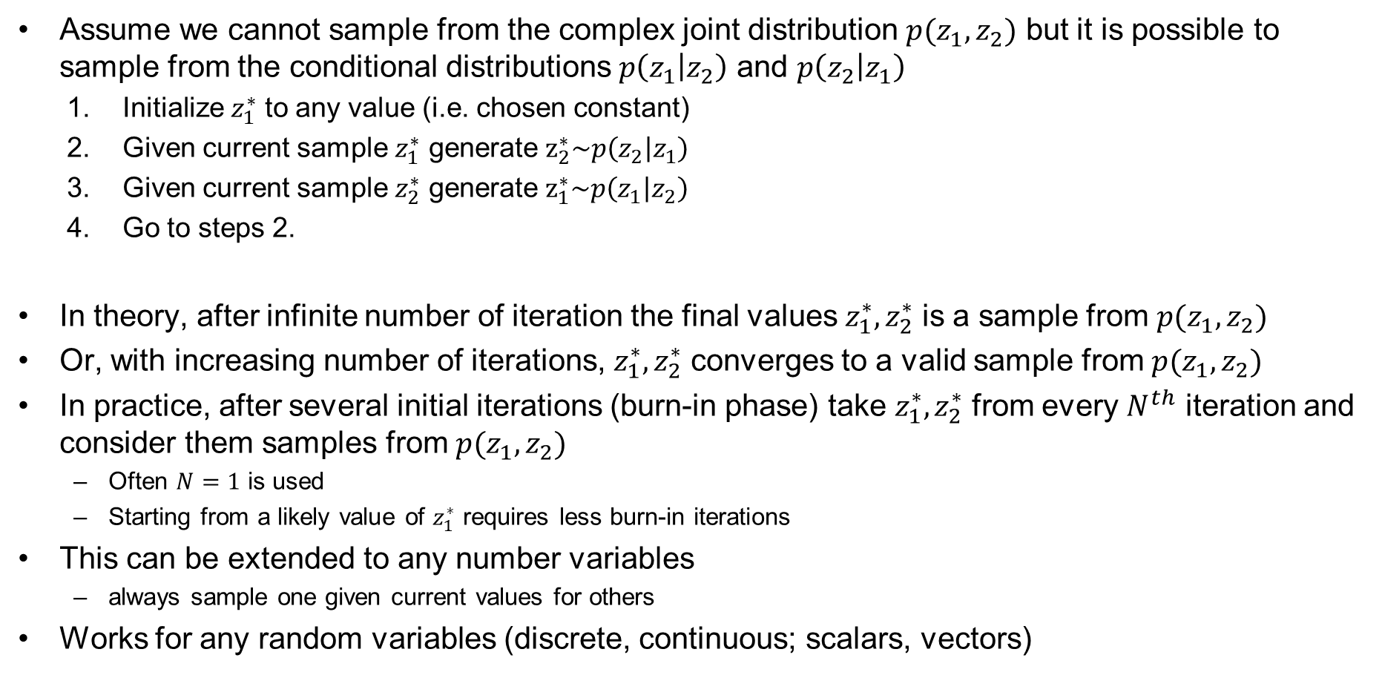
Gibbs Sampling
Assume we cannot sample from the complex joint distribution $p(z_{1},z_{2})$ but it is possible to sample from the conditional distributions $p\left(z_{1} | z_{2}\right)$ and $p\left(z_{2} | z_{1}\right)$
  Initialize $z_{1}^{∗}$ to any value (i.e. chosen constant)
  Given current sample $z_{1}^{∗}$ generate $z_{2}^{∗}\sim p\left(z_{2} | z_{1}\right)$
  Given current sample $z_{2}^{∗}$ generate $z_{1}^{∗}\sim p\left(z_{1} | z_{2}\right)$
  Go to steps 2.
In theory, after infinite number of iteration the final values $z_{1}^{∗},z_{2}^{∗}$ is a sample from $p(z_{1},z_{2})$
Or, with increasing number of iterations, $z_{1}^{∗},z_{2}^{∗}$ converges to a valid sample from $p(z_{1},z_{2})$
In practice, after several initial iterations (burn-in phase) take $z_{1}^{∗},z_{2}^{∗}$ from every $N^{th}$ iteration and consider them samples from $p(z_{1},z_{2})$
  Often $N=1$ is used
  Starting from a likely value of $z_{1}^{∗}$ requires less burn-in iterations
This can be extended to any number variables
  always sample one given current values for others
Works for any random variables (discrete, continuous; scalars, vectors)

Slide 10
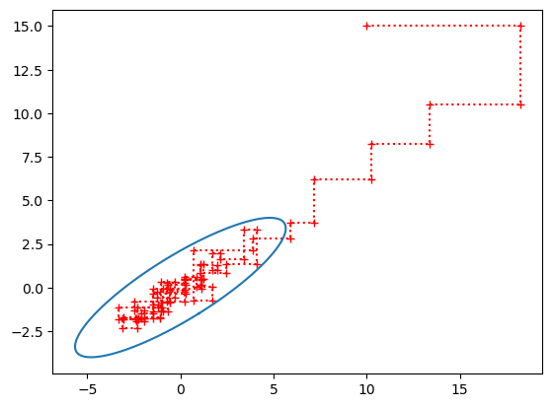
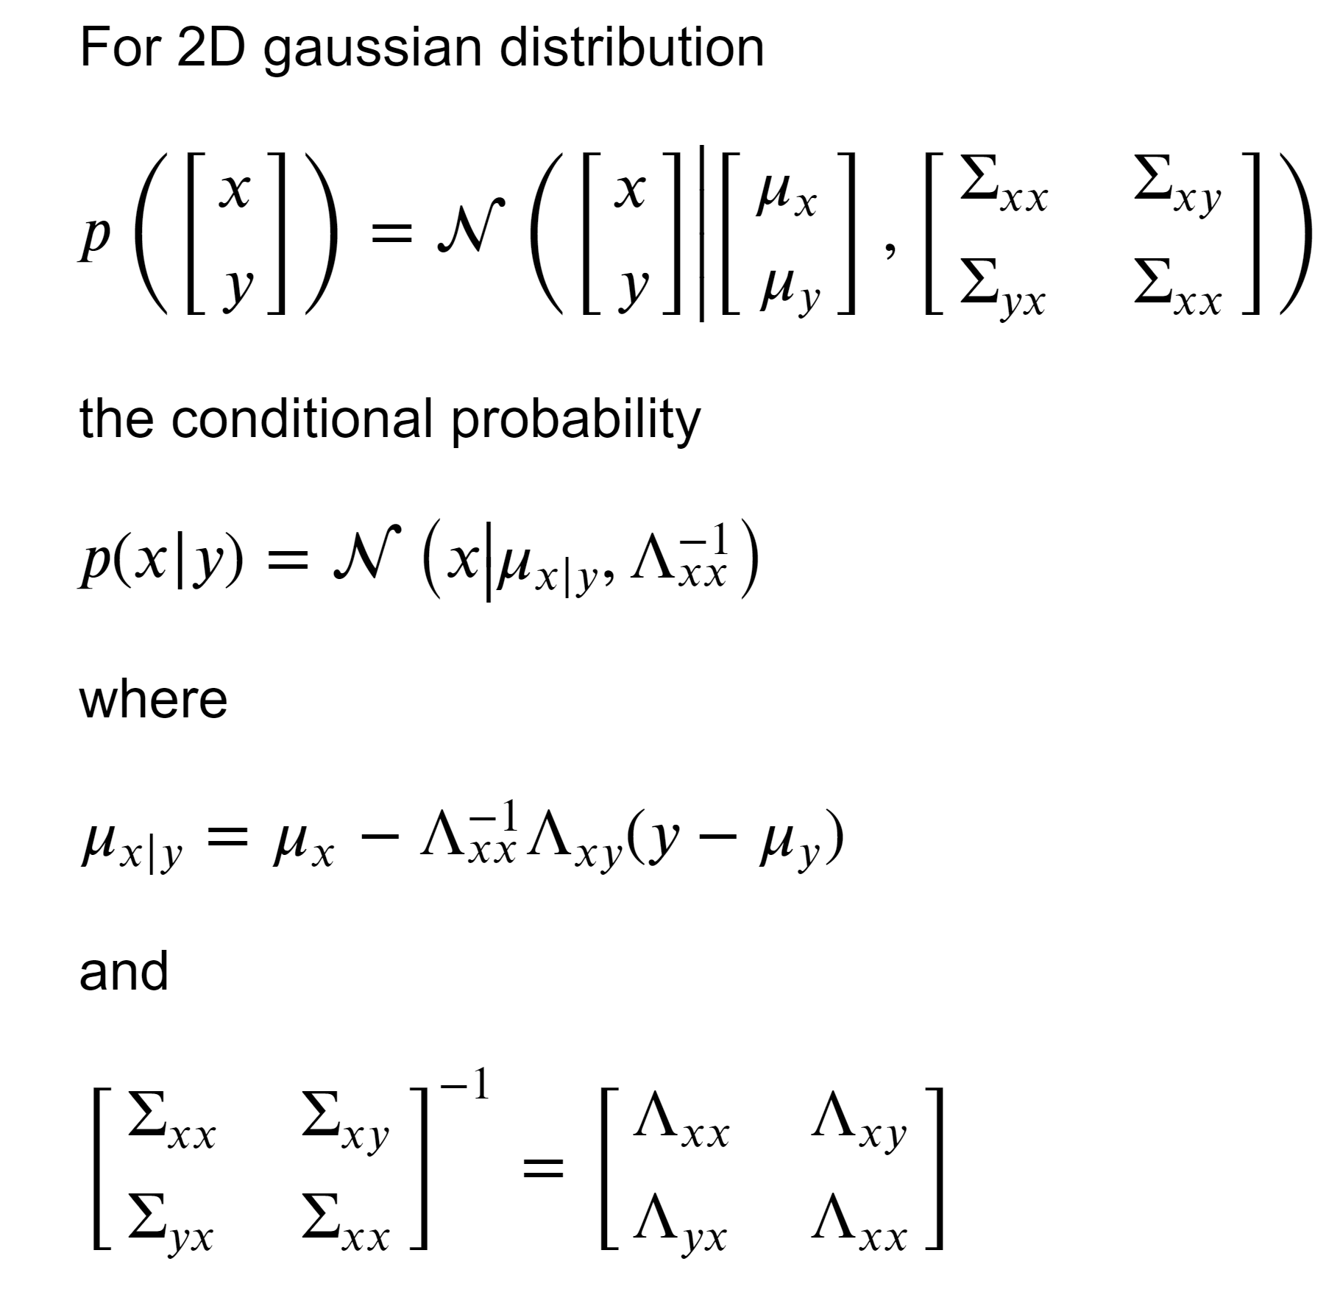

Gibbs sampling for 2D Gaussian
Of course, it is possible to efficiently and exactly sample directly from a 2D Gaussian distribution. We use this toy example only to demonstrate how Gibbs sampling works.
Iterate:
$$x^{∗}\sim p\left(x | y^{∗}\right)$$
$$y^{∗}\sim p\left(y | x^{∗}\right)$$
Burn-in phase

Slide 11
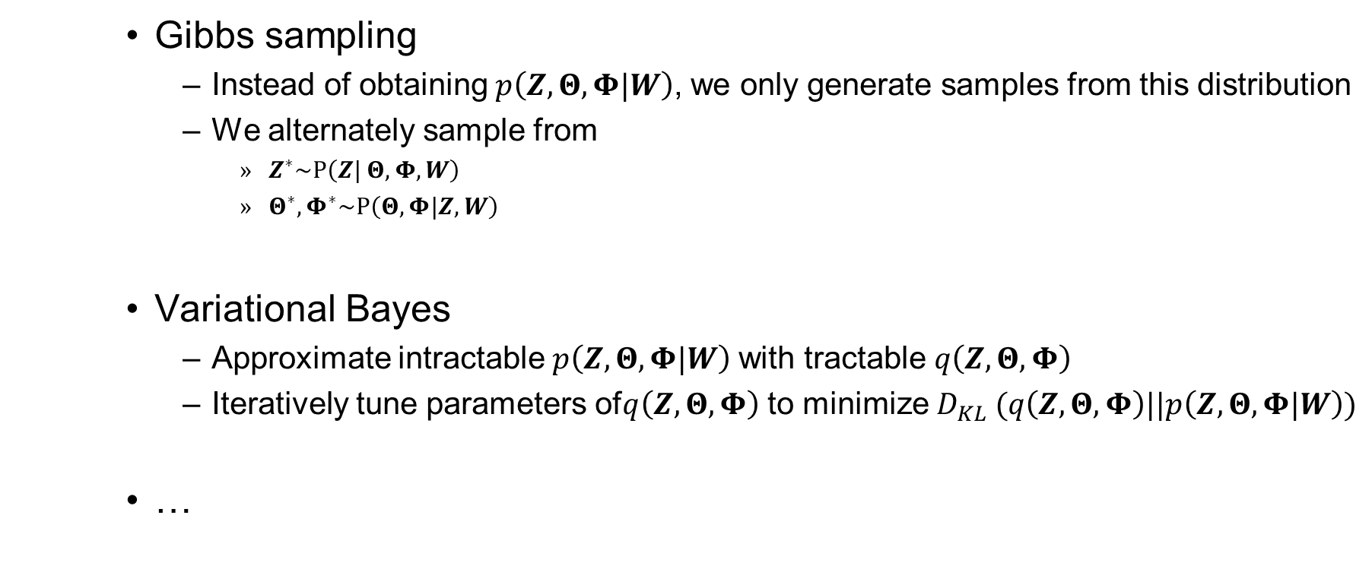
Approximate inference
(for Bayesian LDA)
    Gibbs sampling
      Instead of obtaining$p\left(Z,Θ,Φ|W\right)$, we only generate samples from this distribution
      We alternately sample from
        $Z^{∗}\sim P\left(Z| Θ,Φ,W\right)$
        $Θ^{∗}, Φ^{∗}\sim P\left(Θ,Φ|Z,W\right)$
    Variational Bayes
      Approximate intractable$p\left(Z,Θ,Φ|W\right)$ with tractable $q\left(Z,Θ,Φ\right)$
      Iteratively tune parameters of$q\left(Z,Θ,Φ\right)$ to minimize $D_{KL} (q\left(Z,Θ,Φ\right)||p\left(Z,Θ,Φ|W\right))$
    …

Slide 12

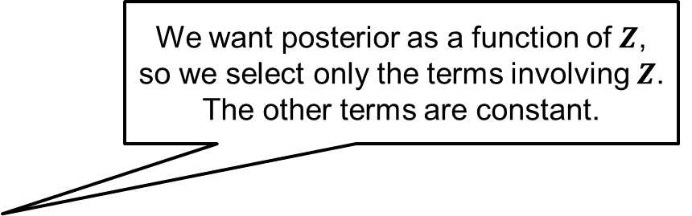
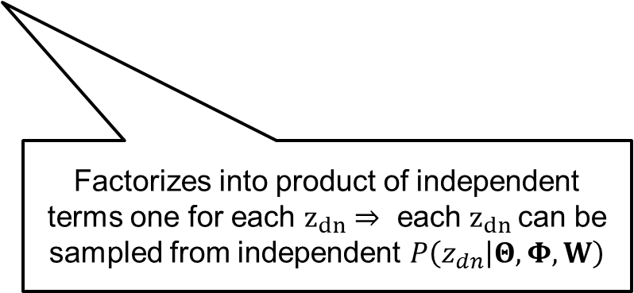
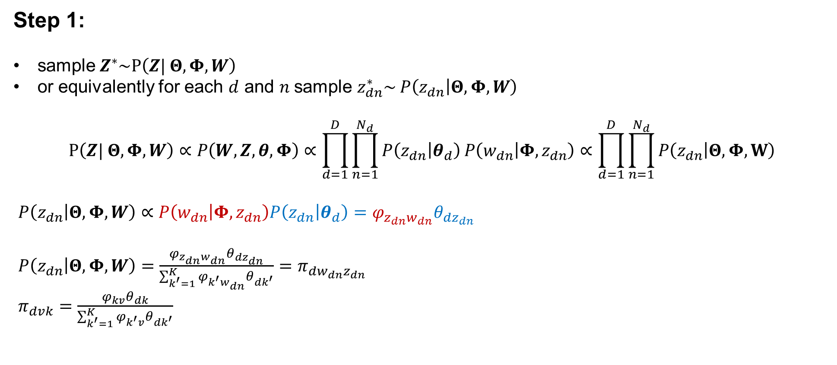
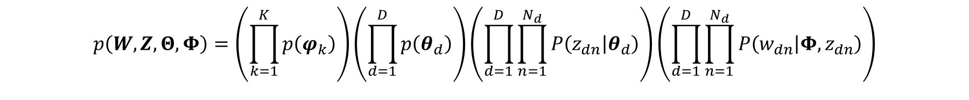
GS inference for LDA: Sampling $Z$
$$p\left(W,Z,Θ,Φ\right)=\left(\prod_{k=1}^{K}{p\left(φ_{k}\right)}\right)\left(\prod_{d=1}^{D}{p\left(θ_{d}\right)}\right)\left(\prod_{d=1}^{D}{\prod_{n=1}^{N_{d}}{P\left(z_{dn} | θ_{d}\right)}}\right)\left(\prod_{d=1}^{D}{\prod_{n=1}^{N_{d}}{P\left(w_{dn} | Φ, z_{dn}\right)}}\right)$$
Step 1:
sample$Z^{∗}\sim P\left(Z| Θ,Φ,W\right)$
or equivalently for each $d$ and $n$ sample $z_{dn}^{∗}\sim$ $P\left(z_{dn} | Θ,Φ,W\right)$
$$P\left(Z| Θ,Φ,W\right)∝P\left(W,Z,θ,Φ\right)∝\prod_{d=1}^{D}{\prod_{n=1}^{N_{d}}{P\left(z_{dn} | θ_{d}\right)}}P\left(w_{dn} | Φ, z_{dn}\right)∝\prod_{d=1}^{D}{\prod_{n=1}^{N_{d}}{P\left(z_{dn} | Θ,Φ,W\right)}}$$
$P\left(z_{dn} | Θ,Φ,W\right)∝P\left(w_{dn} | Φ,z_{dn}\right)P\left(z_{dn} | θ_{d}\right)=φ_{z_{dn}w_{dn}}θ_{dz_{dn}}$
$P\left(z_{dn} | Θ,Φ,W\right)=\frac{φ_{z_{dn}w_{dn}}θ_{dz_{dn}}}{\sum_{k^{′}=1}^{K}{φ_{k^{′}w_{dn}}θ_{dk^{′}}}}=π_{dw_{dn}z_{dn}}$
$π_{dvk}=\frac{φ_{kv}θ_{dk}}{\sum_{k^{′}=1}^{K}{φ_{k^{′}v}θ_{dk^{′}}}}$
We want posterior as a function of $Z$, so we select only the terms involving $Z$. The other terms are constant.
Factorizes into product of independent terms one for each $z_{dn}⇒$ each $z_{dn}$can be sampled from independent $P\left(z_{dn} | Θ,Φ,W\right)$

Slide 13

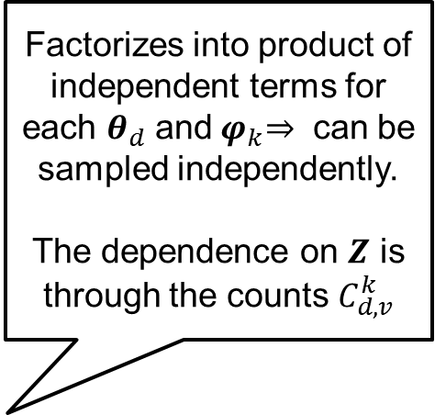
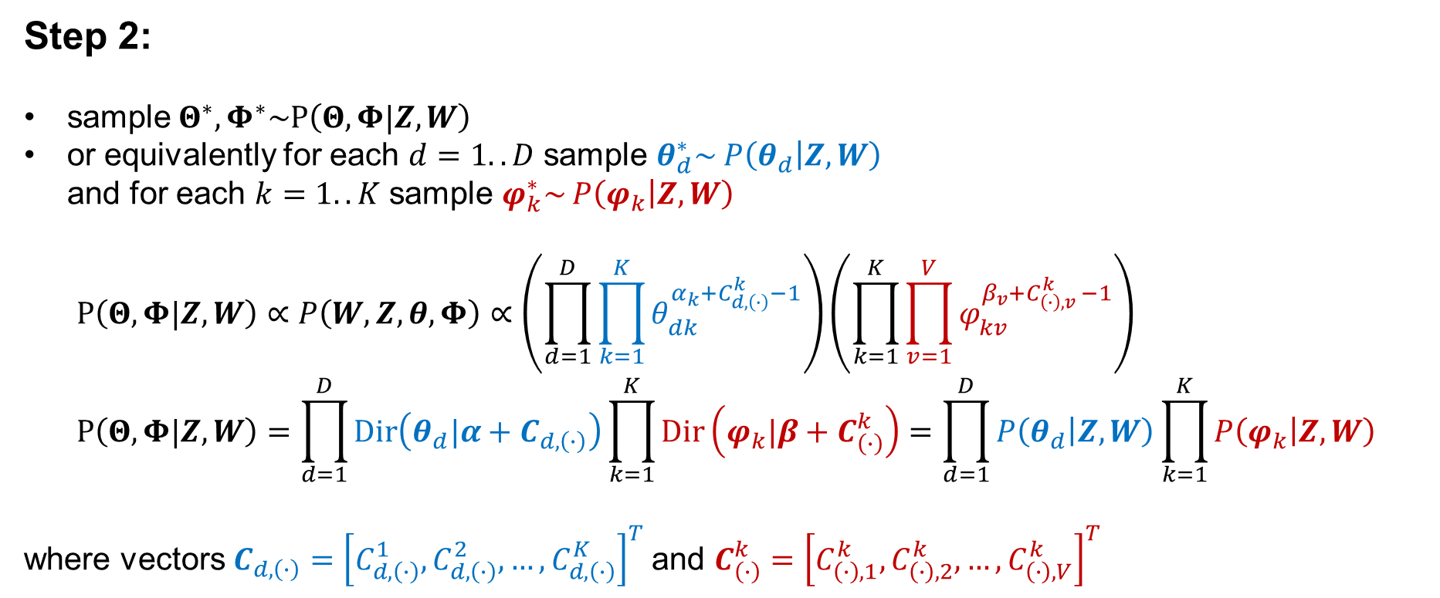

GS inference for LDA: Sampling $Θ$ and $Φ$
$$p\left(W,Z,Θ,Φ\right)∝\left(\prod_{k=1}^{K}{\prod_{v=1}^{V}{φ_{kv}^{β_{v}−1}}}\right)\left(\prod_{d=1}^{D}{\prod_{k=1}^{K}{θ_{dk}^{α_{k}−1}}}\right)\left(\prod_{d=1}^{D}{\prod_{k=1}^{K}{θ_{dk}^{C_{d,\left(∙\right)}^{k}}}}\right)\left(\prod_{k=1}^{K}{\prod_{v=1}^{V}{φ_{kv}^{C_{\left(∙\right),v }^{k}}}}\right)$$
Step 2:
sample$Θ^{∗}, Φ^{∗}\sim P\left(Θ,Φ|Z,W\right)$
or equivalently for each $d=1..D$ sample $θ_{d}^{∗}\sim$ $P\left(θ_{d} | Z,W\right)$
and for each $k=1..K$ sample $φ_{k}^{∗}\sim$ $P\left(φ_{k} | Z,W\right)$
$$P\left(Θ,Φ|Z,W\right)∝P\left(W,Z,θ,Φ\right)∝\left(\prod_{d=1}^{D}{\prod_{k=1}^{K}{θ_{dk}^{α_{k}+C_{d,\left(∙\right)}^{k}−1}}}\right)\left(\prod_{k=1}^{K}{\prod_{v=1}^{V}{φ_{kv}^{β_{v}+C_{\left(∙\right),v }^{k}−1}}}\right) \\ P\left(Θ,Φ|Z,W\right)=\prod_{d=1}^{D}{Dir\left(θ_{d}|α+C_{d,\left(∙\right)}\right)}\prod_{k=1}^{K}{Dir\left(φ_{k}|β+C_{\left(∙\right)}^{k}\right)}=\prod_{d=1}^{D}{P\left(θ_{d} | Z,W\right)}\prod_{k=1}^{K}{P\left(φ_{k} | Z,W\right)}$$
where vectors $C_{d,\left(∙\right)}={\left[C_{d,\left(∙\right)}^{1},C_{d,\left(∙\right)}^{2},…, C_{d,\left(∙\right)}^{K}\right]}^{T}$and $C_{\left(∙\right)}^{k}={\left[C_{\left(∙\right),1}^{k},C_{\left(∙\right),2}^{k},…,C_{\left(∙\right),V}^{k}\right]}^{T}$
Factorizes into product of independent terms for each $θ_{d}$ and${ φ}_{k}⇒$ can be sampled independently.
The dependence on $Z$ is through the counts $C_{d,v}^{k}$

Slide 14
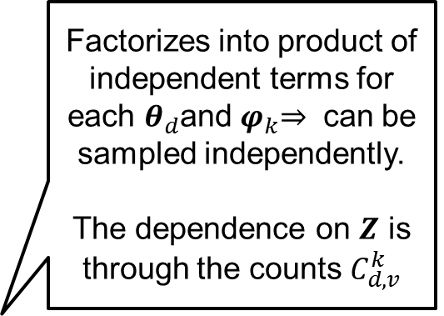
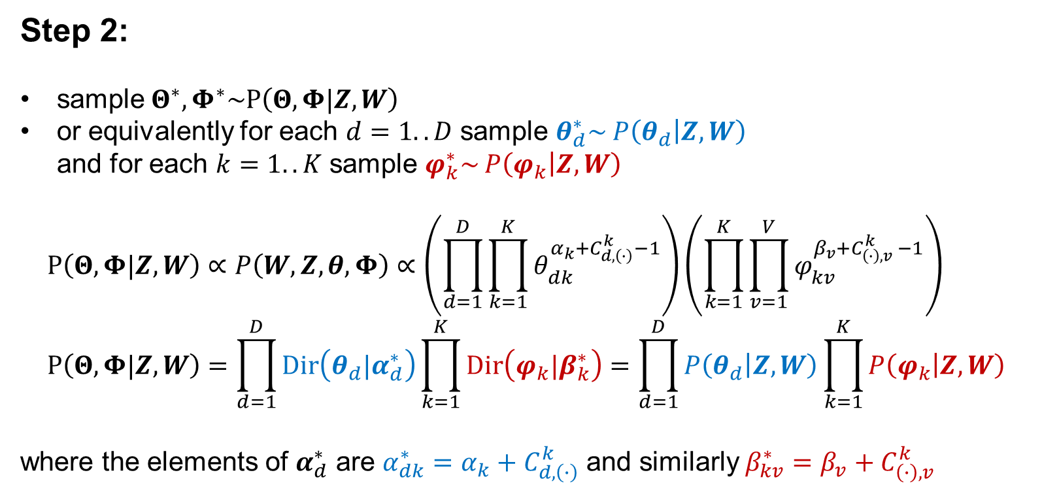
GS inference for LDA: Sampling $Θ$ and $Φ$
$$p\left(W,Z,Θ,Φ\right)∝\left(\prod_{k=1}^{K}{\prod_{v=1}^{V}{φ_{kv}^{β_{v}−1}}}\right)\left(\prod_{d=1}^{D}{\prod_{k=1}^{K}{θ_{dk}^{α_{k}−1}}}\right)\left(\prod_{d=1}^{D}{\prod_{k=1}^{K}{θ_{dk}^{C_{d,\left(∙\right)}^{k}}}}\right)\left(\prod_{k=1}^{K}{\prod_{v=1}^{V}{φ_{kv}^{C_{\left(∙\right),v }^{k}}}}\right)$$
Step 2:
sample$Θ^{∗}, Φ^{∗}\sim P\left(Θ,Φ|Z,W\right)$
or equivalently for each $d=1..D$ sample $θ_{d}^{∗}\sim$ $P\left(θ_{d} | Z,W\right)$
and for each $k=1..K$ sample $φ_{k}^{∗}\sim$ $P\left(φ_{k} | Z,W\right)$
$$P\left(Θ,Φ|Z,W\right)∝P\left(W,Z,θ,Φ\right)∝\left(\prod_{d=1}^{D}{\prod_{k=1}^{K}{θ_{dk}^{α_{k}+C_{d,\left(∙\right)}^{k}−1}}}\right)\left(\prod_{k=1}^{K}{\prod_{v=1}^{V}{φ_{kv}^{β_{v}+C_{\left(∙\right),v }^{k}−1}}}\right) \\ P\left(Θ,Φ|Z,W\right)=\prod_{d=1}^{D}{Dir\left(θ_{d}|α_{d}^{∗}\right)}\prod_{k=1}^{K}{Dir\left(φ_{k}|β_{k}^{∗}\right)}=\prod_{d=1}^{D}{P\left(θ_{d} | Z,W\right)}\prod_{k=1}^{K}{P\left(φ_{k} | Z,W\right)}$$
where the elements of $α_{d}^{∗}$ are $α_{dk}^{∗}=$ $α_{k}+C_{d,\left(∙\right)}^{k}$ and similarly $β_{kv}^{∗}=β_{v}+C_{\left(∙\right),v }^{k}$
Factorizes into product of independent terms for each $θ_{d}$and${ φ}_{k}⇒$ can be sampled independently.
The dependence on $Z$ is through the counts $C_{d,v}^{k}$

Slide 15
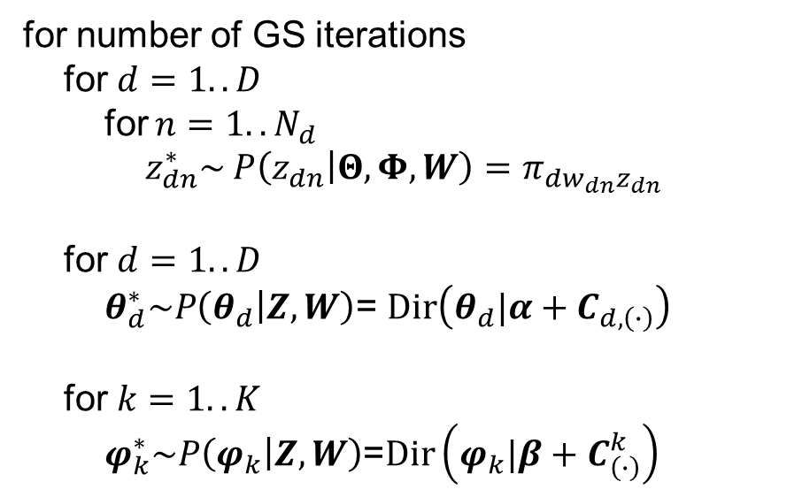
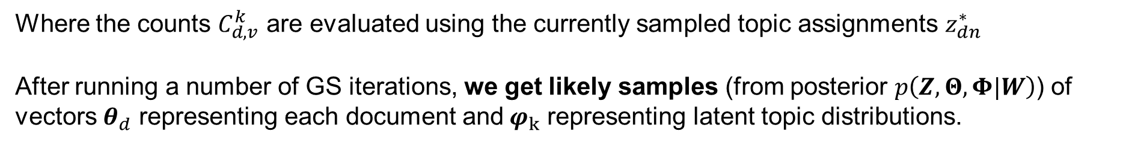
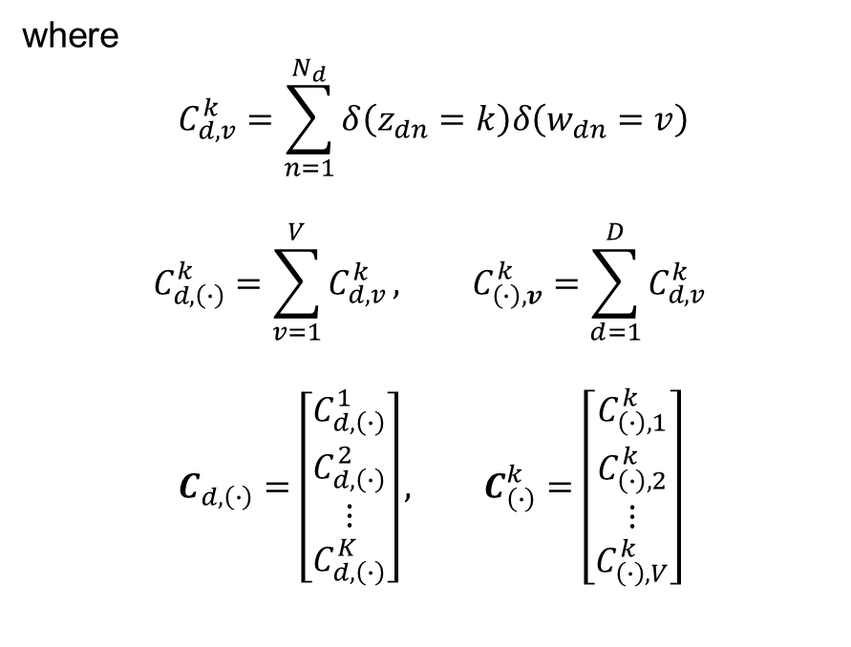
GS inference for LDA: Summary
for number of GS iterations
for $d=1..D$
for $n=1..N_{d}$
$z_{dn}^{∗}\sim$ $P\left(z_{dn} | Θ,Φ,W\right)=π_{dw_{dn}z_{dn}}$
for $d=1..D$
$θ_{d}^{∗}\sim P\left(θ_{d} | Z,W\right)$= $Dir\left(θ_{d}|α+C_{d,\left(∙\right)}\right)$
for $k=1..K$
$φ_{k}^{∗}\sim P\left(φ_{k} | Z,W\right)$=$Dir\left(φ_{k}|β+C_{\left(∙\right)}^{k}\right)$
where
$$C_{d,v}^{k}=\sum_{n=1}^{N_{d}}{δ\left(z_{dn}=k\right)δ\left(w_{dn}=v\right)}$$
$$C_{d,\left(∙\right)}^{k}=\sum_{v=1}^{V}{C_{d,v}^{k}}, C_{\left(∙\right),v}^{k}=\sum_{d=1}^{D}{C_{d,v}^{k}}$$
$$C_{d,\left(∙\right)}=\left[\begin{matrix}C_{d,\left(∙\right)}^{1} \\ C_{d,\left(∙\right)}^{2} \\ ⋮ \\ C_{d,\left(∙\right)}^{K}\end{matrix}\right], C_{\left(∙\right)}^{k}=\left[\begin{matrix}C_{\left(∙\right),1}^{k} \\ C_{\left(∙\right),2}^{k} \\ ⋮ \\ C_{\left(∙\right),V}^{k}\end{matrix}\right]$$
Where the counts $C_{d,v}^{k}$ are evaluated using the currently sampled topic assignments $z_{dn}^{∗}$
After running a number of GS iterations, we get likely samples (from posterior $p\left(Z,Θ,Φ|W\right)$) of vectors $θ_{d}$ representing each document and$φ_{k}$ representing latent topic distributions.

Slide 16
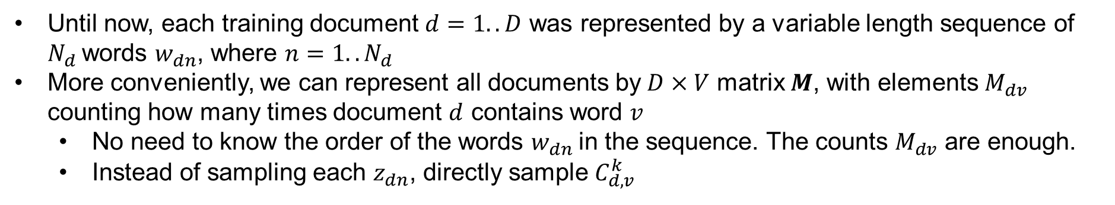
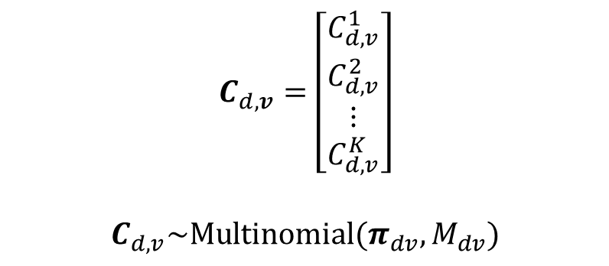
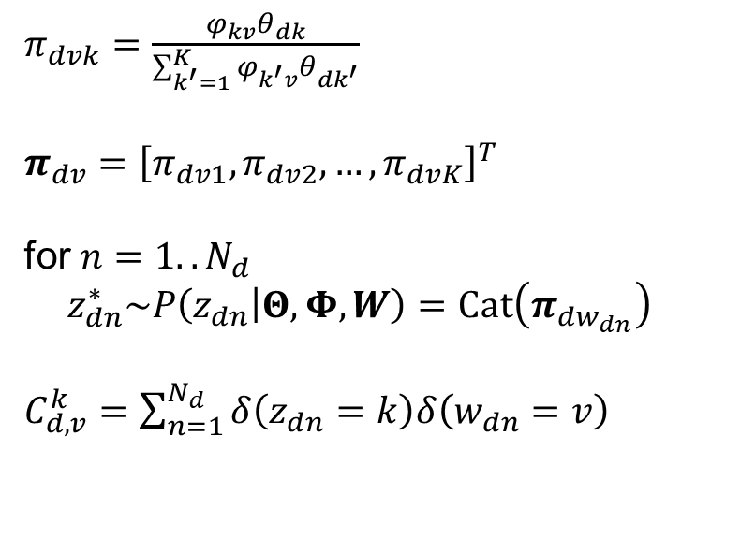
GS inference for LDA: Using word counts
Until now, each training document $d=1..D$ was represented by a variable length sequence of $N_{d}$words $w_{dn}$, where $n=1..N_{d}$
More conveniently, we can represent all documents by$D×V$ matrix $M$, with elements $M_{dv}$ counting how many times document $d$ contains word $v$
  No need to know the order of the words $w_{dn}$in the sequence. The counts $M_{dv}$ are enough.
  Instead of sampling each $z_{dn}$, directly sample $C_{d,v}^{k}$
$π_{dvk}=\frac{φ_{kv}θ_{dk}}{\sum_{k^{′}=1}^{K}{φ_{k^{′}v}θ_{dk^{′}}}}$
$π_{dv}={\left[π_{dv1},π_{dv2},…,π_{dvK}\right]}^{T}$
for $n=1..N_{d}$
$z_{dn}^{∗}\sim P\left(z_{dn} | Θ,Φ,W\right)=Cat\left(π_{dw_{dn}}\right)$
$C_{d,v}^{k}=\sum_{n=1}^{N_{d}}{δ\left(z_{dn}=k\right)δ\left(w_{dn}=v\right)}$
$$C_{d,v}=\left[\begin{matrix}C_{d,v}^{1} \\ C_{d,v}^{2} \\ ⋮ \\ C_{d,v}^{K}\end{matrix}\right]$$
$$C_{d,v}\sim Multinomial(π_{dv},M_{dv})$$

Slide 17
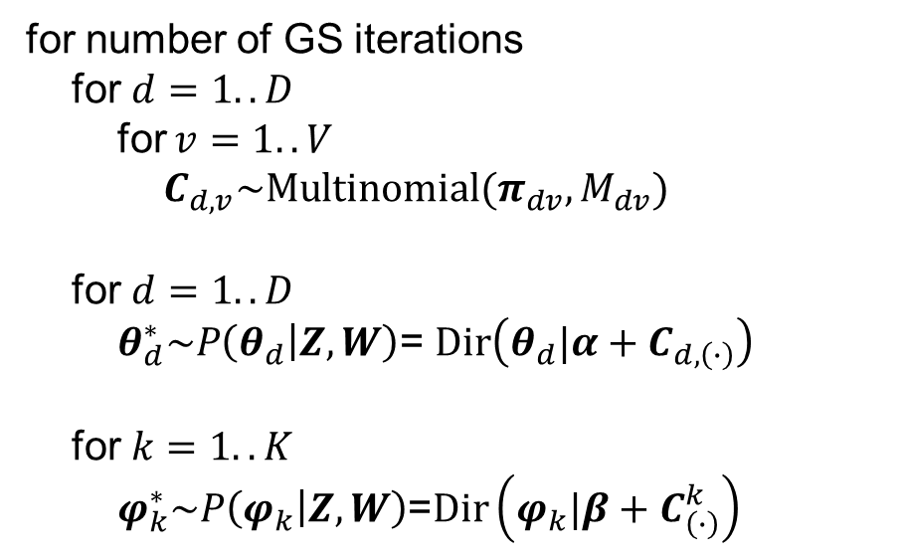
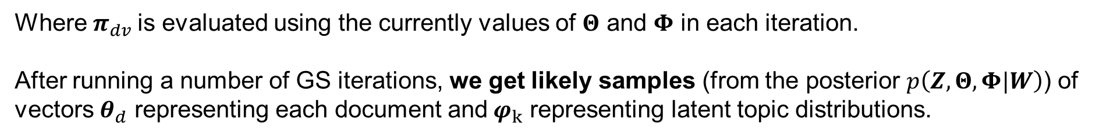
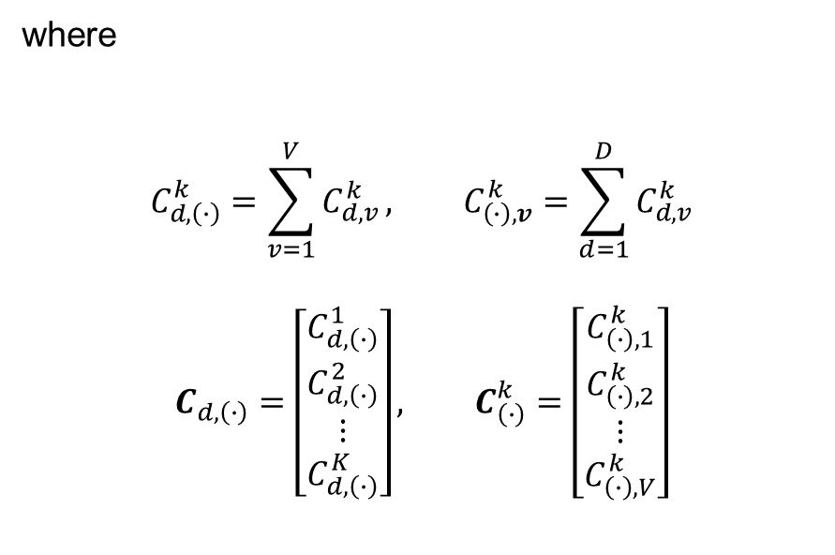
GS inference for LDA: Summary
for number of GS iterations
for $d=1..D$
for $v=1..V$
$C_{d,v}\sim Multinomial(π_{dv},M_{dv})$
for $d=1..D$
$θ_{d}^{∗}\sim P\left(θ_{d} | Z,W\right)$= $Dir\left(θ_{d}|α+C_{d,\left(∙\right)}\right)$
for $k=1..K$
$φ_{k}^{∗}\sim P\left(φ_{k} | Z,W\right)$=$Dir\left(φ_{k}|β+C_{\left(∙\right)}^{k}\right)$
where
$$C_{d,\left(∙\right)}^{k}=\sum_{v=1}^{V}{C_{d,v}^{k}}, C_{\left(∙\right),v}^{k}=\sum_{d=1}^{D}{C_{d,v}^{k}}$$
$$C_{d,\left(∙\right)}=\left[\begin{matrix}C_{d,\left(∙\right)}^{1} \\ C_{d,\left(∙\right)}^{2} \\ ⋮ \\ C_{d,\left(∙\right)}^{K}\end{matrix}\right], C_{\left(∙\right)}^{k}=\left[\begin{matrix}C_{\left(∙\right),1}^{k} \\ C_{\left(∙\right),2}^{k} \\ ⋮ \\ C_{\left(∙\right),V}^{k}\end{matrix}\right]$$
Where $π_{dv}$is evaluated using the currently values of $Θ$ and $Φ$ in each iteration.
After running a number of GS iterations, we get likely samples (from the posterior $p\left(Z,Θ,Φ|W\right)$) of vectors $θ_{d}$ representing each document and$φ_{k}$ representing latent topic distributions.

Slide 18
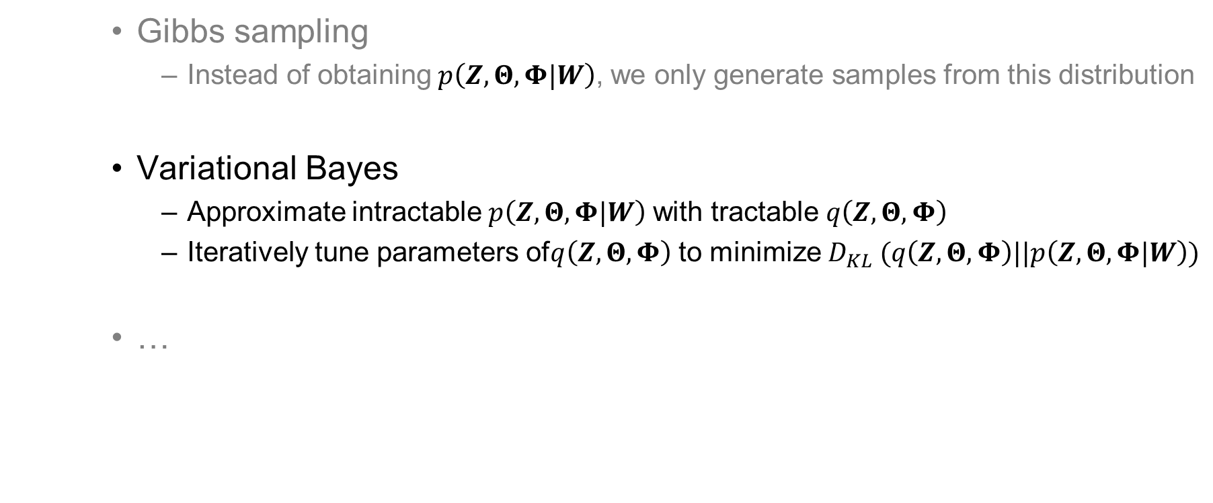
Approximate inference
(for Bayesian LDA)
    Gibbs sampling
      Instead of obtaining$p\left(Z,Θ,Φ|W\right)$, we only generate samples from this distribution
    Variational Bayes
      Approximate intractable$p\left(Z,Θ,Φ|W\right)$ with tractable $q\left(Z,Θ,Φ\right)$
      Iteratively tune parameters of$q\left(Z,Θ,Φ\right)$ to minimize $D_{KL} (q\left(Z,Θ,Φ\right)||p\left(Z,Θ,Φ|W\right))$
    …

Slide 19
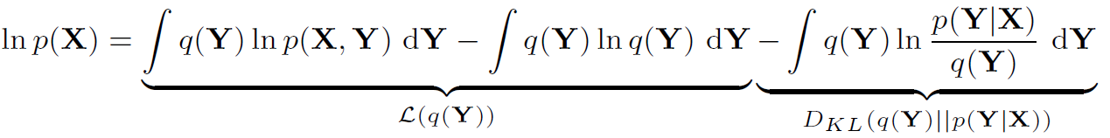
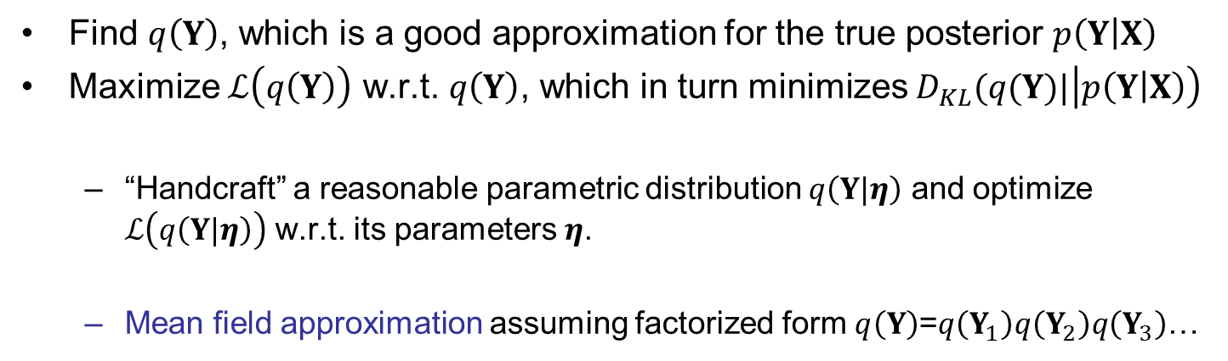
Variational Bayes
Find $q\left(Y\right)$, which is a good approximation for the true posterior $p\left(Y | X\right)$
Maximize $ℒ\left(q\left(Y\right)\right)$ w.r.t. $q\left(Y\right)$, which in turn minimizes $D_{KL}(q(Y)|\left|p\left(Y | X\right)\right)$
  “Handcraft” a reasonable parametric distribution $q\left(Y|η\right)$ and optimize $ℒ\left(q\left(Y|η\right)\right)$ w.r.t. its parameters $η$.
  Mean field approximation assuming factorized form $q\left(Y\right)$=$q\left(Y_{1}\right)q\left(Y_{2}\right)q\left(Y_{3}\right)$…

Slide 20
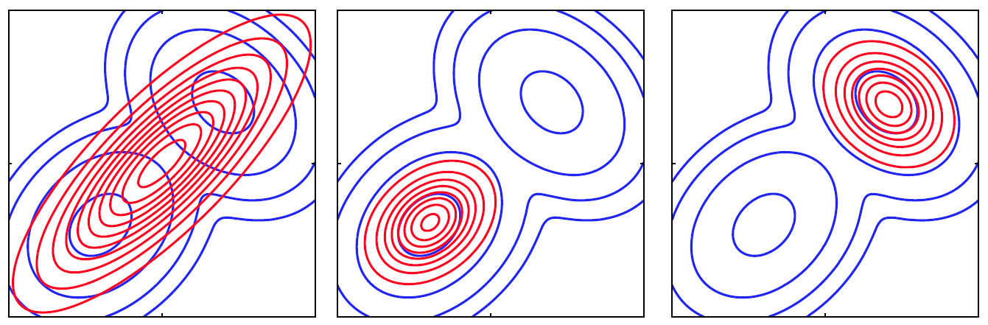

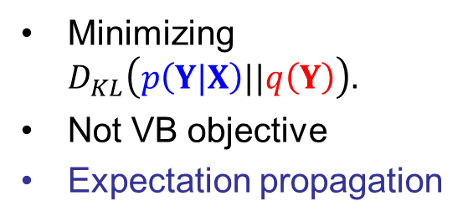
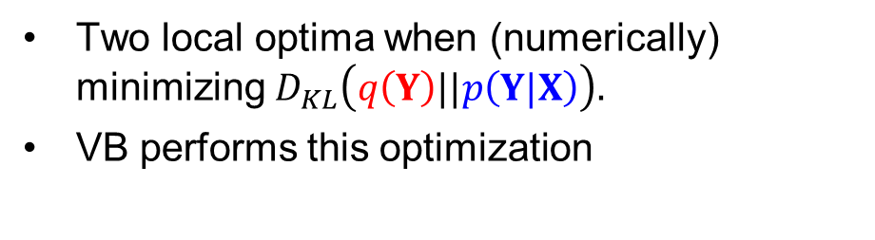
Minimizing Kullback-Leibler divergence
We optimize parameters of (simpler) distribution $q\left(Y\right)$ to minimize Kullback-Leibler divergence between $q\left(Y\right)$ and $p\left(Y|X\right).$
Minimizing $D_{KL}\left(p\left(Y|X\right)||q\left(Y\right)\right).$
Not VB objective
Expectation propagation
Two local optima when (numerically) minimizing $D_{KL}\left(q\left(Y\right)||p\left(Y|X\right)\right).$
VB performs this optimization

Slide 21
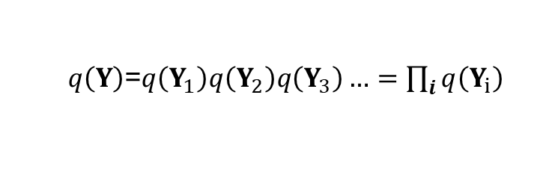
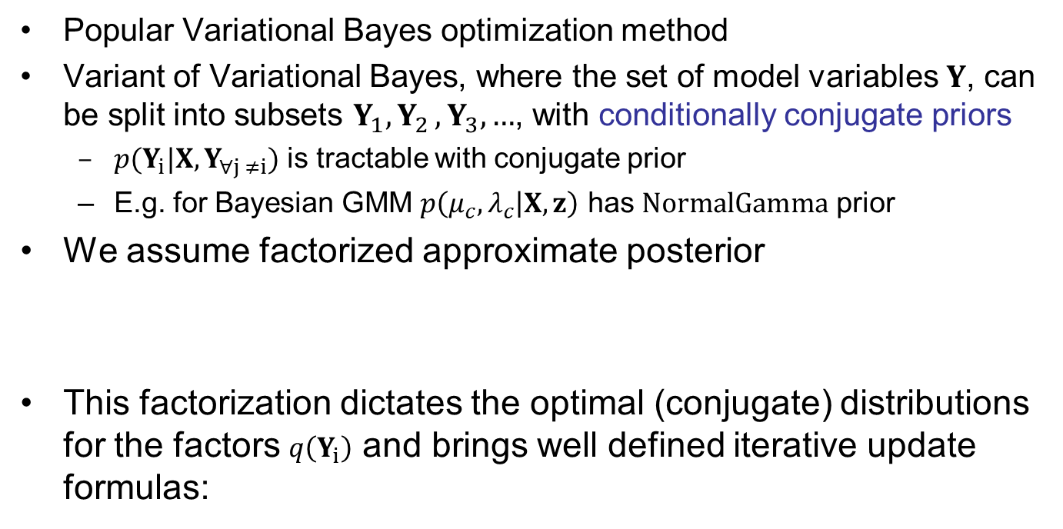
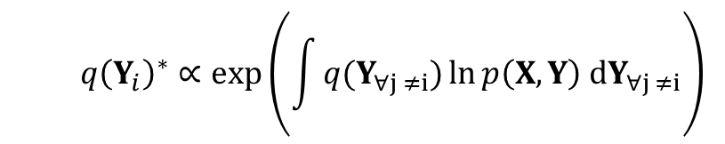
VB – Mean field approximation
Popular Variational Bayes optimization method
Variant of Variational Bayes, where the set of model variables $Y$, can be split into subsets $Y_{1}{,Y}_{2},Y_{3}, …$, with conditionally conjugate priors
  ${p(Y}_{i}|X, Y_{∀j ≠i})$ is tractable with conjugate prior
  E.g. for Bayesian GMM $p\left(μ_{c},λ_{c} | X,z\right)$ has $NormalGamma$ prior
We assume factorized approximate posterior
This factorization dictates the optimal (conjugate) distributions for the factors $q\left(Y_{i}\right)$ and brings well defined iterative update formulas:
  $q\left(Y\right)$=$q\left(Y_{1}\right)q\left(Y_{2}\right)q\left(Y_{3}\right)…=\prod_{i}{q\left(Y_{i}\right)}$
  $$q{\left(Y_{i}\right)}^{∗}∝exp\left(\int{q(Y_{∀j ≠i})\ln{p\left(X,Y\right) dY_{∀j ≠i}}}\right)$$

Slide 22
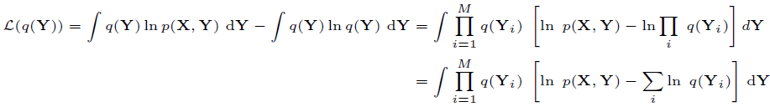

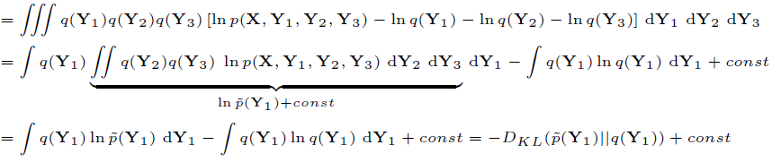


Mean field - update
For example, let $M=3$
Now, lets optimize the lower bound $ℒ\left(q\left(Y_{1}\right)\right)$ w.r.t only one distribution $q\left(Y_{1}\right)$
where $\tilde{p}\left(Y_{1}\right)$ is normalized to be a valid distribution (therefore $+const$)
$ℒ\left(q\left(Y_{1}\right)\right)$ is maximized by setting the $D_{KL}$term to zero, which implies
In general, we can iteratively update each $q\left(Y_{i}\right)$ given the others $q\left(Y_{i≠j}\right)$ as:
where each update guaranties to improve the lower bound $ℒ\left(q\left(Y\right)\right)$

Slide 23
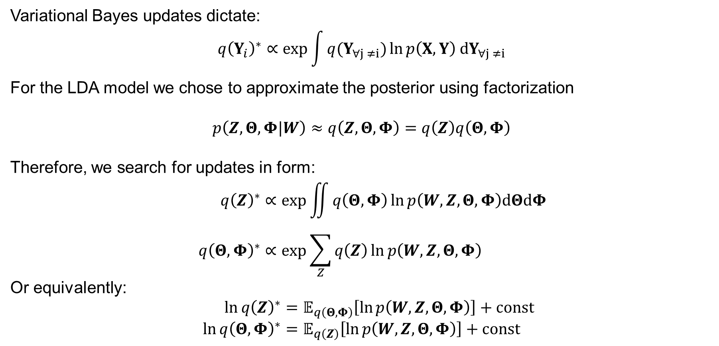
Variational Bayes for LDA
Variational Bayes updates dictate:
$$q{\left(Y_{i}\right)}^{∗}∝\exp{\int{q(Y_{∀j ≠i})\ln{p\left(X,Y\right) dY_{∀j ≠i}}}}$$
For the LDA model we chose to approximate the posterior using factorization
$$p\left(Z,Θ,Φ|W\right)≈q\left(Z,Θ,Φ\right)=q\left(Z\right)q\left(Θ,Φ\right)$$
Therefore, we search for updates in form:
$$q{\left(Z\right)}^{∗}∝\exp{\iint{q\left(Θ,Φ\right)\ln{p\left(W,Z,Θ,Φ\right)dΘdΦ}}} \\ q{\left(Θ,Φ\right)}^{∗}∝\exp{\sum_{Z}{q\left(Z\right)\ln{p\left(W,Z,Θ,Φ\right)}}}$$
Or equivalently:
$$\ln{{q\left(Z\right)}^{∗}}=𝔼_{q\left(Θ,Φ\right)}\left[\ln{p\left(W,Z,Θ,Φ\right)}\right]+const \\ \ln{{q\left(Θ,Φ\right)}^{∗}}=𝔼_{q\left(Z\right)}\left[\ln{p\left(W,Z,Θ,Φ\right)}\right]+const$$

Slide 24
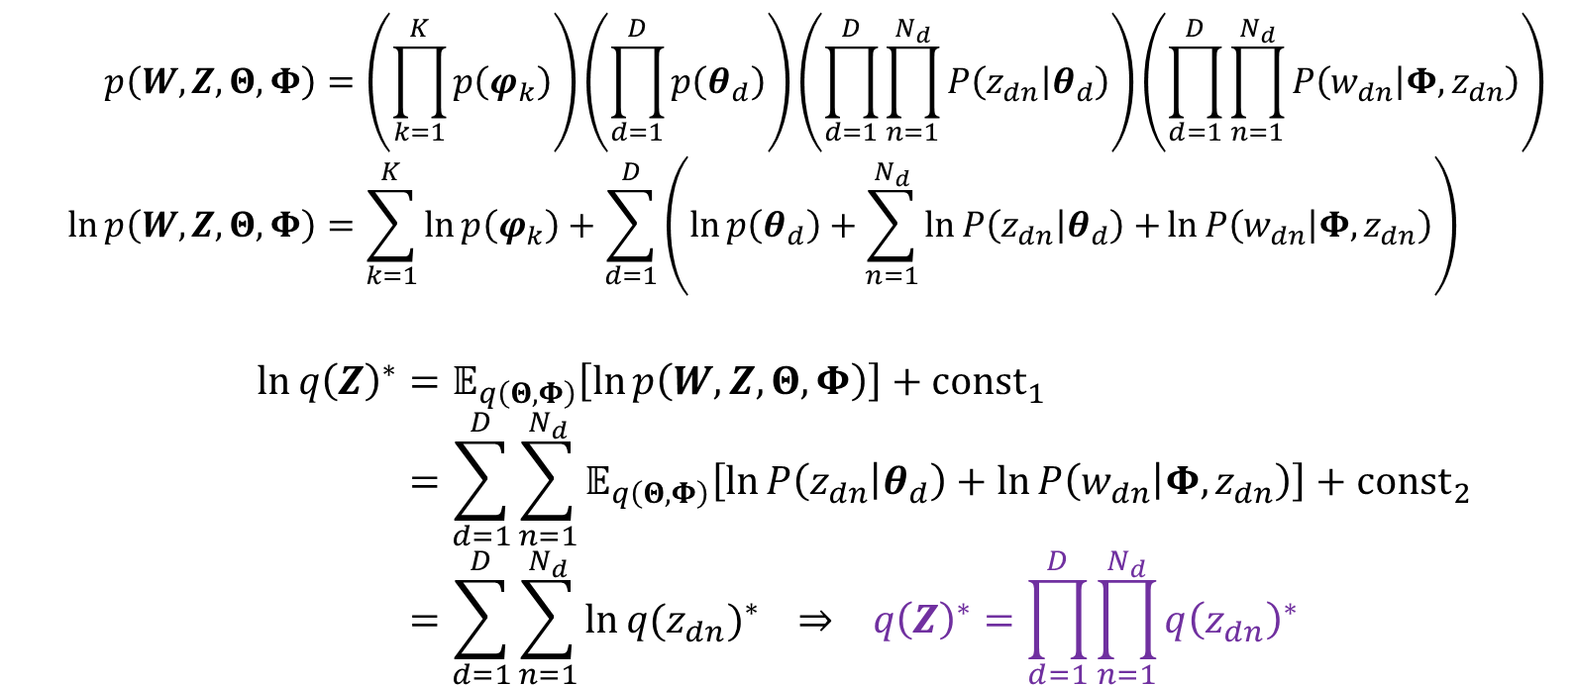


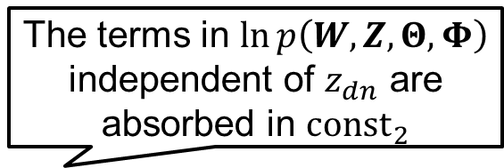
VB update for $q\left(Z\right)$
$$p\left(W,Z,Θ,Φ\right)=\left(\prod_{k=1}^{K}{p\left(φ_{k}\right)}\right)\left(\prod_{d=1}^{D}{p\left(θ_{d}\right)}\right)\left(\prod_{d=1}^{D}{\prod_{n=1}^{N_{d}}{P\left(z_{dn} | θ_{d}\right)}}\right)\left(\prod_{d=1}^{D}{\prod_{n=1}^{N_{d}}{P\left(w_{dn} | Φ, z_{dn}\right)}}\right) \\ \ln{p\left(W,Z,Θ,Φ\right)}=\sum_{k=1}^{K}{\ln{p\left(φ_{k}\right)}}+\sum_{d=1}^{D}{\left(\ln{p\left(θ_{d}\right)}+\sum_{n=1}^{N_{d}}{\ln{P\left(z_{dn} | θ_{d}\right)+}}\ln{P\left(w_{dn} | Φ, z_{dn}\right)}\right)}$$
$$\ln{{q\left(Z\right)}^{∗}}=𝔼_{q\left(Θ,Φ\right)}\left[\ln{p\left(W,Z,Θ,Φ\right)}\right]+{const}_{1} \\ =\sum_{d=1}^{D}{\sum_{n=1}^{N_{d}}{𝔼_{q\left(Θ,Φ\right)}\left[\ln{P\left(z_{dn} | θ_{d}\right)+\ln{P\left(w_{dn} | Φ, z_{dn}\right)}}\right]+{const}_{2}}} \\ =\sum_{d=1}^{D}{\sum_{n=1}^{N_{d}}{\ln{{q(z_{dn})}^{∗}}}} ⇒ {q\left(Z\right)}^{∗}=\prod_{d=1}^{D}{\prod_{n=1}^{N_{d}}{{q\left(z_{dn}\right)}^{∗}}}$$
The terms in $\ln{p\left(W,Z,Θ,Φ\right)}$ independent of $z_{dn}$ are absorbed in ${const}_{2}$
We only require factorization $q\left(Z\right)q\left(Θ,Φ\right)$, but $q\left(Z\right)$ automatically further factorizes into a product of independent categorical distributions one for each $z_{dn}$- so called induced factorization
We will derive the update for distributions $q\left(z_{dn}\right)$ later.

Slide 25
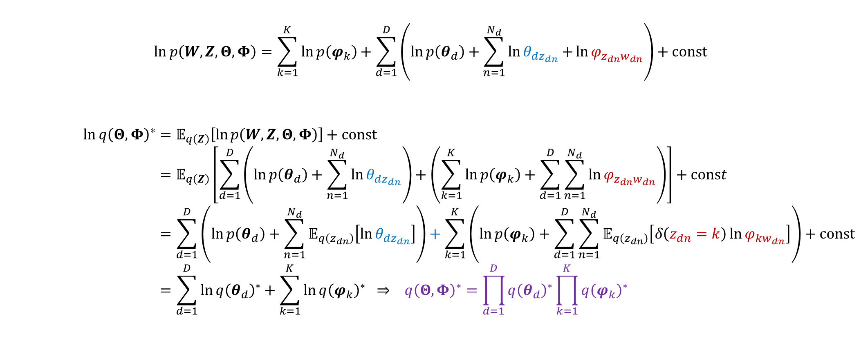

VB update for $q\left(Θ,Φ\right)$
$$\ln{p\left(W,Z,Θ,Φ\right)}=\sum_{k=1}^{K}{\ln{p\left(φ_{k}\right)}}+\sum_{d=1}^{D}{\left(\ln{p\left(θ_{d}\right)}+\sum_{n=1}^{N_{d}}{\ln{θ_{dz_{dn}}+}}\ln{φ_{z_{dn}w_{dn}}}\right)+const}$$
$$\ln{{q\left(Θ,Φ\right)}^{∗}}=𝔼_{q\left(Z\right)}\left[\ln{p\left(W,Z,Θ,Φ\right)}\right]+const \\ =𝔼_{q\left(Z\right)}\left[\sum_{d=1}^{D}{\left(\ln{p\left(θ_{d}\right)}+\sum_{n=1}^{N_{d}}{\ln{θ_{dz_{dn}}}}\right)}+\left(\sum_{k=1}^{K}{\ln{p\left(φ_{k}\right)}+\sum_{d=1}^{D}{\sum_{n=1}^{N_{d}}{\ln{φ_{z_{dn}w_{dn}}}}}}\right)\right]+const \\ =\sum_{d=1}^{D}{\left(\ln{p\left(θ_{d}\right)}+\sum_{n=1}^{N_{d}}{𝔼_{q\left(z_{dn}\right)}\left[\ln{θ_{dz_{dn}}}\right]}\right)}+\sum_{k=1}^{K}{\left(\ln{p\left(φ_{k}\right)}+\sum_{d=1}^{D}{\sum_{n=1}^{N_{d}}{𝔼_{q\left(z_{dn}\right)}\left[δ\left(z_{dn}=k\right)\ln{φ_{kw_{dn}}}\right]}}\right)}+const \\ =\sum_{d=1}^{D}{{\ln{q\left(θ_{d}\right)}}^{∗}}+\sum_{k=1}^{K}{{\ln{q\left(φ_{k}\right)}}^{∗}} ⇒ {q\left(Θ,Φ\right)}^{∗}=\prod_{d=1}^{D}{{q\left(θ_{d}\right)}^{∗}}\prod_{k=1}^{K}{{q\left(φ_{k}\right)}^{∗}}$$
induced factorization

Slide 26

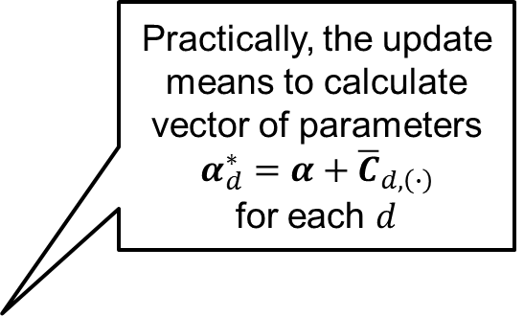


VB update for $q\left(θ_{d}\right)$
$$\ln{{q\left(θ_{d}\right)}^{∗}}=\ln{Dir\left(θ_{d}|α\right)}+\sum_{n=1}^{N_{d}}{𝔼_{q\left(z_{dn}\right)}\left[\ln{θ_{dz_{dn}}}\right]}+const \\ =\left(\sum_{k=1}^{K}{α_{k}−1\ln{θ_{dk}}}\right)+\sum_{n=1}^{N_{d}}{\sum_{k=1}^{K}{q(z_{dn}=k)}\ln{θ_{dk}}}+const \\ =\sum_{k=1}^{K}{\left(α_{k}−1+\sum_{n=1}^{N_{d}}{q(z_{dn}=k)}\right)\ln{θ_{dk}}}+const \\ =\sum_{k=1}^{K}{\left(α_{k}+{\overline{C}}_{d,\left(∙\right)}^{k}−1\right)\ln{θ_{dk}}}+const \\ =\ln{Dir\left(θ_{d}|α+{\overline{C}}_{d,\left(∙\right)}\right)}$$
where
$${\overline{C}}_{d,\left(∙\right)}^{k}=\sum_{n=1}^{N_{d}}{q\left(z_{dn}=k\right)} \\ {\overline{C}}_{d,\left(∙\right)}=\left[{\overline{C}}_{d,\left(∙\right)}^{1},{\overline{C}}_{d,\left(∙\right)}^{2},…,{\overline{C}}_{d,\left(∙\right)}^{K}\right]$$
$${q\left(θ_{d}\right)}^{∗}=Dir\left(θ_{d}|α+{\overline{C}}_{d,\left(∙\right)}\right)=Dir\left(θ_{d}|α_{d}^{∗}\right)$$
Practically, the update means to calculate vector of parameters $α_{d}^{∗}=α+{\overline{C}}_{d,\left(∙\right)}$
for each $d$
Expected counts similar to the hard counts $C_{d,\left(∙\right)}^{k}$ from GS

Slide 27



VB update for $q\left(φ_{k}\right)$
$$\ln{{q\left(φ_{k}\right)}^{∗}}=\ln{Dir\left(φ_{k}|β\right)}+\sum_{d=1}^{D}{\sum_{n=1}^{N_{d}}{𝔼_{q\left(z_{dn}\right)}\left[δ\left(z_{dn}=k\right)\ln{φ_{kw_{dn}}}\right]}}+const \\ =\left(\sum_{v=1}^{V}{β_{v}−1\ln{φ_{kv}}}\right)+\sum_{d=1}^{D}{\sum_{n=1}^{N_{d}}{q\left(z_{dn}=k\right)ln{φ_{kw_{dn}}}}}+const \\ =\sum_{v=1}^{V}{\left(β_{v}−1+\sum_{d=1}^{D}{\sum_{n=1}^{N_{d}}{q\left(z_{dn}=k\right)δ\left(w_{dn}=v\right)}}\right)\ln{φ_{kv}}}+const \\ =\sum_{v=1}^{V}{\left(β_{v}+{\overline{C}}_{\left(∙\right),v}^{k}−1\right)\ln{φ_{kv}}}+const \\ =\ln{Dir\left(φ_{k}|β+{\overline{C}}_{\left(∙\right)}^{k}\right)}$$
where
$${\overline{C}}_{\left(∙\right),v}^{k}=\sum_{d=1}^{D}{\sum_{n=1}^{N_{d}}{q\left(z_{dn}=k\right)δ\left(w_{dn}=v\right)}} \\ {\overline{C}}_{\left(∙\right)}^{k}=\left[{\overline{C}}_{\left(∙\right),1}^{k},{\overline{C}}_{\left(∙\right),2}^{k},…,{\overline{C}}_{\left(∙\right),V}^{k}\right]$$
$${q\left(φ_{k}\right)}^{∗}=Dir\left(φ_{k}|β+{\overline{C}}_{\left(∙\right)}^{k}\right)=Dir\left(φ_{k}|β_{k}^{∗}\right)$$
Practically, the update means to calculate vector of parameters
$$β_{k}^{∗}=β+{\overline{C}}_{\left(∙\right)}^{k}$$
for each $k$

Slide 28



VB update for $q\left(z_{dn}\right)$
$$\ln{{q\left(z_{dn}\right)}^{∗}}=𝔼_{q\left(Θ,Φ\right)}\left[\ln{P\left(z_{dn} | θ_{d}\right)+\ln{P\left(w_{dn} | Φ, z_{dn}\right)}}\right]+const \\ =𝔼_{q\left(θ_{d}\right)}\left[\ln{P\left(z_{dn} | θ_{d}\right)}\right]+𝔼_{q\left(φ_{k}\right)}\left[\ln{P\left(w_{dn} | Φ, z_{dn}\right)}\right]+const \\ =𝔼_{q\left(θ_{d}\right)}\left[\ln{θ_{dz_{dn}}}\right]+𝔼_{q\left(φ_{k}\right)}\left[\ln{φ_{z_{dn}w_{dn}}}\right]+const$$
For ${q\left(θ_{d}\right)}^{∗}=Dir\left(θ_{d}|α_{d}^{∗}\right)$ and ${q\left(φ_{k}\right)}^{∗}=Dir\left(φ_{k}|β_{k}^{∗}\right)$
$$\ln{ρ_{dvk}}=𝔼_{q\left(θ_{d}\right)}\left[\ln{θ_{dk}}\right]+𝔼_{q\left(φ_{k}\right)}\left[\ln{φ_{kv}}\right]+const \\ =ψ\left(α_{dk}^{∗}\right)−ψ\left(\sum_{k^{′}=1}^{K}{α_{{dk}^{′}}^{∗}}\right)+ψ\left(β_{kv}^{∗}\right)−ψ\left(\sum_{v^{′}=1}^{V}{β_{kv^{′}}^{∗}}\right)+const$$
Therefore, we update
$${q\left(z_{dn}=k\right)}^{∗}=π_{dw_{dn}k}$$
$$π_{dvk}=\frac{ρ_{dvk}}{\sum_{k^{′}=1}^{K}{ρ_{dvk^{′}}}}$$
Practically, the update means to evaluate 3D matrix with elements $π_{dvk}$

Slide 29



VB inference for LDA using word counts
Again, as for the GS inference, rather than using sequence of words $w_{dn}$, we prefer to represent documents by$D×V$ matrix $M$, with elements $M_{dv}$ counting how many times document $d$ contains word $v$
Instead of estimating each $q\left(z_{dn}=k\right)$, we directly estimate expected counts ${\overline{C}}_{\left(∙\right),v}^{k}$ and ${\overline{C}}_{d,\left(∙\right)}^{k}$
$$q\left(z_{dn}=k\right)=π_{dw_{dn}k} \\ {\overline{C}}_{\left(∙\right),v}^{k}=\sum_{d=1}^{D}{{\overline{C}}_{d,v}^{k}}=\sum_{d=1}^{D}{\sum_{n=1}^{N_{d}}{q\left(z_{dn}=k\right)δ\left(w_{dn}=v\right)}} \\ {\overline{C}}_{d,\left(∙\right)}^{k}=\sum_{v=1}^{V}{{\overline{C}}_{d,v}^{k}}=\sum_{n=1}^{N_{d}}{q\left(z_{dn}=k\right)} \\ {\overline{C}}_{d,v}^{k}=\sum_{n=1}^{N_{d}}{q\left(z_{dn}=k\right)δ\left(w_{dn}=v\right)}=π_{dvk}\sum_{n=1}^{N_{d}}{δ\left(w_{dn}=v\right)}$$
${\overline{C}}_{d,v}^{k}=$ $π_{dvk}M_{dv}$

Slide 30

ELBO objective to monitor progress
$$ℒ\left(q\left(Z,Θ,Φ\right)\right)=𝔼_{q\left(Z,Θ,Φ\right)}\left[\ln{\frac{p\left(W,Z,Θ,Φ\right)}{q\left(Z,Θ,Φ\right)}}\right] \\ =\sum_{d=1}^{D}{\sum_{n=1}^{N_{d}}{𝔼_{q\left(z_{dn}\right)}\left[𝔼_{q\left(θ_{d}\right)}\left[\ln{P\left(z_{dn} | θ_{d}\right)}\right]+𝔼_{q\left(φ_{k}\right)}\left[\ln{P\left(w_{dn} | Φ, z_{dn}\right)}\right]−\ln{q\left(z_{dn}\right)}\right]}} \\ −\sum_{k=1}^{K}{𝔼_{q\left(φ_{k}\right)}\left[\ln{\frac{q\left(φ_{k}\right)}{p\left(φ_{k}\right)}}\right]}−\sum_{d=1}^{D}{𝔼_{q\left(θ_{d}\right)}\left[\ln{\frac{q\left(θ_{d}\right)}{p\left(θ_{d}\right)}}\right]} \\ =\sum_{d=1}^{D}{\sum_{n=1}^{N_{d}}{\sum_{k=1}^{K}{q\left(z_{dn}=k\right)[\ln{ρ_{dw_{dn}k}}−\ln{q\left(z_{dn}=k\right)}]}}}−\sum_{d=1}^{D}{KL\left(q\left(θ_{d}\right)||p\left(θ_{d}\right)\right)}−\sum_{k=1}^{K}{KL\left(q\left(φ_{k}\right)||p\left(φ_{k}\right)\right)} \\ =\sum_{d=1}^{D}{\sum_{v=1}^{V}{\sum_{k=1}^{K}{{\overline{C}}_{d,v}^{k}\left(\ln{ρ_{dvk}}−\ln{π_{dvk}}\right)}}}−\sum_{d=1}^{D}{KL\left(Dir\left(α_{d}^{∗}\right)||Dir\left(α\right)\right)}−\sum_{k=1}^{K}{KL\left(Dir\left(β_{k}^{∗}\right)||Dir\left(β\right)\right)}$$
$$KL\left(Dir\left(α\right)||Dir\left(β\right)\right)=\ln{Γ\left(\sum_{c=1}^{C}{α_{c}}\right)−}\sum_{c=1}^{C}{\ln{Γ\left(α_{c}\right)}}−\ln{Γ\left(\sum_{c=1}^{C}{β_{c}}\right)+}\sum_{c=1}^{C}{\ln{Γ\left(β_{c}\right)}}+\sum_{c=1}^{C}{\left(α_{c}−β_{c}\right)}\left(ψ\left(α_{c}\right)−ψ\left(\sum_{c^{′}=1}^{C}{α_{c^{′}}}\right)\right)$$

Slide 31

Efficient ELBO calculation
$$ℒ\left(q\left(Z,Θ,Φ\right)\right)=\sum_{d=1}^{D}{\sum_{v=1}^{V}{\sum_{k=1}^{K}{{\overline{C}}_{d,v}^{k}\left(\ln{ρ_{dvk}}−\ln{π_{dvk}}\right)}}}−\sum_{d=1}^{D}{KL\left(Dir\left(α_{d}^{∗}\right)||Dir\left(α\right)\right)}−\sum_{k=1}^{K}{KL\left(Dir\left(β_{k}^{∗}\right)||Dir\left(β\right)\right)}$$
Right after updating $q\left(z_{dn}\right)$ (i.e. evaluating the terms $π_{dvk}$), the red term becomes independent of $k$since
$$π_{dvk}=\frac{ρ_{dvk}}{\sum_{k^{′}=1}^{K}{ρ_{dvk^{′}}}}⇒\ln{ρ_{dvk}−}\ln{π_{dvk}=}\ln{\sum_{k^{′}=1}^{K}{ρ_{dvk^{′}}}}$$
Therefore, right after updating $q\left(z_{dn}\right)$ and before updating any $q\left(θ_{d}\right)$ or $q\left(φ_{k}\right),$ we efficiently calculate ELBO $ℒ\left(q\left(Z,Θ,Φ\right)\right)$ as:
$$ℒ\left(q\left(Z,Θ,Φ\right)\right)=\sum_{d=1}^{D}{\sum_{v=1}^{V}{M_{dv}}}\ln{\sum_{k=1}^{K}{ρ_{dvk}}}−\sum_{d=1}^{D}{KL\left(Dir\left(α_{d}^{∗}\right)||Dir\left(α\right)\right)}−\sum_{k=1}^{K}{KL\left(Dir\left(β_{k}^{∗}\right)||Dir\left(β\right)\right)}$$
where we have used $\sum_{k=1}^{K}{{\overline{C}}_{d,v}^{k}}= M_{dv}$, and where we can reuse the terms $\sum_{k^{′}=1}^{K}{ρ_{dvk^{′}}}$ that were just calculated for normalizing the terms $π_{dvk}$.

Slide 32



VB inference for LDA: Summary
for number of VB iterations
for every $d=1..D$, $v=1..V$ and $k=1..K$
$$\ln{ρ_{dvk}}=ψ\left(α_{dk}^{∗}\right)−ψ\left(\sum_{k^{′}=1}^{K}{α_{{dk}^{′}}^{∗}}\right)+ψ\left(β_{kv}^{∗}\right)−ψ\left(\sum_{v^{′}=1}^{V}{β_{kv^{′}}^{∗}}\right) \\ π_{dvk}=\frac{ρ_{dvk}}{\sum_{k^{′}=1}^{K}{ρ_{dvk^{′}}}} \\ {\overline{C}}_{d,v}^{k}=π_{dvk}M_{dv}$$
for $d=1..D$
$α_{d}^{∗}=α+{\overline{C}}_{d,\left(∙\right)}$
for $k=1..K$
$β_{k}^{∗}=β+{\overline{C}}_{\left(∙\right)}^{k}$
where
$${\overline{C}}_{d,\left(∙\right)}^{k}=\sum_{v=1}^{V}{{\overline{C}}_{d,v}^{k}}, {\overline{C}}_{\left(∙\right),v}^{k}=\sum_{d=1}^{D}{{\overline{C}}_{d,v}^{k}}$$
$${\overline{C}}_{d,\left(∙\right)}=\left[\begin{matrix}C_{d,\left(∙\right)}^{1} \\ C_{d,\left(∙\right)}^{2} \\ ⋮ \\ C_{d,\left(∙\right)}^{K}\end{matrix}\right], {\overline{C}}_{\left(∙\right)}^{k}=\left[\begin{matrix}C_{\left(∙\right),1}^{k} \\ C_{\left(∙\right),2}^{k} \\ ⋮ \\ C_{\left(∙\right),V}^{k}\end{matrix}\right]$$
Where $π_{dv}$is evaluated using the currently values of $α_{d}^{∗}$and $β_{k}^{∗}$in each iteration.
After running a number of VB iterations, ${q\left(θ_{d}\right)}^{∗}=Dir\left(θ_{d}|α_{d}^{∗}\right)$and ${q\left(φ_{k}\right)}^{∗}=Dir\left(φ_{k}|β_{k}^{∗}\right)$ are approximate posteriors for all $d=1..D$ and $k=1..K$

