Slide 1
Bayesian Models in Machine Learning
Approximate inference in Bayesian models
Lukáš Burget
BAYa lectures, November 2023

Slide 2
Bayesian Gaussian Mixture Model
We assume that the observed data were generated as follows:
$π \sim Dir(α)$
For Gaussian component $c=1…C$
$μ_{c}, λ_{c} \sim NormalGamma\left(μ_{c}, λ_{c}|m,κ,a,b\right)$
For each observation $n=1…N$
$z_{n} \sim P\left(z_{n} | π\right)=Cat\left(z_{n}|π\right)$
$x_{n} \sim p\left(x_{n} | z_{n},μ,λ\right)=𝒩\left(x_{n}|μ_{z_{n}}, λ_{z_{n}}^{−1}\right)$
The task is to infer the posterior distribution of parameters $p(π,μ_{1}, λ_{1},…μ_{C},λ_{C}|x)$ given some $observed data x=\left[x_{1},x_{2},…,x_{N}\right]$
Intractable: need for approximations
$$π$$
$$α$$
z_{n}
$$m, κ,a,b$$
$$μ_{c}, λ_{c}$$
x_{n}
$$n=1.. N$$
$$c=1..C$$

Slide 3
Approximate inference (for Bayesian GMM)
Variational Bayes
Approximate intractable $p\left(μ, λ,π,z | X\right)$with tractable$q\left(μ, λ,π,z\right)$
Iteratively tune parameters of $q\left(π,μ, λ,z\right)$ minimize $D_{KL} (q\left(π,μ, λ,z\right)||p\left(μ, λ,π,z | X\right))$
Gibbs sampling
Instead of obtaining $p\left(π,μ, λ,z | X\right)$, we only generate samples from this distribution
Integrating over $p\left(π,μ, λ,z | X\right)$ (e.g. for predictive distribution) can be approximated with empirical expectations
…

Slide 4
Variational Bayes
Find $q\left(Y\right)$, which is good approximation for the true posterior $p\left(Y | X\right)$
Maximize $ℒ\left(q\left(Y\right)\right)$ w.r.t. $q\left(Y\right)$, which in turn minimizes $D_{KL}(q(Y)|\left|p\left(Y | X\right)\right)$
“Handcraft” a reasonable parametric distribution $q\left(Y|η\right)$ and optimize $ℒ\left(q\left(Y|η\right)\right)$ w.r.t. its parameters $η$.
Mean field approximation assuming factorized form $q\left(Y\right)$=$q\left(Y_{1}\right)q\left(Y_{2}\right)q\left(Y_{3}\right)$…

Slide 5
Minimizing Kullback-Leibler divergence
We optimize parameters of (simpler) distribution $q\left(Y\right)$ to minimize Kullback-Leibler divergence between $q\left(Y\right)$ and $p\left(Y|X\right).$
Minimizing $D_{KL}\left(p\left(Y|X\right)||q\left(Y\right)\right).$
Not VB objective
Expectation propagation
Two local optima when (numerically) minimizing $D_{KL}\left(q\left(Y\right)||p\left(Y|X\right)\right).$
VB performs this optimization

Slide 6
VB – Mean field approximation
Popular Variational Bayes optimization method
Variant of Variational Bayes, where the set of model variables $Y$, can be split into subsets $Y_{1}{,Y}_{2},Y_{3}, …$, with conditionally conjugate priors
${p(Y}_{i}|X, Y_{∀j ≠i})$ is tractable with conjugate prior
E.g. for Bayesian GMM $p\left(μ_{c},λ_{c} | X,z\right)$ has $NormalGamma$ prior
We assume factorized approximate posterior
This factorization dictates the optimal (conjugate) distributions for the factors $q\left(Y_{i}\right)$ and brings well defined iterative update formulas:
$q\left(Y\right)$=$q\left(Y_{1}\right)q\left(Y_{2}\right)q\left(Y_{3}\right)…=\prod_{i}{q\left(Y_{i}\right)}$
$$q{\left(Y_{i}\right)}^{∗}∝exp\left(\int{q(Y_{∀j ≠i})\ln{p\left(X,Y\right) dY_{∀j ≠i}}}\right)$$

Slide 7
Mean field - update
For example, let $M=3$
Now, lets optimize the lower bound $ℒ\left(q\left(Y_{1}\right)\right)$ w.r.t only one distribution $q\left(Y_{1}\right)$
where $\tilde{p}\left(Y_{1}\right)$ is normalized to be a valid distribution (therefore $+const$)
$ℒ\left(q\left(Y_{1}\right)\right)$ is maximized by setting the $D_{KL}$term to zero, which implies
In general, we can iteratively update each $q\left(Y_{i}\right)$ given the others $q\left(Y_{i≠j}\right)$ as:
where each update guaranties to improve the lower bound $ℒ\left(q\left(Y\right)\right)$

Slide 8
Variational Bayes for GMM
Joint likelihood for Bayesian GMM
where
Mean field approximation $q\left(μ, λ,π,z\right)=q\left(z\right)q\left(μ, λ,π\right)$ dictates updates:

Slide 9
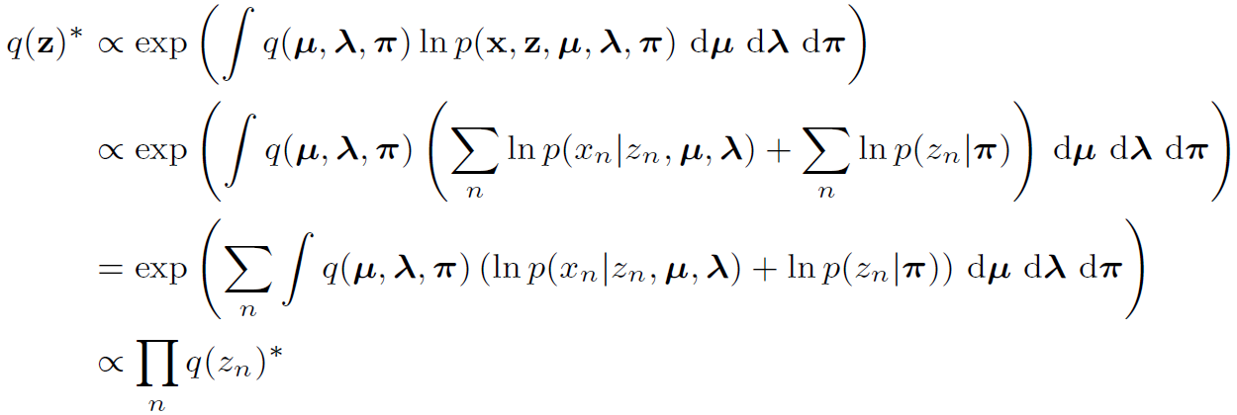
VBGMM – update for $q\left(z\right)$
We see that $q\left(z\right)$ further factorizes - so called induced factorization
Similar to responsibilities from EM

Slide 10
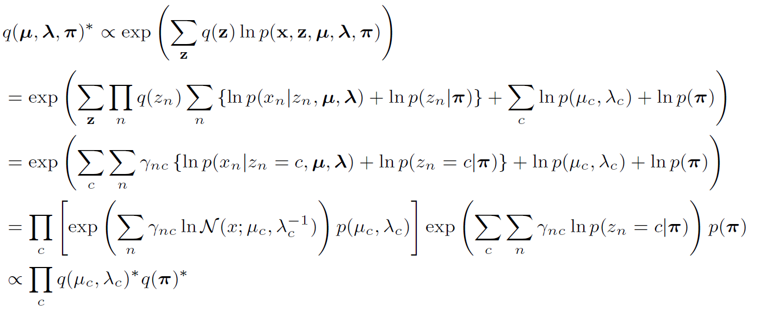
VBGMM – update for $q\left(π,μ, λ\right)$
Again, we obtain induced factorization for $q\left(μ, λ,π\right)$

Slide 11
Flashback - Factorization over components
Example with only 3 fames (i.e $z=[z_{1},z_{2},z_{3}]$)
$$\sum_{z}{\prod_{n}{q(z_{n})}\sum_{n}{f\left(z_{n}\right)=}}$$
$$\sum_{z_{1}}{\sum_{z_{2}}{\sum_{z_{3}}{q\left(z_{1}\right)q\left(z_{2}\right)q\left(z_{3}\right)f(z_{1})}}}+\sum_{z_{1}}{\sum_{z_{2}}{\sum_{z_{3}}{q\left(z_{1}\right)q\left(z_{2}\right)q\left(z_{3}\right)f(z_{2})}}+}\sum_{z_{1}}{\sum_{z_{2}}{\sum_{z_{3}}{q\left(z_{1}\right)q\left(z_{2}\right)q\left(z_{3}\right)f(z_{3})}}}=$$
$$\sum_{z_{1}}{q\left(z_{1}\right)}f\left(z_{1}\right)\sum_{z_{2}}{q\left(z_{2}\right)}\sum_{z_{3}}{q\left(z_{3}\right)}+\sum_{z_{1}}{q\left(z_{1}\right)}\sum_{z_{2}}{q\left(z_{2}\right)}f\left(z_{2}\right)\sum_{z_{3}}{q\left(z_{3}\right)}+\sum_{z_{1}}{q\left(z_{1}\right)}\sum_{z_{2}}{q\left(z_{2}\right)}\sum_{z_{3}}{q\left(z_{3}\right)f\left(z_{3}\right)}=$$
$$\sum_{z_{1}}{q\left(z_{1}\right)}f\left(z_{1}\right)+\sum_{z_{2}}{q\left(z_{2}\right)}f\left(z_{2}\right)+\sum_{z_{3}}{q\left(z_{3}\right)f\left(z_{3}\right)}=$$
$$\sum_{c=1}^{C}{q\left(z_{1}=c\right)f(z_{1}=c)}+\sum_{c=1}^{C}{q\left(z_{2}=c\right)f(z_{2}=c)}+\sum_{c=1}^{C}{q\left(z_{3}=c\right)f(z_{3}=c)}=$$
$$\sum_{c=1}^{C}{\sum_{n}{q\left(z_{n}=c\right)f(z_{n}=c)}}$$

Slide 12
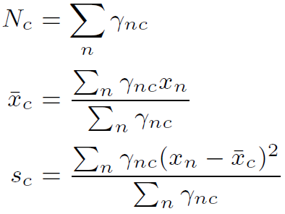
VBGMM – update for $q\left(μ_{c}, λ_{c}\right)$
Updating distribution $q(μ_{c},λ_{c})$ means updating the parameters $m_{c}^{∗},κ_{c}^{∗},$ $a_{c}^{∗},$ $b_{c}^{∗}$

Slide 13
VBGMM – update for $q\left(π\right)$
Updating distributions$q(π)$ means updating the vector $α_{}^{∗}=[α_{1}^{∗},α_{2}^{∗},…α_{C}^{∗}]$

Slide 14
VBGMM – update for $q\left(z_{n}\right)$
where $ψ(. )$ is digamma function
Updating distributions$q(z_{n})$ means computing responsibilities $γ_{nc}$

Slide 15
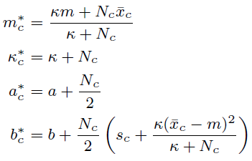
Summary of VB-GMM updates
Update distributions $q\left(z_{n}\right)$ (i.e. the responsibilities $γ_{nc}$):
For all $c=1..C$, update parameters of$q\left(μ_{c},λ_{c}\right)$ and $q\left(π\right)$:
$α_{c}^{∗}=α_{c}+N_{c}$
Iterate until convergence

Slide 16
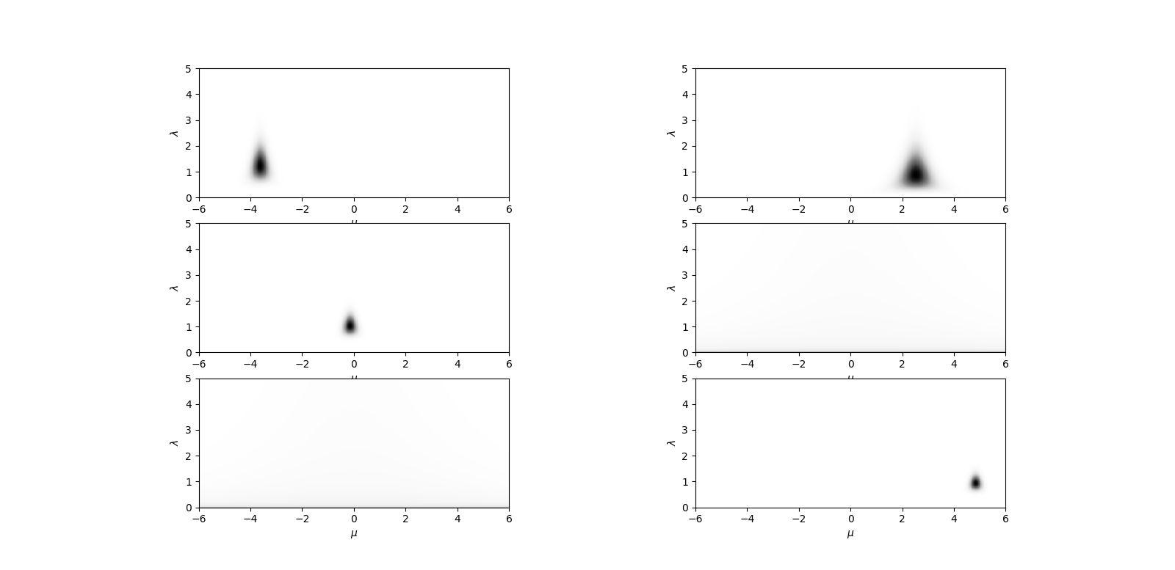
VB parameter posteriors
Priors:
$p\left(μ_{c}, λ_{c}\right), =NormalGamma\left(μ_{c}, λ_{c}|0.0, 0.05, 0.05, 0.05\right), c=1..C$
$p\left(π\right), =Dir\left(π|[1, 1, 1, 1, 1, 1]\right)$
Posteriors:
$α_{N}=\left[\text{17.1} \text{8.3} \text{32.2} \text{ 1.0} \text{1.0} \text{46.4}\right]$
$q\left(μ_{c}, λ_{c}\right)$ for the 6 Gaussian components
Fallback to prior
Fallback to prior
Fallback to prior

Slide 17
Evaluating VB-GMM
Lower bound $ℒ\left(q\left(Y\right)\right)$ can be evaluated to check for the convergence
Formula not shown here
Posterior predictive distribution is a mixture component specific posterior predictive of Student’s t-distributions
$$p\left(x^{′}|x\right)=\sum_{c}{St\left(x^{′} | m_{c}^{∗}, {2a}_{c}^{∗},\frac{a_{c}^{∗}κ_{c}^{∗}}{b_{c}^{∗}\left(κ_{c}^{∗}+1\right)}\right)π_{c}^{∗}}$$
where mixture weights are give by categorical posterior predictive:
$$π_{c}^{∗}=\frac{α_{c}^{∗}}{\sum_{c}{α_{c}^{∗}}}$$

Slide 18
VB predictive vs. ML solution
VB was initialized from ML solution – first update of $q\left(μ_{c}, λ_{c}\right)$ and $q\left(π\right)$ uses the responsibilities from last ML iteration
VB recovers from ML overfitting and more robust solution closer to the true distribution for generating the training data

Slide 19
Approximate inference (for Bayesian GMM)
Variational Bayes
Approximate intractable $p\left(π,μ, λ,z | X\right)$with tractable$q\left(π,μ, λ,z | X\right)$
Iteratively tune parameters of $q(π,μ, λ,z)$ minimize $D_{KL} (q(π,μ, λ,z)||p\left(π,μ, λ,z | X\right))$
Gibbs sampling
Instead of obtaining $p\left(π,μ, λ,z | X\right)$, we only generate samples from this distribution
Integrating over $p\left(π,μ, λ,z | X\right)$ (e.g. for predictive distribution) can be approximated with empirical expectations
…

Slide 20
Gibbs Sampling
Assume we cannot sample from complex joint distribution $p(z_{1},z_{2})$ but it is possible to sample from conditional distributions $p\left(z_{1} | z_{2}\right)$ and $p\left(z_{2} | z_{1}\right)$
Given $z_{1}^{∗}$ and generate $z_{2}^{∗}\sim p\left(z_{2} | z_{1}\right)$
Given $z_{2}^{∗}$ and generate $z_{1}^{∗}\sim p\left(z_{1} | z_{2}\right)$
Iterate previous two steps
After several iterations (burn-in) the algorithm starts generating samples from $p(z_{1},z_{2})$
It can be extended to more than two variables

Slide 21
Gibbs Sampling for Bayesian GMM
Using sampled values of ${\{μ}_{c}^{∗},λ_{c}^{∗}\}$ and $π_{}^{∗}$, generate new samples (hard assignments of observations to GMM components) from posterior over $z_{n}^{∗}$
The distribution is just like the responsibilities from EM:
Using the sampled values $z_{n}^{∗} ,$ for each component $c$, generate new samples of GMM parameters $μ_{c}^{∗},λ_{c}^{∗}$ from posteriors $p\left(μ_{c},λ_{c}\right|x,z^{∗})$
Estimate sufficient statistics $N_{c}^{∗}, {\overline{x}}_{c}^{∗},s_{c}^{∗}$ using the observations $\{x_{n}:z_{n}=c\}$ (i.e. those hard assigned to the component $c$) and calculated the posterior as:
Sample $π_{}^{∗}$ from posterior $p\left(π | z^{∗}\right)=Dir\left(π | α+N^{∗}\right)$ where the vector of component occupation counts $N^{∗}=\left[N_{1}^{∗},N_{2}^{∗},…,N_{C}^{∗}\right]$is given by $z^{∗}$
$$P\left(z_{n}=c|x_{n}\right)=\frac{p\left(x_{n}|z_{n}=c\right)P(z_{n}=c) }{\sum_{k}{p\left(x_{n}|k\right)P(k)}}= \frac{𝒩\left(x_{n}|μ_{c}^{∗},λ_{c}^{∗−1}\right)π_{c}^{∗}}{\sum_{k}{𝒩\left(x_{i}|μ_{k}^{∗},λ_{k}^{∗−1}\right)π_{k}^{∗}}}$$
$$p\left(μ_{c},λ_{c}\right|x)=NormalGamma\left(μ_{c},λ_{c} | \frac{κm+N_{c}{\overline{x}}_{c}}{κ+N_{c}},κ+N_{c},a+\frac{N_{c}}{2},b+\frac{N_{c}}{2}\left(s_{c}+ \frac{κ{\left({\overline{x}}_{c}−m\right)}^{2}}{κ+N_{c}}\right)\right)$$

Slide 22
First 5-iterations of GS
Predictive distributions can be approximated by empirical expectations using the samples from the posterior distribution ${\hat{η}}_{l}$:
$$p\left(x^{′} | X\right)=\int{p\left(x^{′} | η\right)p\left(η | X\right)d}η≈\frac{1}{L}\sum_{l}{p\left(x^{′} | {\hat{η}}_{l}\right)}$$

Slide 23
First 30-iterations of GS
Predictive distributions can be approximated by empirical expectations using the samples from the posterior distribution ${\hat{η}}_{l}$:
$$p\left(x^{′} | X\right)=\int{p\left(x^{′} | η\right)p\left(η | X\right)d}η≈\frac{1}{L}\sum_{l}{p\left(x^{′} | {\hat{η}}_{l}\right)}$$

Slide 24
Collapsed GS for Bayesian GMM
Sampling discrete latent variables like $z_{n}$ is fine as they have limited number of possible values
For continuous latent variables like $π,μ_{c}, λ_{c}$, however, we might need too many samples to get a reasonable representation of their posterior distributions (especially for multivariate higher dimensional variables).
Collapsed Gibbs Sampling
Iterates over (and samples only from) a subset of the latent variables in the model (e.g. the discrete ones)
integrates (marginalizes) over the remaining (continuous) variables
CBS for Bayesian GMM:
where
$z_{\backslash i}$ is $z$ with $z_{i}$ removed
$x_{\backslash i}$ is $x$ with $x_{i}$ removed

Slide 25
CGS for BGMM - $P\left(z_{i} | z_{\backslash i}\right)$
How do we obtain ${p(z}_{i}\left|x, z_{\backslash i}\right)$?
Lets first introduce some useful distributions
Posterior distribution of weights $π$ given $z_{\backslash i}$ (or corresponding vector of component occupation counts $N_{\backslash i}$)
Posterior predictive distribution for $z_{i}$ given $z_{\backslash i}$

Slide 26
CGS for BGMM - $p\left(x_{i} | z_{i},x_{\backslash i},z_{\backslash i}\right)$
Let $S_{c\backslash i}$ define the subset of observations assigned by $z_{\backslash i}$to component $c$
Posterior distribution of $μ_{c}, λ_{c}$ given $x_{\backslash i}, z_{\backslash i}$ is estimated in the usual way using only the observations $S_{c\backslash i}$
Posterior predictive distrib. of $x_{i}$ for component $c$ given observations $S_{c\backslash i}$

Slide 27
CGS for BGMM - $p\left(x_{i} | x,z_{\backslash i}\right)$
Finally, using Bayes rule
The Collapsed Gibbs sampling iterations gives us samples from $z^{∗}\sim p(z\left|x\right)$. What can we do with that?
GMM posterior predictive distribution for new $x^{′}$ given $x$ and (sampled) $z$
Full predictive distribution can be approximated using the samples $z_{l}^{∗}$ as

Slide 28
Infinite Bayesian GMM
Let’s consider Bayesian GMM with an infinite number of Gaussian components $c=1..∞$
The priors for $μ_{c}, λ_{c}$ for Gaussian component $c=1…∞$ can be defined as before:
$p\left(μ_{c}, λ_{c}\right) \sim NormalGamma\left(μ_{c}, λ_{c}| m,κ,a,b\right)$
However, we need an infinite number of mixture weights $π$ = [$π_{1},π_{2}, … ]$ so that $\sum_{c=1}^{∞}{π_{c}}=1$
We also need a suitable prior distribution for $π$
$$π$$
$$α$$
z_{n}
$$m, κ,a,b$$
$$μ_{c}, λ_{c}$$
x_{n}
$$n=1.. N$$
$$c=1..∞$$

Slide 29
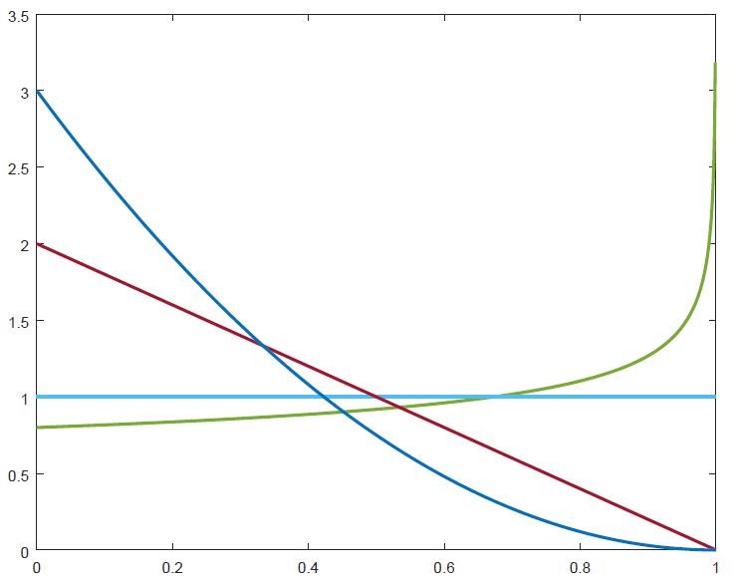
Stick breaking process - GEM
$for c=1,2,…, ∞$ $v_{c} \sim Beta\left(1,α\right)$ $π_{c}=v_{c}\prod_{k=1}^{c−1}{ (1−v_{k})}$
Take a unit length stick For $c=1,2,…, ∞$
Generate $v_{c}$in range $\left(0,1\right)$from $Beta\left(1,α\right)$
Break the stick into two pieces with proportions $v_{c }: 1−v_{c}$
The length of the first piece corresponds to $π_{c}$
The second piece is the stick to be broken in further iterations
The resulting infinite dimensional vector of weights is a sample from the stick breaking process $π \sim GEM(α)$ (Griffiths, Engen and McCloskey)
$GEM(α)$ can be used as a prior for infinite number of component weights
With small concentration parameter $α$, only few weights will be non-negligable
$$Beta\left(1,α\right)$$

Slide 30
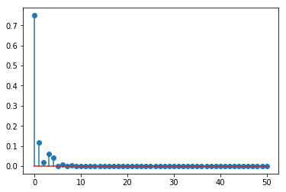
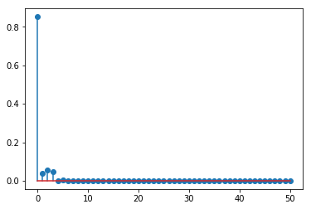
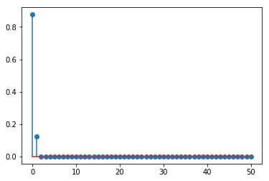
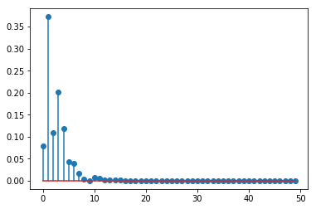
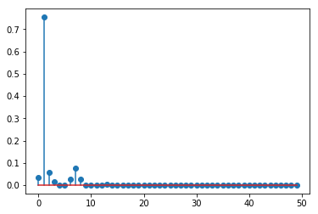
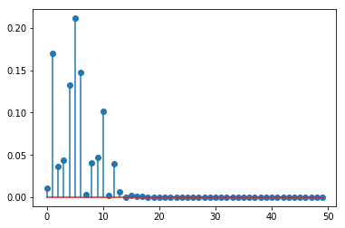
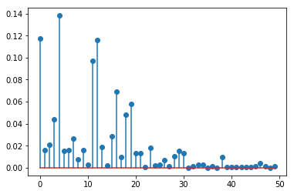
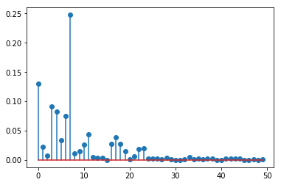
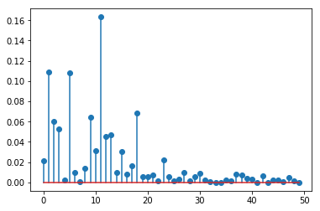
Samples from GEM
$α=0.5$
$α=2$
$α=10$

Slide 31
Infinite Bayesian GMM
We assume that the observed data were generated as follows:
$π=\left[π_{1},π_{2},… \right] \sim GEM(α)$
For Gaussian component $c=1…∞$
$μ_{c}, λ_{c} \sim NormalGamma\left(μ_{c}, λ_{c}|m,κ,a,b\right)$
For each observation $i=1…N$
$z_{n} \sim P\left(z_{n} | π\right)=Cat\left(z_{n}|π\right)$
$x_{n} \sim p\left(x_{n} | z_{n},μ,λ\right)=𝒩\left(x_{n}|μ_{z_{n}}, λ_{z_{n}}^{−1}\right)$
Obviously, the observed data can be generated from at most $N$Gaussian components.
Again, the task is to infer the posterior distribution of parameters $p(π,μ_{1}, λ_{1},μ_{2},λ_{2}…|x)$ given some $observed data x=\left[x_{1},x_{2},…,x_{N}\right]$
$$π$$
$$α$$
z_{n}
$$m, κ,a,b$$
$$μ_{c}, λ_{c}$$
x_{n}
$$n=1.. N$$
$$c=1..∞$$

Slide 32
CGS for infinite Bayesian GMM
We can use the same Collapsed Gibbs sampling iterations that we used in the case of the BGMM with fixed number of Gaussian components where again and the component posterior predictive
The only difference will be in $P\left(z_{i} | z_{\backslash i}\right)$, which is evaluated using Chinese Restaurant Process (CRP)

Slide 33
Chinese Restaurant Process
Let the prior on the infinite weight vector be $p\left(π\right)=GEM\left(π | α\right)$
Let${ z}_{n}, n=1..N$ be samples generated from an (unknown) “infinite categorical distribution” $Cat\left(z_{n} | π\right)$
The posterior $p\left(π | z\right)∝ \prod_{n}{p\left(z_{n}|π\right)}p(π)$ is intractable
We cannot even easily sample from it as the sample would be infinite vector of weights
However, the predictive posterior $P\left(z^{′} | z\right)=∫P\left(z^{′}|π\right)p\left(π|z\right)dπ$ can be evaluated as $P\left(z^{′}=c | z\right)=\frac{N_{c}}{α+N}$ $P\left(z^{′}=C+1 | z\right)=\frac{α}{α+N}$ where $N_{c}$ is the number of observations assigned by $z$ to category $c$ and $C+1$ is a new so far not seen category.

Slide 34
Posterior predictive: Dirichlet vs GEM prior
Posterior predictive for Categorical distribution and Dirichlet prior (with single concentration parameter) converges to CRP as the number of categories increases
Prior: $Dir\left(π | α\right)$
Observation distribution: $Cat\left(z | π\right)$
Posterior $Dir\left(π | m+α\right)$, where $m=[N_{1},N_{2}, …, N_{C}]$
Posterior predictive $p\left(z^{′} | z\right)=\int{Cat\left(z^{′} | π\right)Dir\left(π | α_{N}\right)}dπ=Cat\left(z^{′} | \frac{α+m}{\sum_{c}{α_{c}+N_{c}}}\right)$
For single concentration parameter $α_{c}=α=\frac{γ}{C}$
$$p\left(z^{′}=k | z\right)=\frac{α+N_{k}}{Cα+N}=\frac{\frac{γ}{C}+N_{k}}{γ+N}$$
$$p\left(z^{′}=k | z\right)=\frac{N_{k}}{γ+N} for C→\text{∞}$$
$γ$ is number of prior observations that we keep constant with increasing $C$ ➔ $α_{c}$gets smaller with increasing $C$

Slide 35
Chinese Restaurant Process
Imagine Chinese Restaurant with an infinite number of tables, each with infinite capacity
The first customer sits at the first table
Every new customer:
Joins already occupied table with probability proportional to the number of customers sitting at that table $P\left(z^{′}=c | z\right)=\frac{N_{c}}{α+N}$
or starts a new table with probability proportional to concentrarion parameter $α$ $P\left(z^{′}=C+1 | z\right)=\frac{α}{α+N}$

Slide 36
Dirichlet Process
We have defined Infinite BGMM as (for simplicity assuming the same $σ$ for all Gaussian component variances $σ$ and conjugate prior $p\left(μ_{c}\right)=𝒩\left(μ_{c}\right|μ_{0},σ_{0})$):
$$π=\left[π_{1},π_{2},… \right] \sim GEM\left(α\right) \\ μ_{c} \sim 𝒩\left(μ_{c}\right|μ_{0},σ_{0}), c=1..∞ \\ z_{i} \sim π, i=1..N$$
$$x_{i} \sim 𝒩\left(x_{i} | μ_{z_{i}},σ\right), i=1..N$$
Alternative definition using $δ_{μ}\left(\tilde{μ}\right)=\left\{\begin{aligned}1, μ=\tilde{μ} \\ 0, μ≠\tilde{μ}\end{aligned}\right.$
$$π=\left[π_{1},π_{2},… \right] \sim GEM\left(α\right) \\ μ_{c} \sim 𝒩\left(μ_{c}\right|μ_{0},σ_{0}), c=1..∞ \\ {\tilde{μ}}_{i} \sim G=\sum_{c=1}^{∞}{π_{c}δ_{μ_{c}}({\tilde{μ}}_{i})}, i=1..N \\ x_{i} \sim 𝒩\left(x_{i} | {\tilde{μ}}_{i}\right), i=1..N$$
or using Dirichlet Process with base distribution $H=𝒩\left(μ_{0},σ_{0} \right)$ and concentration parameter $α$
$$G \sim DP\left(H, α\right) \\ {\tilde{μ}}_{i} \sim G, i=1..N \\ x_{i} \sim 𝒩\left(x_{i} | {\tilde{μ}}_{i}\right), i=1..N$$

Slide 37
Dirichlet process
Samples $G \sim DP\left(𝒩\left(0,1\right), α\right)$
$α=1$
$α=10$
$α=100$
$α=1000$
$G$ is discrete distribution with continuous support
$DP\left(𝒩\left(0,1\right), α\right)$ is distribution over discrete distributions with continuous support

Slide 38
Dirichlet process
Samples $G \sim DP\left(𝒩\left(0,1\right), α\right)$
$$α=10$$
⬅A➔|⬅B➔|⬅C➔
⬅A➔|⬅B➔|⬅C➔
⬅A➔|⬅B➔|⬅C➔
0.11
0.78
0.11
0.03
0.85
0.12
0.09
0.80
0. 11
Let’s decide on arbitrary partitioning of the support (regions A, B, C, ...).
Now, for each sample from the DP, let’s integrate the probability mass in each partition. The resulting vectors of probabilities are samples from Dirichlet distribution.
When Categorical distribution is used as the base distribution DP degrades to Dirichlet distribution
$DP\left(Cat\left(π\right), α\right)=Dir(απ)$

Slide 39
Pitman-Yor process
Generalization of Dirichlet Process based on stick breaking process $GEM\left(α,d\right)$ with two parameters
discount parameter $0≤d<1$
concentration parameter $α> −d$
$for c=1,2,…, ∞$ $v_{c} \sim Beta\left(1−d,α+cd\right)$ $π_{c}=v_{c}\prod_{k=1}^{c−1}{ (1−v_{k})}$
For $d=0$, PY process degrades to DP
With 𝑑 close to one, distribution of weights has long tail following Zipf's law: first weights is (in average) twice the second one, tree times the third one, ...
In any language, the most frequent word is about 2x more frequent than the second most frequent and 3x more frequent than the third most frequent and …
In English: 7% “THE”, 3.5% “OF”, 2.8%, “AND”, …
Largest city in a country has about twice the population of the second largest …
Same for: corporation sizes, income rankings, ranks of number of people watching the same TV channel

Slide 40
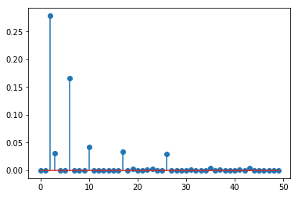
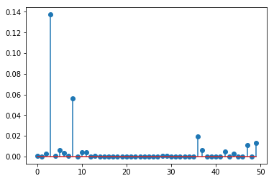
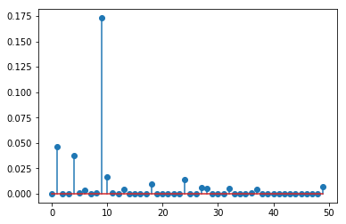
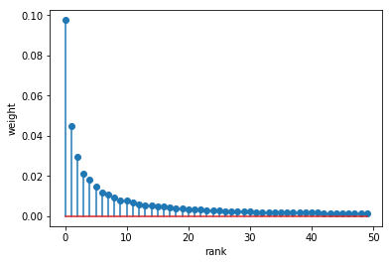
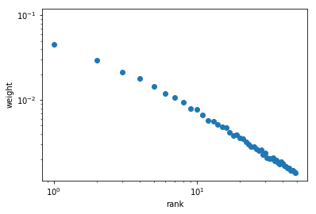
Samples from $GEM\left(α=0,d=0.9\right)$
average over many samples
linear scale
log-log scale

Slide 41
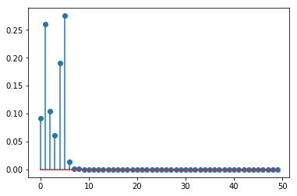
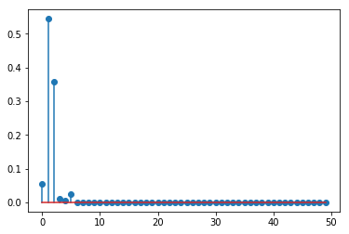
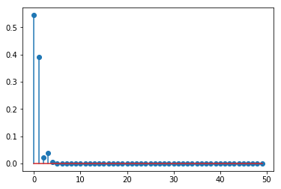
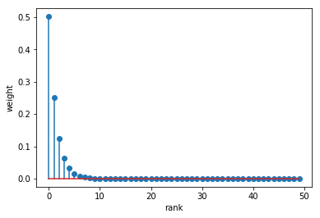
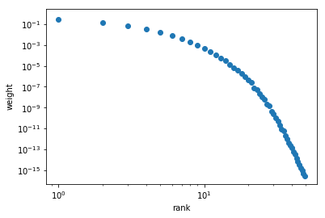
Samples from $GEM\left(α=1,d=0\right)$
average over many samples
linear scale
log-log scale

Slide 42
CRP for $GEM\left(α,d\right)$
Imagine Chinese Restaurant with an infinite number of tables, each with infinite capacity
The first customer sits at the first table
Every new customer:
Joins one of $C$ already occupied table with probability proportional to the number of customers sitting at that table minus discount $d$ $P\left(z^{′}=c | z\right)=\frac{N_{c}−d}{α+N}$
or starts a new $C+1$table with probability $P\left(z^{′}=C+1 | z\right)=\frac{α+Cd}{α+N}$

Slide 43
Pitman-Yor Process
Sample from Pitman-Yor Process with base distribution $H$and concentration parameter $α$ and discount $d$
$$G \sim PY\left(H, α,d\right)$$
can be obtained as
$$π \sim GEM\left(α,d\right) \\ μ_{c} \sim H, c=1..∞$$
$$G=\sum_{c=1}^{∞}{π_{c}δ_{μ_{c}}}$$
In CRP analogy, $μ_{c}$ is a meal served at table $c$.
For $H=NormalGamma$ (or $Normal)$ $G$ again corresponds to (parameters of) infinite Gaussian Mixture model and $PY\left(H, α,d\right)$ can be seen and prior for GMM parameters.
However, for $PY$process, it is interesting to consider $H=Cat$

Slide 44
PY Process for $H=Cat\left(r\right)$
$r=[r_{1},r_{2},…,r_{K}]$ are probabilities of $K$ categories
$μ_{c}$ corresponds to category associated with cluster $c$
$δ_{μ_{c}}$is distribution where $P\left(μ_{c}\right)=1$ and $P\left({μ≠μ}_{c}\right)=0$
When sampling from $G$, we pick $δ_{μ_{c}}$with probability $π_{c}$and generated corresponding category $μ_{c}$
$⇒G$ is (finite) Categorical distribution where $P\left(μ_{k}\right)=\sum_{c:μ_{c}=μ_{k}}{π_{c}}$

Slide 45
PY Process for $H=Cat\left(r\right)$
$$G\sim PY\left(Cat\left(r\right), α,d\right)$$
$G$ is Categorical Distribution
We have seen that
$$PY\left(Cat\left(r\right), α,d=0\right)=DP\left(Cat\left(r\right), α\right)=Dir\left(αr\right)$$
But for $d≠0$
$$PY\left(Cat\left(r\right), α,d\right)≠Dir\left( \right)$$
Prior for (finite) Categorical distributions imposing Zipf’s law
Useful for modeling different phenomena e.g. in Natural Language Processing (NLP)

Slide 46
$PY\left(Cat\left(r\right), α,d\right)$ prior
We assume (unigram) generative model, where sequence of categories (e.g. words $x=[x_{1},x_{2},$…$x_{N}]$ are generated as
$$G\sim PY\left(Cat\left(r\right), α,d\right) \\ for i=1..N \\ x_{i}\sim G$$
or equivalently
$$π=\left[π_{1},π_{2},… \right] \sim GEM\left(α,d\right) \\ μ_{c} \sim Cat\left(r\right), c=1..∞ \\ z_{i} \sim π, i=1..N \\ x_{i}=μ_{z_{i}}, i=1..N$$

Slide 47
CGS with $PY\left(Cat\left(r\right), α,d\right)$ prior
We use Collapsed Gibbs sampling (similar to infinite BGMM)
$P\left(z_{i} | z_{\backslash i}\right)$is evaluated using Chinese Restaurant Process (CRP)
$P\left(z_{i}=c | z_{\backslash i}\right)=\frac{N_{\backslash i}^{c}−d}{α+N−1}$ $P\left(z_{i}=C+1 | z_{\backslash i}\right)=\frac{α+Cd}{α+N−1}$
$P\left(x_{i} | z_{i}=C+1,x_{\backslash i},z_{\backslash i}\right)=Cat\left(x_{i}|r\right)$ when starting new table.
Each table $c$, serves only one “meal” $μ_{c}$, which is shared by all customers $z_{j}=c$ sitting at that table$⇒$ For already occupied table $c$, we can look at any customer sitting at the table (i.e. $z_{j}∈$ $z_{\backslash i}∧z_{j}=c$) and his meal $x_{j}=μ_{c}$ and we know that a new customer $z_{i}=c$ joining the same table will eat the same meal with probability one
$P\left(x_{i}=μ_{c} | z_{i}=c,x_{\backslash i},z_{\backslash i}\right)=1$ and $P\left(x_{i}≠μ_{c} | z_{i}=c,x_{\backslash i},z_{\backslash i}\right)=0$

Slide 48
CGS with $PY\left(Cat\left(r\right), α,d\right)$ prior-II
$\text{A}\text{pproximate} \text{posterior} \text{predictive}$
$$P\left(x|x\right) \\ ≈\frac{1}{L}\sum_{l}{P\left(x | x,z_{l}^{∗}\right)}=\frac{1}{L}\sum_{l}{\sum_{c=1}^{C_{l}+1}{P\left(x | z=c,x,z_{l}^{∗}\right)P\left(z=c | z_{l}^{∗}\right)}}=\frac{1}{L}\sum_{l}{\left(\sum_{c:μ_{c}=x}{P\left(z=c | z_{l}^{∗}\right)+ }Cat\left(x|r\right)P\left(z=C_{l}+1 | z_{l}^{∗}\right)\right)}=\frac{1}{L}\sum_{l}{\left(\sum_{c:μ_{c}=x}{\frac{N_{l}^{c}−d}{α+N}+ }Cat\left(x|r\right)\frac{α+C_{l}d}{α+N}\right)}$$

Slide 49
Language Modeling
In NLP or speech processing, we often need to model distribution of word sequences $P\left(x_{1},x_{2},…,x_{N}\right)=P\left(x_{1}\right)P\left(x_{2} | x_{1}\right)P\left(x_{3} | x_{1},x_{2}\right)…P(x_{N}|x_{1},x_{2},…, x_{N−1})$
This can be approximated by N-gram language model (LM)
uni-gram: $P\left(x_{1},x_{2},…,x_{N}\right)≈P\left(x_{1}\right)P\left(x_{2}\right)P\left(x_{3}\right)…P\left(x_{N}\right)$
bi-gram: $P\left(x_{1},x_{2},…,x_{N}\right)≈P\left(x_{1}\right)P\left(x_{2} | x_{1}\right)P\left(x_{3} | x_{2}\right)…P(x_{N}|x_{N−1})$
ML estimatimation of $P(x)$ or $P(x|h)$ is not robust – not seeing certain word or word pair in training text $x$does not mean that it has zero probability in new data.
Smoothing techniques (Good–Turing discounting, Kneser–Ney smoothing, …) are typically used to get better estimates.
Let’s use Bayesian approach …

Slide 50
Bayesian Language Modeling
For unigram
We assume that individual words are i.i.d. from $x_{n}∼Cat\left(x_{n}|r_{1}\right)$
Let’s use $r_{1}∼PY\left(H_{0}, α,d\right)$as a prior for the parameters $r_{1}$
For $H_{0}$, will be flat categorical distribution $Cat\left(x|r_{0}\right)=\frac{1}{K}$
We can use the CGS inference described before
We can use the approximate posterior predictive $P\left(x|x\right)$ as the unigram probabilities, where $x$ is the training text.
For bigram
One Categorical distribution for each bigram history $P\left(x | h\right)=Cat\left(x|r_{h}\right)$
$r_{h}\sim PY\left(H, α,d\right)$ as a prior for parameter of each bigram distribution
$H=Cat\left(r_{1}\right)$ is categorical distribution, but its parameters $r_{1}$are treated as random variable with prior $r_{1}\sim PY\left(H_{0}, α,d\right)$ (i.e. as for the unigram).
Y. Teh. A hierarchical Bayesian language model based on Pitman-Yor process. In Proceedings of ACL International Conference, 2006.

