Slide 1

Bayesian Models in Machine Learning
GMM, EM algorithm
Lukáš Burget
BAYa lectures, October 2023

Slide 2
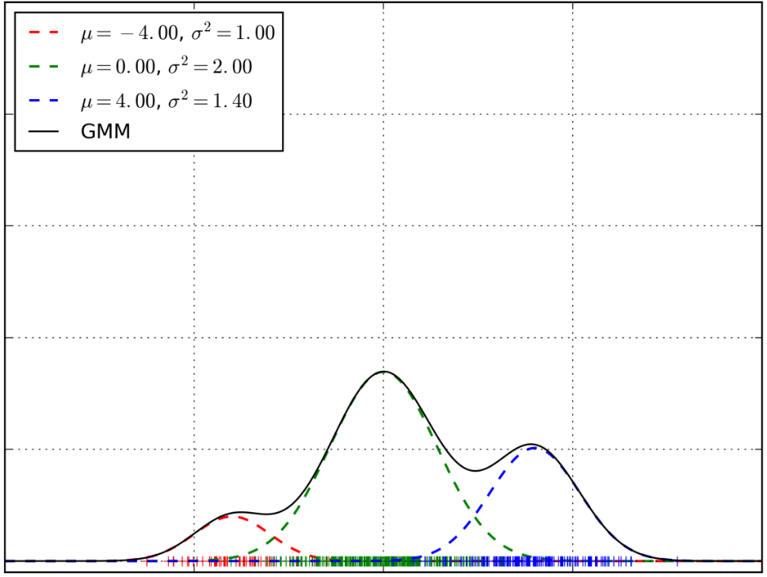

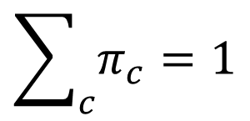

GMM - recapitulation
$$p\left(x|η\right)=\sum_{c}{𝒩\left(x;μ_{c},σ_{c}^{2} \right)π_{c}}$$
→ p(x)
where
$$η=\{π_{c},μ_{c},σ_{c}^{2}\}$$
$$\sum_{c}{π_{c}}=1$$
→ x
We can see the sum above just as a function defining the shape of the probability density function
or …

Slide 3


Multivariate GMM - recapitulation
$$p\left(x|η\right)=\sum_{c}{𝒩\left(x;μ_{c},Σ_{c}\right)π_{c}}$$
where
$$η=\{π_{c},μ_{c},Σ_{c}\}$$
$$\sum_{c}{π_{c}}=1$$
We can see the sum above just as a function defining the shape of the probability density function
or …

Slide 4
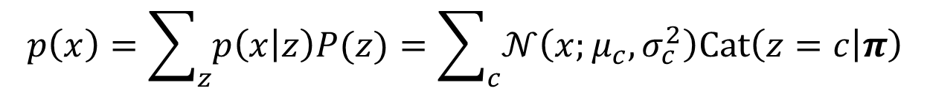
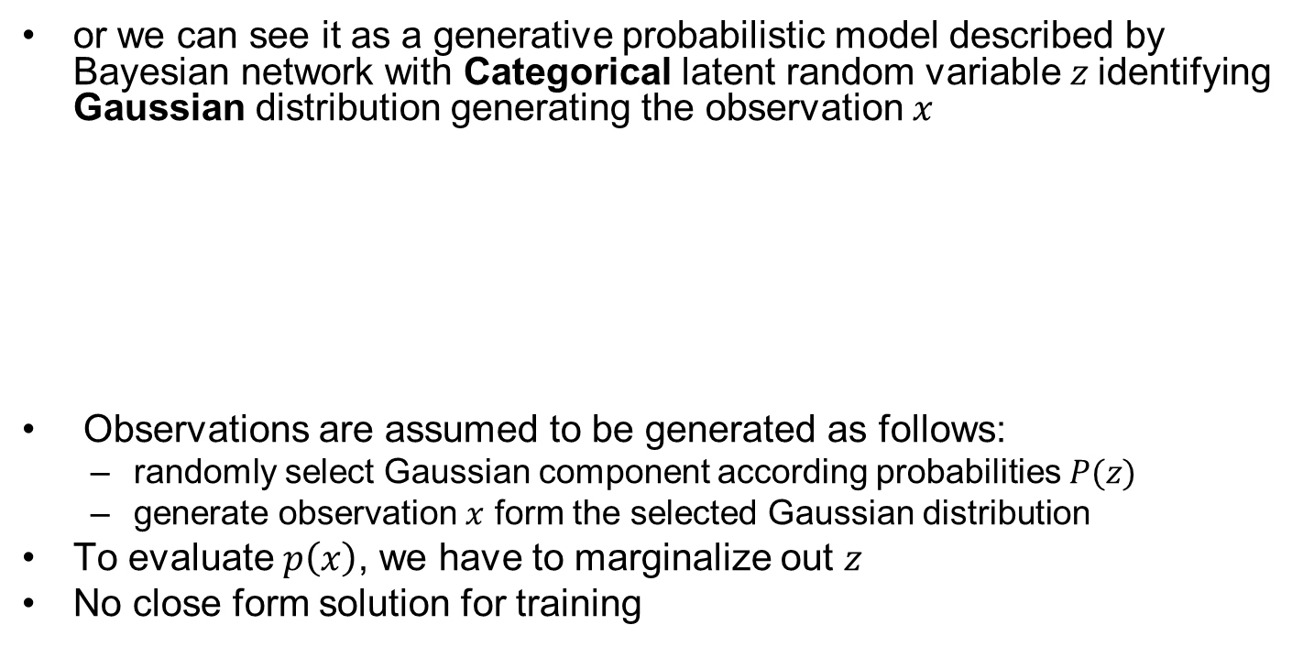



BN for GMM – recapitulation
$$p\left(x\right)=\sum_{z}{p\left(x | z\right)P(z)}=\sum_{c}{𝒩\left(x;μ_{c},σ_{c}^{2}\right)Cat\left(z=c | π\right)}$$
or we can see it as a generative probabilistic model described by Bayesian network with Categorical latent random variable $z$identifying Gaussian distribution generating the observation $x$
Observations are assumed to be generated as follows:
  randomly select Gaussian component according probabilities $P(z)$
  generate observation $x$ form the selected Gaussian distribution
To evaluate $p\left(x\right)$, we have to marginalize out $z$
No close form solution for training
$$z$$
$$p\left(x,z\right)=p\left(x | z\right)P(z)$$
$$x$$

Slide 5

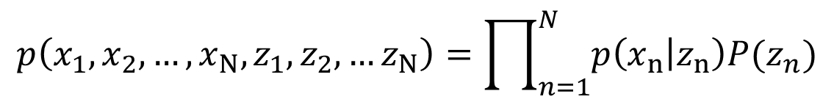
BN for GMM – recapitulation II
Multiple observations:
z₁
z₂
z_{N-1}
z_{N}
z_{n}
or
x₁
x₂
x_{N-1}
x_{N}
x_{n}
$$n=1..N$$
$$p\left(x_{1},x_{2},…,x_{N},z_{1},z_{2},…z_{N}\right)=\prod_{n=1}^{N}{p\left(x_{n} | z_{n}\right)P(z_{n})}$$

Slide 6
Training GMM –Viterbi training
Intuitive and Approximate iterative algorithm for training GMM parameters.
Using current model parameters, let Gaussians classify data as if the Gaussians were different classes (Even though all the data corresponds to only one class modeled by the GMM)
Re-estimate parameters of Gaussians using the data assigned to them in the previous step.
New weights will be proportional to the number of data points assigned to the Gaussians.
Repeat the previous two steps until the algorithm converges.

Slide 7
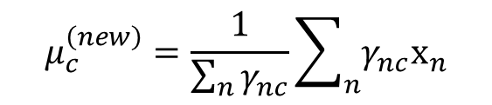
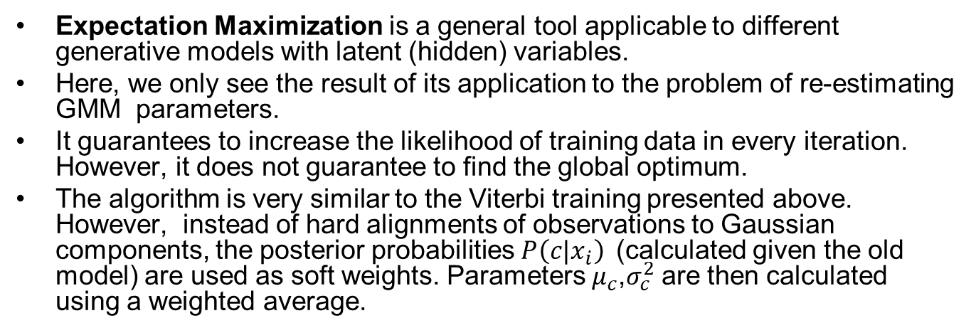
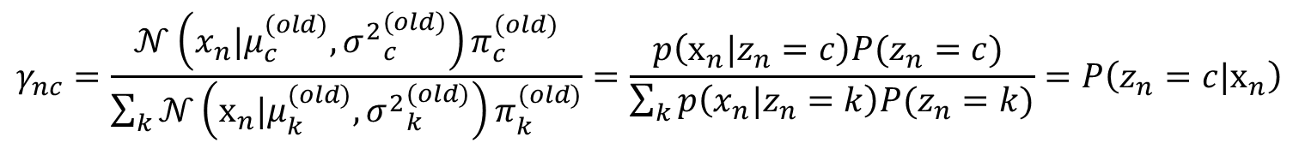
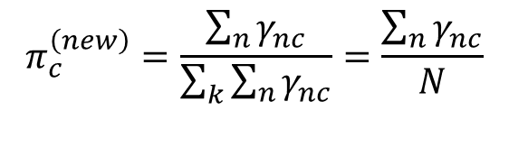
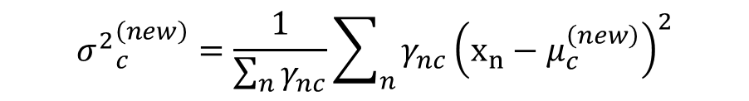
Training GMM – EM algorithm
Expectation Maximization is a general tool applicable to different generative models with latent (hidden) variables.
Here, we only see the result of its application to the problem of re-estimating GMM parameters.
It guarantees to increase the likelihood of training data in every iteration. However, it does not guarantee to find the global optimum.
The algorithm is very similar to the Viterbi training presented above. However, instead of hard alignments of observations to Gaussian components, the posterior probabilities $P\left(c|x_{i}\right)$(calculated given the old model) are used as soft weights. Parameters $μ_{c}$,$σ_{c}^{2}$are then calculated using a weighted average.
$$γ_{nc}=\frac{𝒩\left(x_{n}|μ_{c}^{(old)},{σ^{2}}_{c}^{(old)}\right)π_{c}^{(old)}}{\sum_{k}{𝒩\left(x_{n}|μ_{k}^{(old)},{σ^{2}}_{k}^{(old)}\right)π_{k}^{(old)}}}=\frac{p\left(x_{n}|z_{n}=c\right)P(z_{n}=c) }{\sum_{k}{p\left(x_{n}|z_{n}=k\right)P(z_{n}=k)}}=P\left(z_{n}=c|x_{n}\right)$$
$$μ_{c}^{\left(new\right)}=\frac{1}{\sum_{n}{γ_{nc}}}\sum_{n}{γ_{nc}x_{n}}$$
$$π_{c}^{\left(new\right)}=\frac{\sum_{n}{γ_{nc}}}{\sum_{k}{\sum_{n}{γ_{nc}}}}=\frac{\sum_{n}{γ_{nc}}}{N}$$
$${σ^{2}}_{c}^{\left(new\right)}=\frac{1}{\sum_{n}{γ_{nc}}}\sum_{n}{γ_{nc}{\left(x_{n}−μ_{c}^{\left(new\right)}\right)}^{2}}$$

Slide 8

GMM to be learned

Slide 9
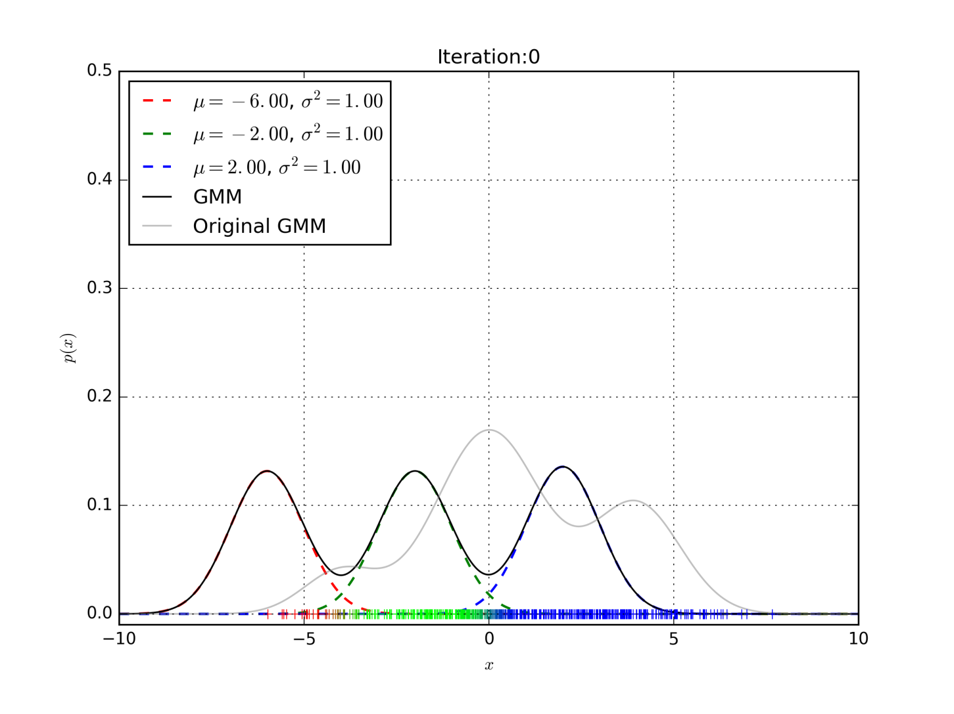
EM algorithm

Slide 10
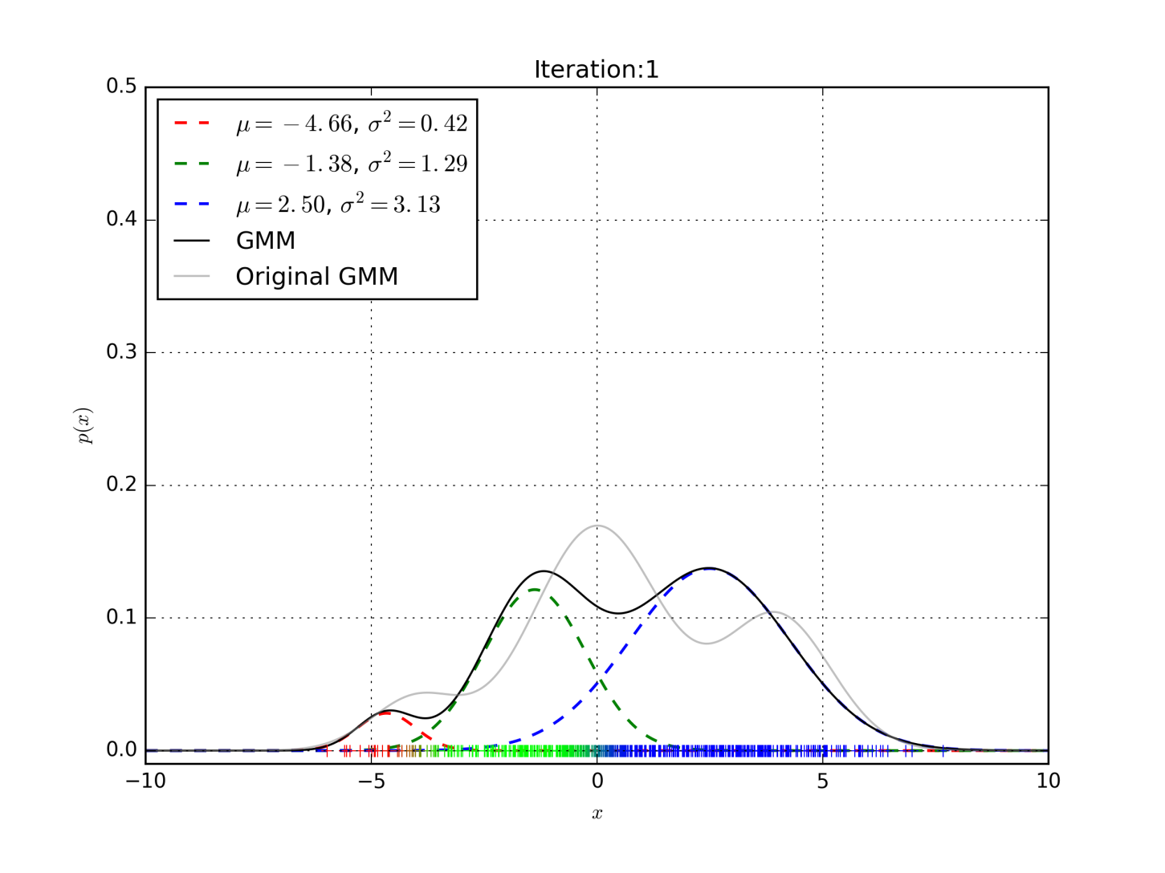
EM algorithm

Slide 11
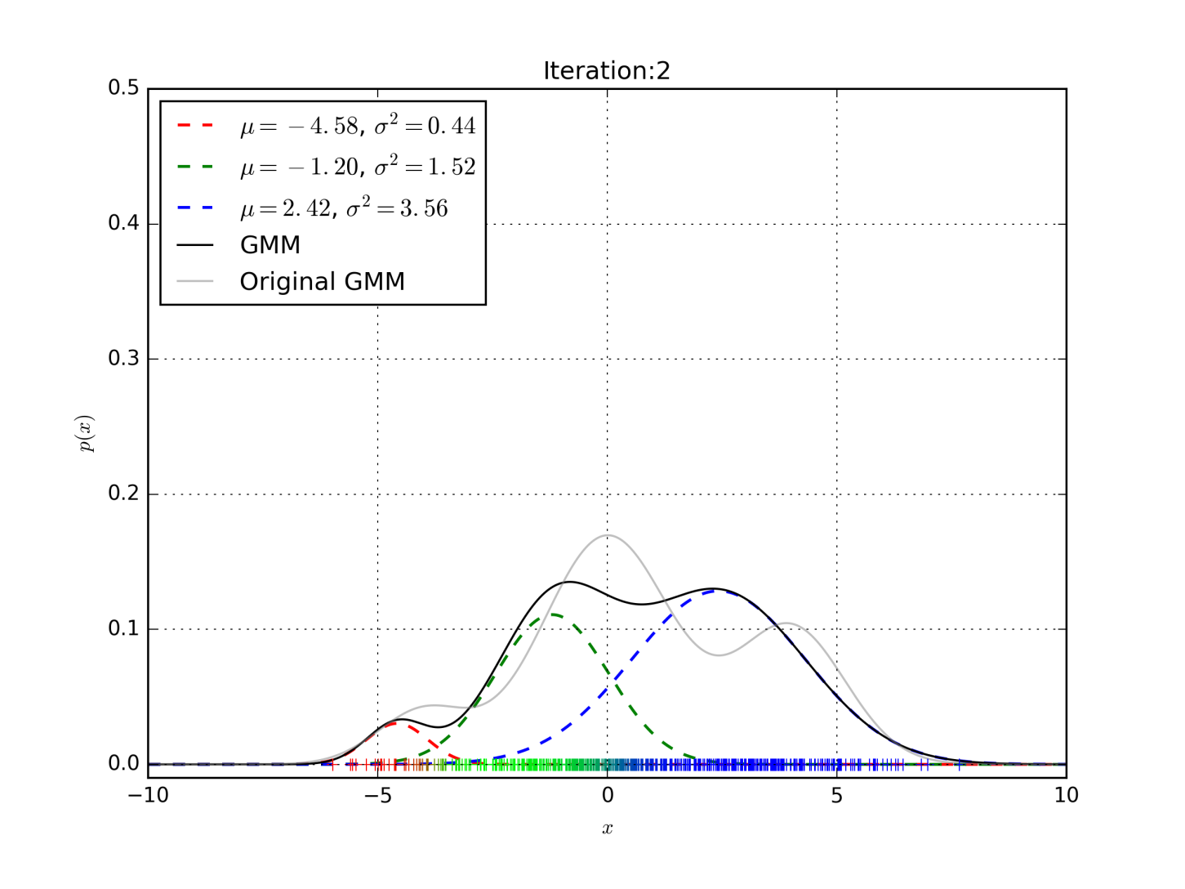
EM algorithm

Slide 12

EM algorithm

Slide 13
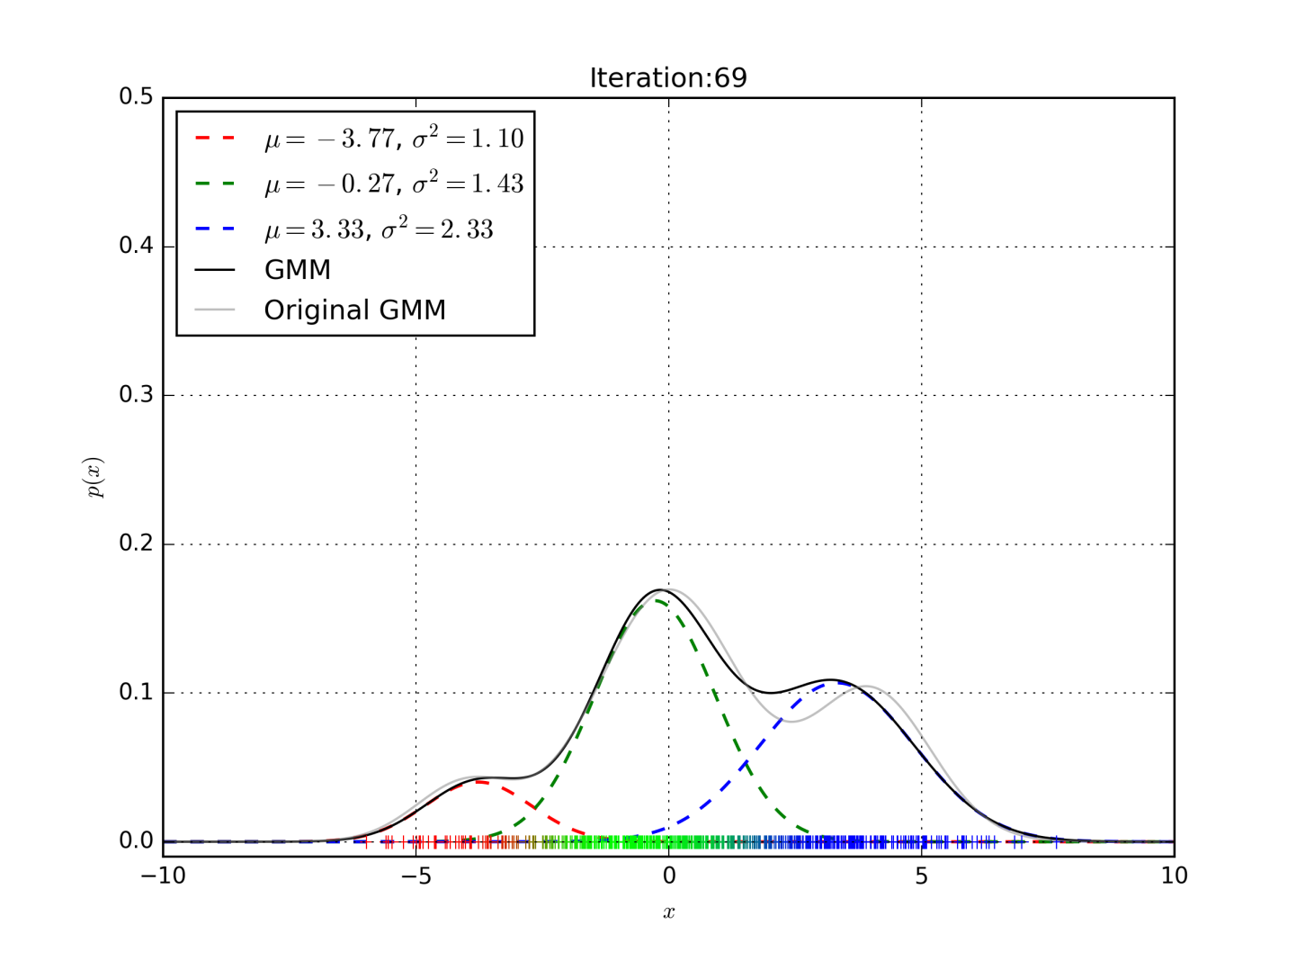
EM algorithm

Slide 14
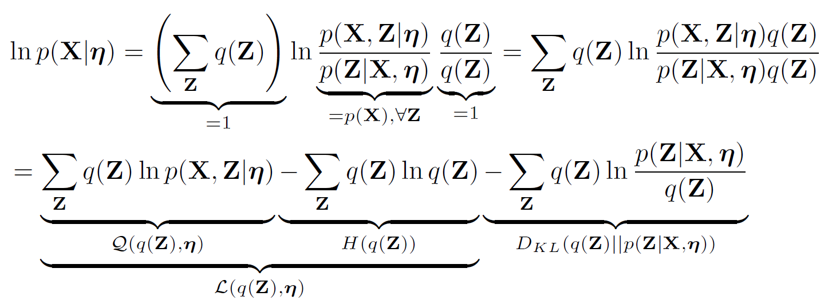
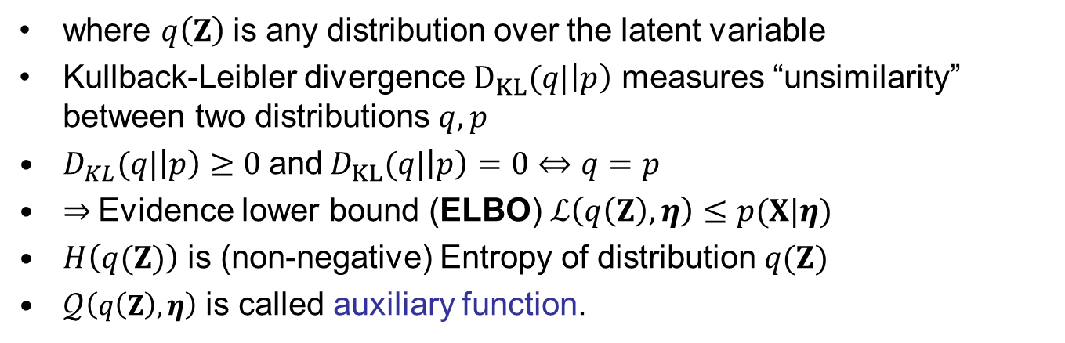
Expectation maximization algorithm
where $q\left(Z\right)$is any distribution over the latent variable
Kullback-Leibler divergence $D_{KL}(q|\left|p\right)$ measures “unsimilarity” between two distributions $q,p$
$D_{KL}(q|\left|p\right)≥0$and$D_{KL}(q|\left|p\right)=0⇔q=p$
⇒ Evidence lower bound (ELBO) $ℒ\left(q\left(Z\right),η\right)≤p(X|η)$
$H\left(q(Z)\right)$ is (non-negative) Entropy of distribution $q(Z)$
$𝒬\left(q\left(Z\right),η\right)$ is called auxiliary function.

Slide 15
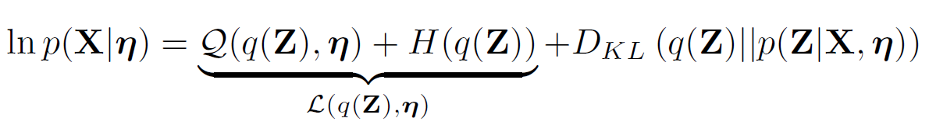
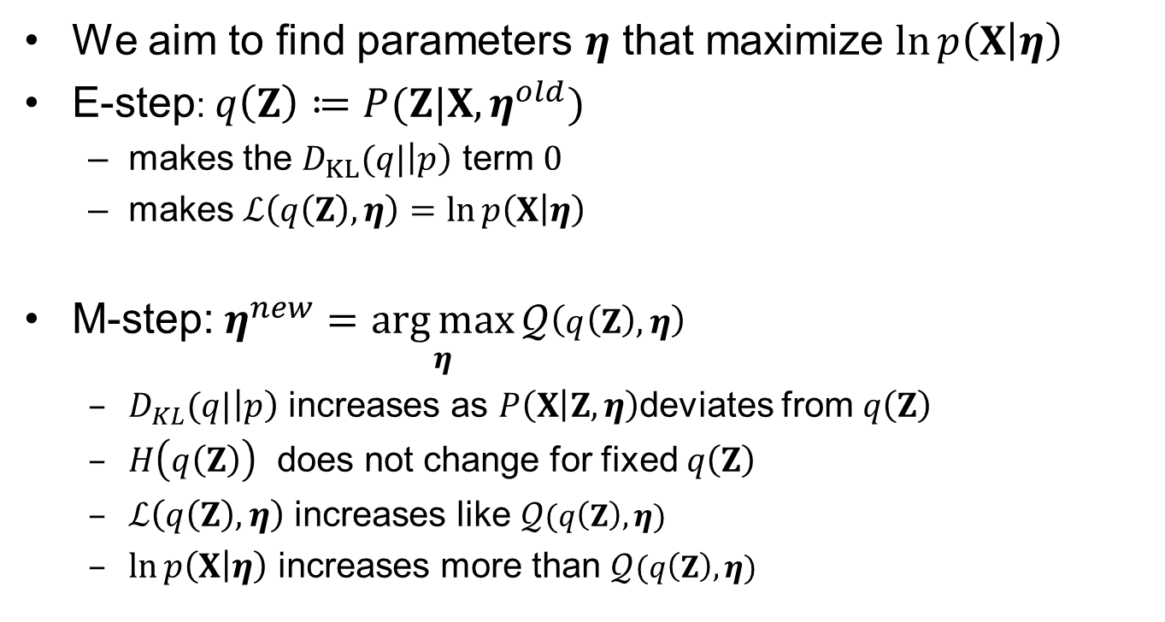
Expectation maximization algorithm
We aim to find parameters $η$ that maximize $\ln{p\left(X | η\right)}$
E-step: $q\left(Z\right)≔P(Z|X,η^{old})$
  makes the $D_{KL}(q|\left|p\right)$ term $0$
  makes $ℒ\left(q\left(Z\right),η\right)=\ln{p\left(X | η\right)}$
M-step:$η^{new}=\underset{η}{\arg{max}}𝒬\left(q\left(Z\right),η\right)$
  $D_{KL}(q|\left|p\right)$ increases as $P\left(X | Z,η\right)$deviates from $q\left(Z\right)$
  $H\left(q\left(Z\right)\right)$ does not change for fixed $q\left(Z\right)$
  $ℒ\left(q\left(Z\right),η\right)$ increases like $𝒬(q\left(Z\right),η)$
  $\ln{p\left(X | η\right)}$ increases more than $𝒬(q\left(Z\right),η)$

Slide 16
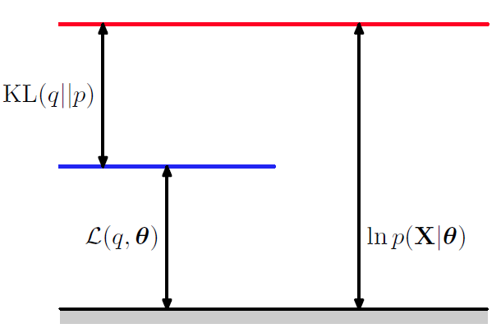
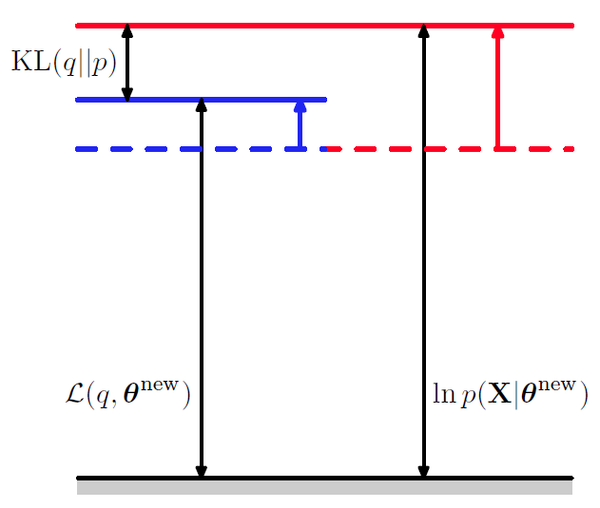
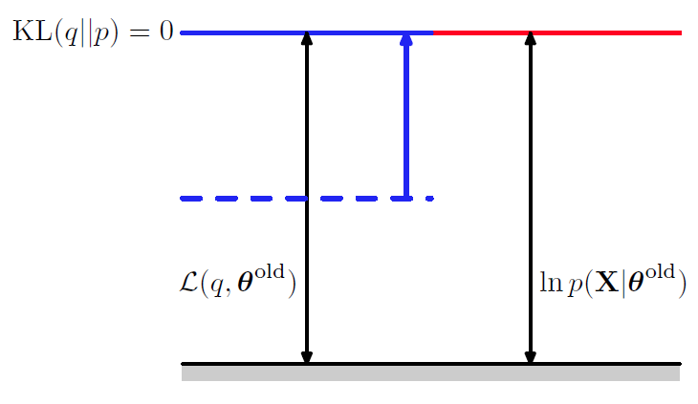



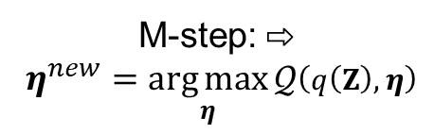




Expectation maximization algorithm
$$ℒ\left(q\left(Z\right),η\right)$$
$$\ln{p\left(X | η\right)}$$
⇩ E-step: $q\left(Z\right)≔P(Z|X,η^{old})$
M-step: ⇨
$η^{new}=\underset{η}{\arg{max}}𝒬\left(q\left(Z\right),η\right)$
$$ℒ\left(q\left(Z\right),η^{old}\right)$$
$$\ln{p\left(X | η^{old}\right)}$$
$$ℒ\left(q\left(Z\right),η^{new}\right)$$
$$\ln{p\left(X | η^{new}\right)}$$

Slide 17
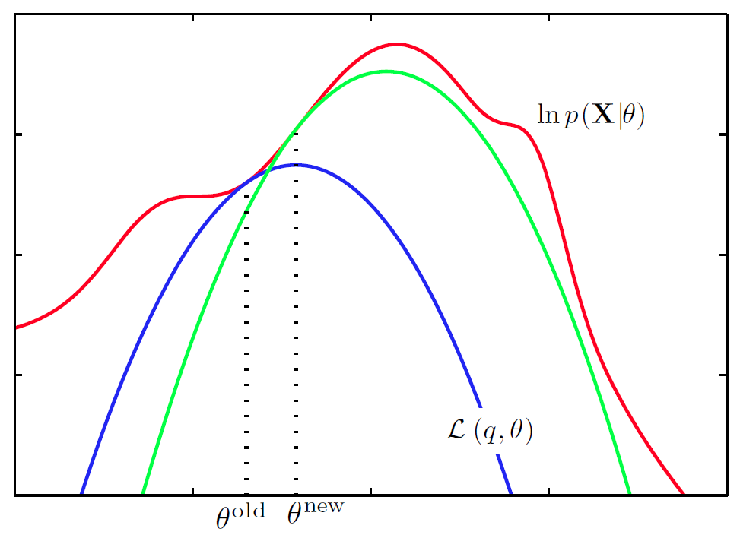
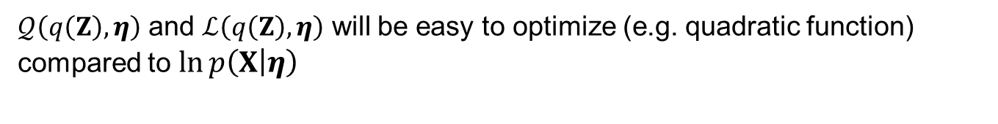



Expectation maximization algorithm
$𝒬\left(q\left(Z\right),η\right)$ and $ℒ\left(q\left(Z\right),η\right)$ will be easy to optimize (e.g. quadratic function) compared to $\ln{p\left(X | η\right)}$
$$\ln{p\left(X | η\right)}$$
$$ℒ\left(q\left(Z\right),η\right)$$
$$η^{old}{ η}^{new}$$

Slide 18

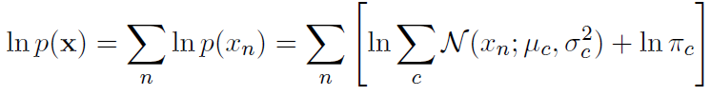




EM for GMM
Now, we aim to train parameters $η=\left\{μ_{z}, σ_{z}^{2}, π_{z}\right\}$ of Gaussian Mixture model
Given training observations $x=[x_{1}, x_{2}, …, x_{N}]$ we search for ML estimate of $η$ that maximizes log likelihood of the training data.
Direct maximization of this objective function w.r.t. $η$ is intractable.
We will use EM algorithm, where we maximize the auxiliary function which is (for simplicity) sum of per-observation auxiliary functions
Again, in M-step has to increase more than

Slide 19
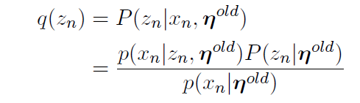
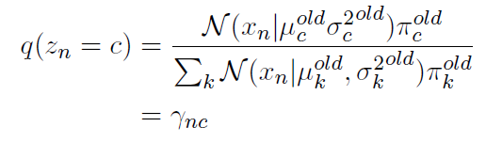
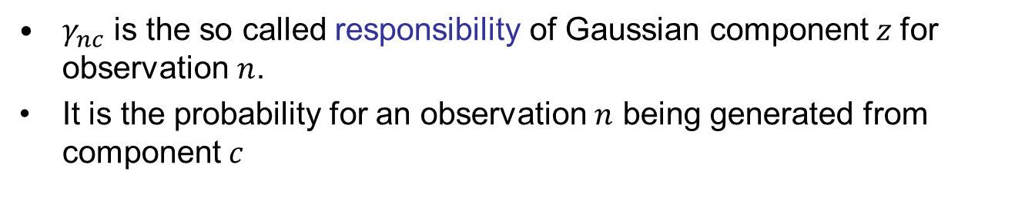
EM for GMM – E-step
$γ_{nc}$ is the so called responsibility of Gaussian component$z$ for observation $n$.
It is the probability for an observation $n$ being generated from component$c$

Slide 20
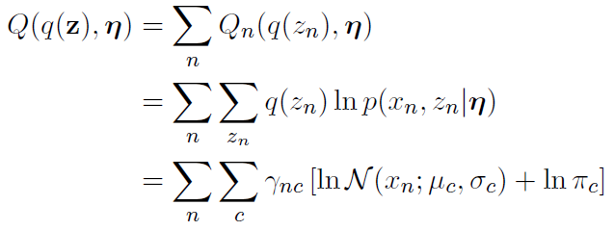
EM for GMM – M-step
In M-step, the auxiliary function is maximized w.r.t. all GMM parameters

Slide 21
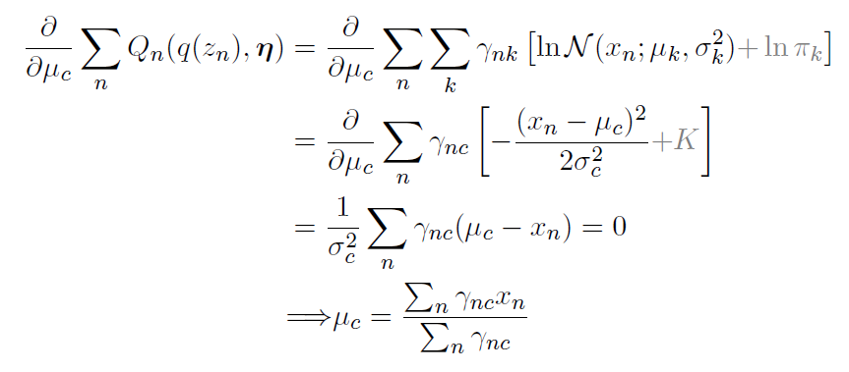
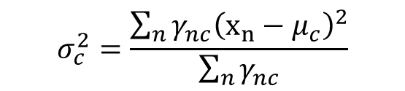
EM for GMM –update of means
Update for component mean means:
Update for variances: can be derived similarly.
$$σ_{c}^{2}=\frac{\sum_{n}{γ_{nc}{\left(x_{n}−μ_{c}\right)}^{2}}}{\sum_{n}{γ_{nc}}}$$

Slide 22
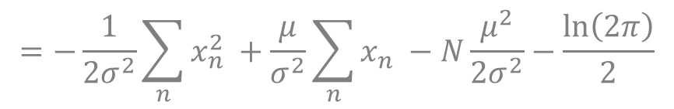
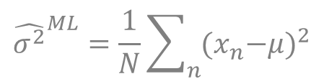
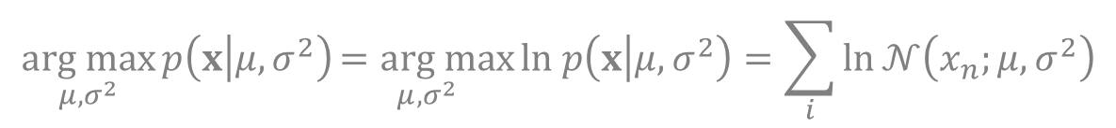
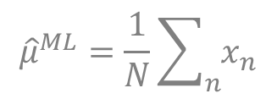
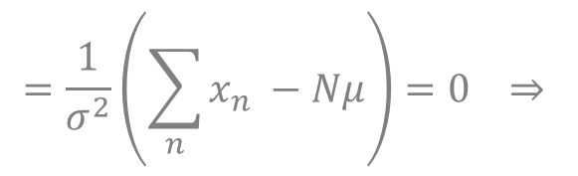
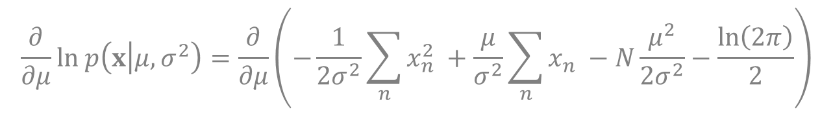
Flashback: ML estimate for Gaussian
$$\underset{μ,σ^{2}}{arg max}{p\left(x | μ,σ^{2}\right)}\underset{μ,σ^{2}}{=arg max}{ln p\left(x | μ,σ^{2}\right)}=\sum_{i}{ln}𝒩\left(x_{n};μ,σ^{2}\right)$$
$$=−\frac{1}{2σ^{2}}\sum_{n}{x_{n}^{2} }+\frac{μ}{σ^{2}}\sum_{n}{x_{n} }−N\frac{μ^{2}}{2σ^{2}}−\frac{ln\left(2π\right)}{2}$$
$$\frac{∂}{∂μ}ln p\left(x | μ,σ^{2}\right)=\frac{∂}{∂μ}\left(−\frac{1}{2σ^{2}}\sum_{n}{x_{n}^{2} }+\frac{μ}{σ^{2}}\sum_{n}{x_{n} }−N\frac{μ^{2}}{2σ^{2}}−\frac{ln\left(2π\right)}{2}\right)$$
$$=\frac{1}{σ^{2}}\left(\sum_{n}{x_{n} }−Nμ\right)=0 ⇒$$
$${\hat{μ}}^{ML}=\frac{1}{N}\sum_{n}{x_{n}}$$
$${\hat{σ^{2}}}^{ML}=\frac{1}{N}\sum_{n}{{{(x}_{n}−μ)}^{2}}$$
and similarly:

Slide 23
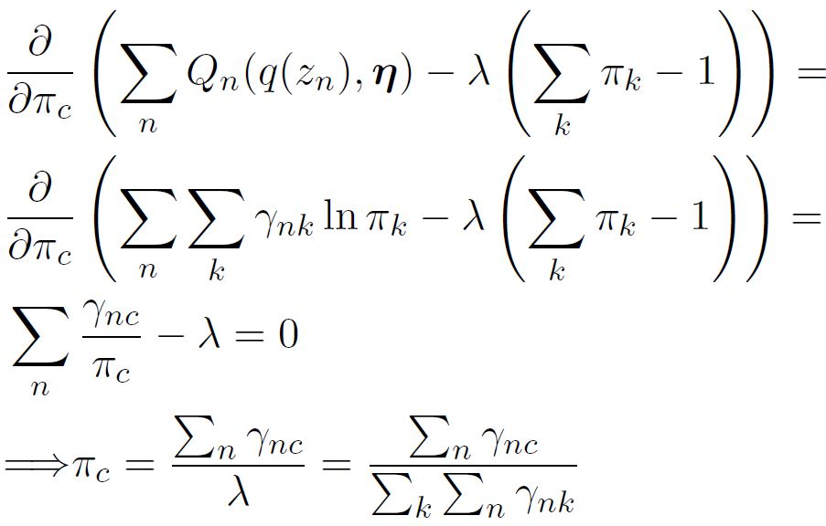

EM for GMM –update of weights
Weights $π_{c}$ need to sum up to one. When updating weights, Lagrange multiplier $λ$is used to enforce this constraint.

Slide 24
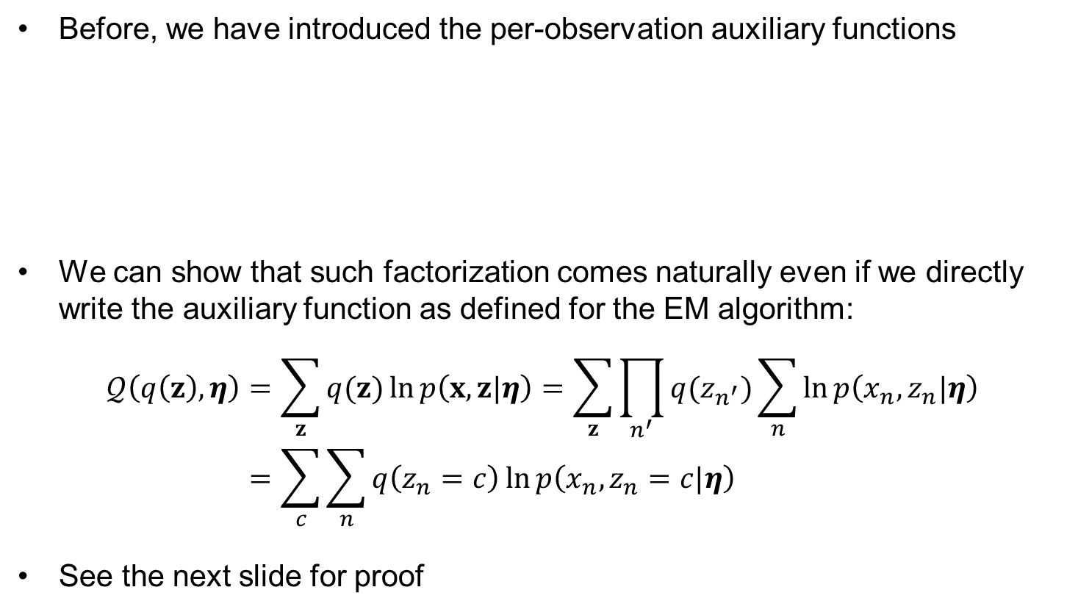
Factorization of the auxiliary function more formally
Before, we have introduced the per-observation auxiliary functions
We can show that such factorization comes naturally even if we directly write the auxiliary function as defined for the EM algorithm:
$$𝒬\left(q\left(z\right),η\right)=\sum_{z}{q(z)}\ln{p\left(x,z|η\right)}=\sum_{z}{\prod_{n^{′}}{q(z_{n^{′}})}\sum_{n}{\ln{p\left(x_{n},z_{n}|η\right)}}} \\ =\sum_{c}{\sum_{n}{q\left(z_{n}=c\right)\ln{p\left(x_{n},z_{n}=c|η\right)}}}$$
See the next slide for proof

Slide 25
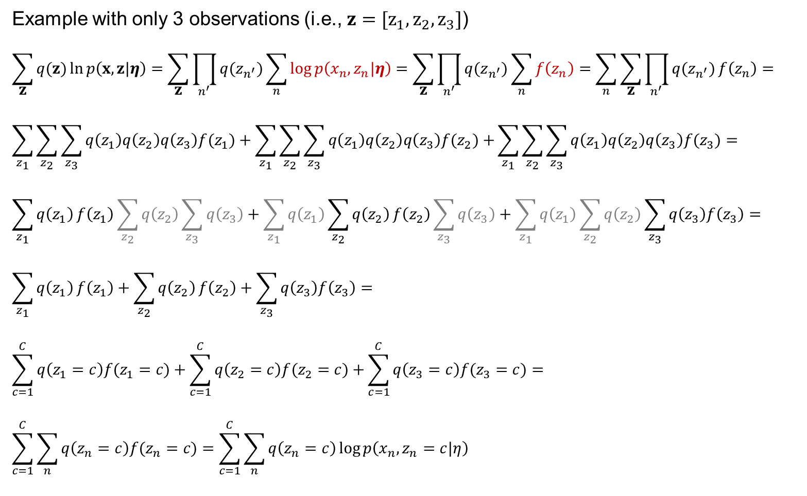
Factorization over components
Example with only 3 observations (i.e., $z=[z_{1},z_{2},z_{3}]$)
$$\sum_{z}{q(z)}\ln{p\left(x,z|η\right)}=\sum_{z}{\prod_{n^{′}}{q(z_{n^{′}})}\sum_{n}{\log{p\left(x_{n},z_{n}|η\right)}}}=\sum_{z}{\prod_{n^{′}}{q(z_{n^{′}})}\sum_{n}{f\left(z_{n}\right)}}=\sum_{n}{\sum_{z}{\prod_{n^{′}}{q(z_{n^{′}})}f\left(z_{n}\right)}}=$$
$$\sum_{z_{1}}{\sum_{z_{2}}{\sum_{z_{3}}{q\left(z_{1}\right)q\left(z_{2}\right)q\left(z_{3}\right)f(z_{1})}}}+\sum_{z_{1}}{\sum_{z_{2}}{\sum_{z_{3}}{q\left(z_{1}\right)q\left(z_{2}\right)q\left(z_{3}\right)f(z_{2})}}+}\sum_{z_{1}}{\sum_{z_{2}}{\sum_{z_{3}}{q\left(z_{1}\right)q\left(z_{2}\right)q\left(z_{3}\right)f(z_{3})}}}=$$
$$\sum_{z_{1}}{q\left(z_{1}\right)}f\left(z_{1}\right)\sum_{z_{2}}{q\left(z_{2}\right)}\sum_{z_{3}}{q\left(z_{3}\right)}+\sum_{z_{1}}{q\left(z_{1}\right)}\sum_{z_{2}}{q\left(z_{2}\right)}f\left(z_{2}\right)\sum_{z_{3}}{q\left(z_{3}\right)}+\sum_{z_{1}}{q\left(z_{1}\right)}\sum_{z_{2}}{q\left(z_{2}\right)}\sum_{z_{3}}{q\left(z_{3}\right)f\left(z_{3}\right)}=$$
$$\sum_{z_{1}}{q\left(z_{1}\right)}f\left(z_{1}\right)+\sum_{z_{2}}{q\left(z_{2}\right)}f\left(z_{2}\right)+\sum_{z_{3}}{q\left(z_{3}\right)f\left(z_{3}\right)}=$$
$$\sum_{c=1}^{C}{q\left(z_{1}=c\right)f(z_{1}=c)}+\sum_{c=1}^{C}{q\left(z_{2}=c\right)f(z_{2}=c)}+\sum_{c=1}^{C}{q\left(z_{3}=c\right)f(z_{3}=c)}=$$
$$\sum_{c=1}^{C}{\sum_{n}{q\left(z_{n}=c\right)f(z_{n}=c)}}=\sum_{c=1}^{C}{\sum_{n}{q\left(z_{n}=c\right)\log{p\left(x_{n},z_{n}=c|η\right)} ⁡}}$$

Slide 26
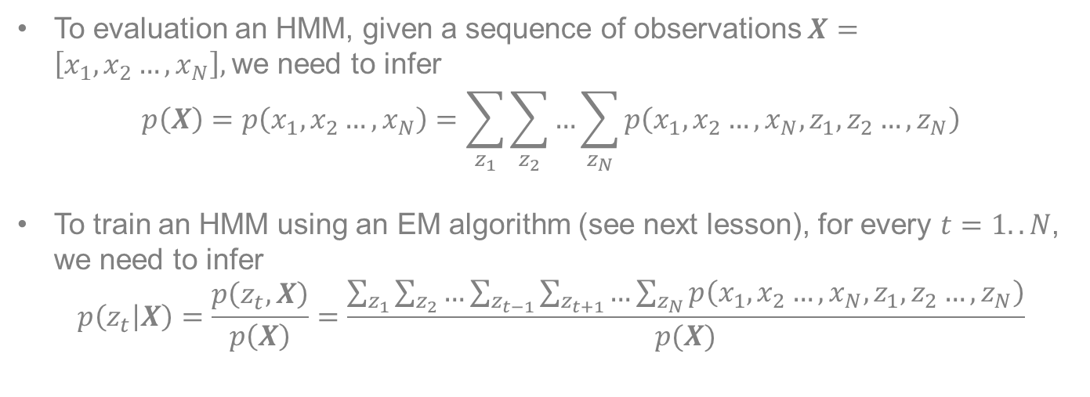
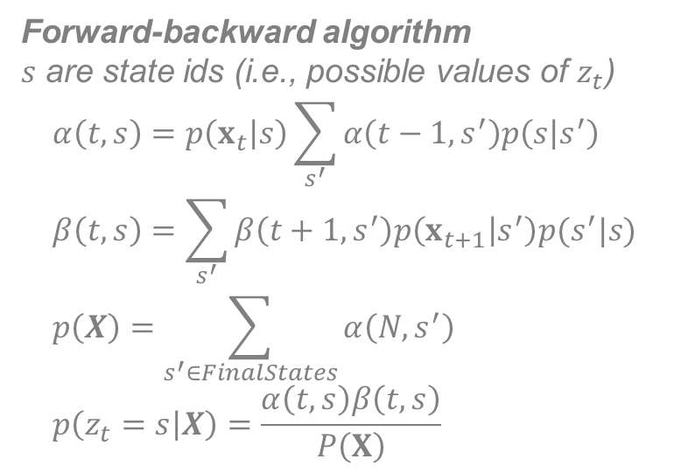
Flashback: Example: BP for HMM
To evaluation an HMM, given a sequence of observations $X=\left[x_{1},x_{2}…,x_{N}\right],$we need to infer
$$p\left(X\right)=p\left(x_{1},x_{2}…,x_{N}\right)=\sum_{z_{1}}{\sum_{z_{2}}{…\sum_{z_{N}}{p\left(x_{1},x_{2}…,x_{N},z_{1},z_{2}…,z_{N}\right)}}}$$
To train an HMM using an EM algorithm (see next lesson), for every $t=1..N$, we need to infer
$$p\left(z_{t} | X\right)=\frac{p\left(z_{t},X\right)}{p\left(X\right)}=\frac{\sum_{z_{1}}{\sum_{z_{2}}{…\sum_{z_{t−1}}{\sum_{z_{t+1}}{…\sum_{z_{N}}{p\left(x_{1},x_{2}…,x_{N},z_{1},z_{2}…,z_{N}\right)}}}}}}{p(X)}$$
Forward-backward algorithm
$s$ are state ids (i.e., possible values of $z_{t}$)
$$α\left(t,s\right)=p\left(x_{t} | s\right)\sum_{s^{′}}{α\left(t−1,s^{′}\right)p\left(s | s^{′}\right)} \\ β\left(t,s\right)=\sum_{s^{′}}{β\left(t+1,s^{′}\right)p\left(x_{t+1} | s^{′}\right)p(s^{′}|s)} \\ p\left(X\right)=\sum_{s^{′}∈FinalStates}{α\left(N,s^{′}\right)} \\ p\left(z_{t}=s | X\right)=\frac{α\left(t,s\right)β\left(t,s\right)}{P\left(X\right)}$$
z₁
z₂
z_{N-1}
z_{N}
x₁
x₂
x_{N-1}
x_{N}

Slide 27


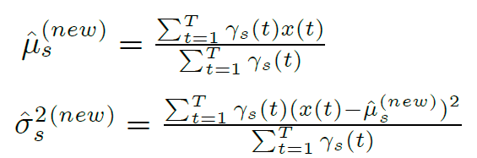
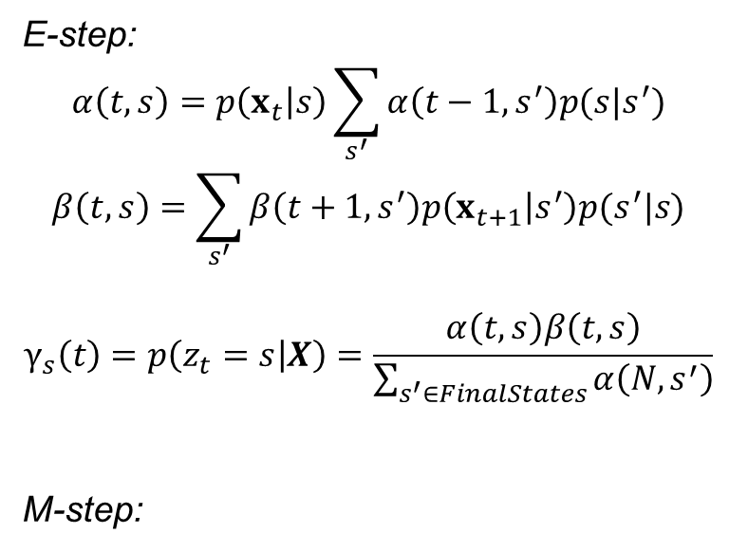
Examples: Training HMMs using EM
E-step:
$$α\left(t,s\right)=p\left(x_{t} | s\right)\sum_{s^{′}}{α\left(t−1,s^{′}\right)p(s|s^{′})}$$
$$β\left(t,s\right)=\sum_{s^{′}}{β\left(t+1,s^{′}\right)p\left(x_{t+1} | s^{′}\right)p(s^{′}|s)}$$
$$γ_{s}\left(t\right)=p\left(z_{t}=s | X\right)=\frac{α\left(t,s\right)β\left(t,s\right)}{\sum_{s^{′}∈FinalStates}{α\left(N,s^{′}\right)}}$$
M-step:
s
t

Slide 28
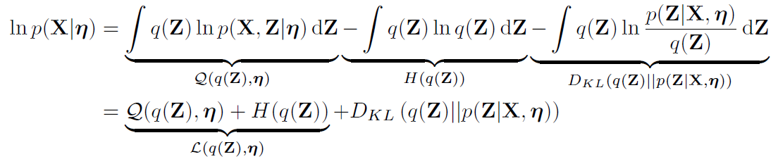

EM for continuous latent variable
Same equations, where sums over the latent variable $Z$ are simply replaced by integrals

Slide 29


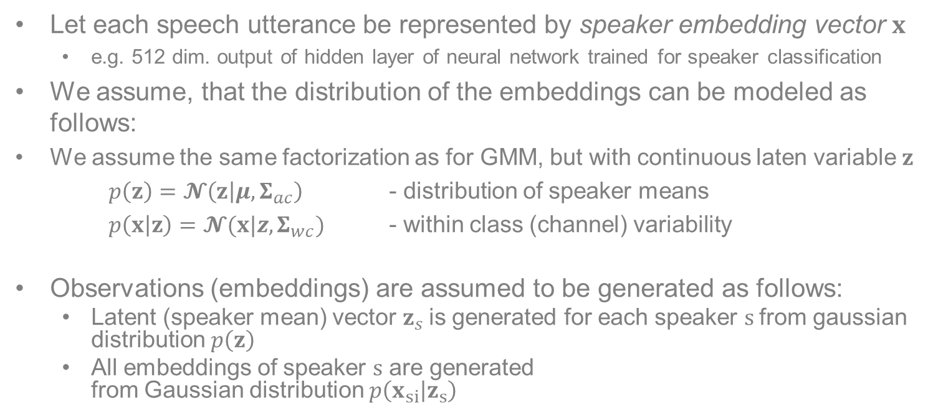











Flashback: PLDA model for speaker verification
Let each speech utterance be represented by speaker embedding vector $x$
  e.g. 512 dim. output of hidden layer of neural network trained for speaker classification
We assume, that the distribution of the embeddings can be modeled as follows:
We assume the same factorization as for GMM, but with continuous laten variable $z$
$p\left(z\right)=𝓝\left(z | μ,Σ_{ac}\right)$ - distribution of speaker means
$p\left(x | z\right)=𝓝(x|z,Σ_{wc})$ - within class (channel) variability
Observations (embeddings) are assumed to be generated as follows:
  Latent (speaker mean) vector $z_{s}$is generated for each speaker $s$from gaussian distribution $p\left(z\right)$
  All embeddings of speaker $s$ are generated
  from Gaussian distribution $p\left(x_{si} | z_{s}\right)$
$$z_{s}$$
$$z_{1}$$
$$…$$
$$z_{S}$$
$$x_{11}$$
$$x_{12}$$
$$…$$
$$x_{1N_{1}}$$
$$x_{S1}$$
$$x_{S2}$$
$$…$$
$$x_{SN_{1}}$$
$$x_{Si}$$

